Slide 1
Challenges and Strategies of Energy Efficiency and Demand Management in Taiwan: Policy and Institutional Perspectives
Jyh-Yih Hsu
Department of Applied Economics and
Department of Management Information Systems
Chung-Hsing University
Taichung, Taiwan
2013/10/18

Slide 2
Outline
Introduction
Rationale for Policy Tools
Experience of Advanced Countries
Smart Grid for Energy Efficiency
Challenges of the Policy
Conclusion: Strategies of the Policy/Institution

Slide 3
1. Introduction

Slide 4
Importance of Energy Efficiency and Demand Management
Not in my back yard (NIMBY) effect
Prevailing ICT technology for energy efficiency and demand management.
5 kWh Conservation
(Supply-Side)
1 kWh Saving
(Demand-Side)
Fossil Fuel Exploitation
Power Plant
Transportation and Distribution System
Meter
End-used Devise
Energy Loss
(Second Law of Thermodynamics)

Slide 5
Three Dimensions of Energy Management
Energy management deals with three dimensions
End-Use : High energy-efficient equipment
3
2
2
Production Process:
Technology and management innovation
Energy Consumption:
Behavior patterns of energy consumption
Industrial and Commercial Sectors
Commercial, Residential and Public Sectors
3
1
Sectors : Industrial, Commercial, Residential and Public sectors’ outputs

Slide 6
Demand Response Options
Time-of-Use, TOU
Real-Time Price, RTP
Critical-Peak Pricing, CPP
Price-Based
options
Demand
Response
(DR)
Capacity Market Programs/Ancillary Services Market Programs
Demand Bidding/Buyback
Emergency DR programs
Interruptible/Curtailable Service
Direct Load Control Programs
Incentive-Based
options
Source: FERC(2006)Benefits of Demand Response in Electricity Markets and Recommendations for Achieving Them.

Slide 7
2. Rationale for Policy Tools

Slide 8
Rationale for the Policy Tools
1. Two types of policy tools
(1) Regulatory approach: Command and control policy tool
Emission or efficiency standard (eg. EER)
(2) Market-based approach: Incentive policy tools
Cap and trade (Coase theorem)
eg. RPS, EEPS(Energy Efficiency Portfolio Standard)
eg. REC(Renewable Energy Certificates), TWC
Taxation or subsidy (Pigovian tax)
eg. energy tax, carbon tax, FIT
2. Public-private partnership (PPP), including “third party” participation.

Slide 9
Regulatory Approach
Adjusting process for seeking optimal energy efficiency ratio (EER)
(Marginal Control Cost)
MCC
(Marginal External Cost)
MEC
P
F
0
1
W_{e}
3
W*

Slide 10
Coase Theorem
Property rights traded by A and B.
Transparent and full information for A and B.
P
P
Marginal cost of A
Marginal cost of B
Social Optimal
B
A
Q
E*
B’s action
A’s action

Slide 11
Renewable Portfolio Standard Policy
Definition of RPS
A Renewable Portfolio Standard requires the increased production of energy from renewable energy sources, such as wind, solar, biomass, and geothermal.
RPS: to be fulfilled with REC(renewable energy certificated) and RAM(renewable auction mechanism).

Slide 12
REC and RAM
Definition of REC(renewable energy certificated)
REC are tradable, non-tangible energy commodities in the United States that represent proof that 1 MWh of electricity was generated from an eligible renewable energy resource.
In most applications, the REC are tradable, based on Coase Theorem
Definition of RAM(renewable auction mechanism)
The Renewable Auction Mechanism, or RAM, is a simplified market-based procurement mechanism for renewable distributed generation (DG) projects greater than 3 MW and up to 20 MW on the system side.
Competitive bidding
Reducing transaction costs of FIT

Slide 13
Tradable White Certificates Policy for Energy Efficiency and Management
Definition of TWC(Tradable White Certificates)
White certificates are documents certifying that a certain reduction of energy consumption has been attained.
In most applications, the white certificates are tradable and combined with an obligation to achieve a certain target of energy savings.
Base on Coase theorem, applied by EU countries such as: UK, Italy, France, Denmark, Belgium.

Slide 14
Pigovian Tax or Subsidy
From Arthur Cecil Pigou (1877 – 1959)
Pigovian tax is a tax levied on a market activity that generates negative externalities.
P
MCC
S
T
0
W_{e}
Pollutant

Slide 15
Feed-in Tariff Policy
Definition of feed-in tariff(FIT)
A feed-in tariff is a policy mechanism designed to accelerate investment in renewable energy technologies.
Base on Pigovian tax (negative tax or subsidy)

Slide 16
Comparison with RPS, RAM and FIT
 | FIT | RPS | RAM
Renewable Energy Tariff Rate | Determined by a Panel or committee, organized by government officers, experts, industrial representatives, etc. | Determined by market trading system | Bid a price close to or slightly higher than cost
Risk of Renewable Energy Investors | Normally risk is minimum due to the long-tem guaranteed rate as cash flow | Depends on the market rate with potential fluctuation | IOUs purchase electricity with the bid price for a fixed period and bidders would sign a long-term contract with the IOUs.
Obligation of the Utility | Utilities are obligated to purchase the renewable energy | Utilities are obligated to fulfill the percentage required by law or policy | Certain capacity was required to be purchased through RAM.
Reflection of Renewable Energy Cost | Costs would be normally reflected on end-use customers | Costs could be shared by utilities and end-use customers. | Costs would be reflected on bundled customers.
Characteristic of the Policy Alternatives | Based on the various types of renewable energy production costs Promotes renewable energy by benchmarking a standard cost and encouraging more efficient producers to the market. Normally a sequentially decreased rate can enhance technology improvement with lowering cost A potential increase of end-use electricity rate due to the higher FIT procurement of renewable energy Normally requires long-term(20 years) contract for the guaranteed rate | Market mechanism can determine an optimal price. Penalty will be implemented for the utilities violating the required percentage of renewable energy Cost could be lowered by market competition The market will normally prevail one type of renewable energy which is the least-cost one Avoid administration costs for regularly adjusting prices and possible disputes. Normally needs REC for market trade t achieve RPS. | Market-based and non-negotiable price(contract). Avoid administration costs for regularly adjusting prices and possible disputes. Performance and development deposits was required to protect ratepayers and utilities. Flexibility in constructing its own contracts with some required standard terms. RAM policy has been adopted by California in 2011.

Slide 17
3. Experience of Advanced Countries
3.1 US Experience
3.2 UK Experience
3.3 Japan Experience
3.4 South Korea Experience

Slide 18
3.1 US Experience: Energy Demand-Side Management
According to information provided by survey respondents to the Federal Energy Regulatory Commission (FERC) 2012 Demand Response and Advanced Metering Survey, the potential demand response resource contribution from all U.S. demand response programs is estimated to be nearly 72,000 megawatts (MW), or about 9.2 % of U.S. peak demand.

Slide 19
3.1 US vs Germany: Renewable Energy Policy
US: RPS(major), FIT(minor)
Germany: FIT(major), RPS (minor)
Germany launched FIT in 2001.
FIT(Germany) fountainhead from 1978 US Public Utility Regulatory Policy Act (PURPA) , eg Standard Offers for QF(Qualified Facility)

Slide 20


3.1 US Experience: “Green Button” Behind-Meter Service
US White House launched Green Button policy in Jan. 2012.
Green Button: download electricity usage data (when, how, how many) via computers or mobile devices immediately. (provided by electricity companies)
Data mining and consumer empowering : consumer authorizes third party to download their electricity usage data.
(Source: http://www.greenbuttondata.org/)

Slide 21
3.1 US Experience: Aggregator as a Third Party(1/4)
Third Party(aggregators or ESCOs) coordinates electric utility and customers for electricity demand management.
Who is the aggregator?
An entity responsible for planning, scheduling, accounting, billing, and settlement for energy deliveries for their customers in order to implement demand-side management.
Aggregators seek to bring together customers or generators so they can buy or sell power in bulk, making a profit sharing amount their customers on the transaction.

Slide 22
3.1 US Experience: Aggregator as a Third Party(2/4)
Municipal Aggregators
Municipal Aggregation allows local government to combine the purchasing power of its residents to achieve savings on electricity costs.
Municipal aggregators buy electricity in bulk, and bid the price in wholesale market.
For example, there are three municipal aggregator in Massachusetts: Cape Light Compact, Colonial Power Inc. and Hampshire Council of Government.

Slide 23
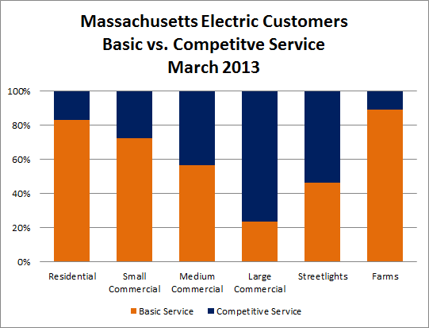
3.1 US Experience: Aggregator as a Third Party(3/4)
The case in Massachusetts state as follow:
* Competitive service is provided by aggregators, while basic service is not.
Source: Colonial Power Group (http://www.colonialpowergroup.com/municipalaggregation/)

Slide 24
3.1 US Experience: Aggregator as a Third Party(4/4)
In 2006, a specific area in Connecticut was suffering for a critical situation where the capacity of the transmission network was not able to support the summer peak electricity demand. Comverge deployed a demand response program able to reduce 28 MW of load.
Comverge was contracted by ISO-NE with a four year duration contract. Comverge controlled domestic and small consumers’ air conditioning devices with a system called Coolsentry.
There were 15,000 consumers with Coolsentry system; each consumer receives a payment of $100 per year for participating into the demand response program.

Slide 25
3.1 US Experience: General Law and Regulation
2011:
FERC approved “Market-based Demand Response Compensation Rule”
Makes the wholesale market more competitive
2013:
FERC approved “Revisions to Electric Reliability Organization Definition of Bulk Electric System and Rules of Procedure”
Provides specific definition of distributed generation system

Slide 26
3.1 US Experience: Green City
2013 in California
City of Lancaster:
new homes with lots that are 7,000 square feet or more must have solar panels that can produce up to 1 kW of energy at any given time. Homes in rural areas must be able to produce 1.5 kW with their systems.
A solar installer in city of Lancaster can issue a permit within 15 minutes, whereas in city of Palmdale, it can take two months.
City of Sebastopol:
requiring new residential and commercial buildings to include a photovoltaic energy-generation system. The system would have to provide 2 watts of power per square foot of insulated building area or offset 75% of the building’s annual electric load.

Slide 27
3.2 EU Policy Experience: Tradable White Certificates (TWC) for Energy Efficiency Policy
TWC implementation in EU: UK 2002 ; Italy 2005 ; France 2005.
TWC commands energy companies to fulfill energy saving obligations, e.g. British Gas had 15% reduction in total residential gas demand despite a 7% increase in the number of households using gas in the period 2004-2009.

Slide 28
3.2 UK experience: Zero-Carbon Building
UK Energy White Paper (2007) :
A requirement for all new homes to be zero-carbon buildings by 2016.
Improving the energy efficiency of existing homes.
A requirement that new domestic electricity meters should have real time displays from 2008, and a commitment to upgrade existing domestic meters on request.

Slide 29
3.3 Japan Experience: Technology RDDD&D
Technology Research, Development, Demonstration Deployment and Diffusion (RDDD&D) is required to capture the potential energy efficiency benefit and achieve GHG(Green House Gas) emission reductions.
Japan Demonstrates Smart City: 2010-2014, to identify the optimum form for smart grids and smart cities in Japan. (City of Yokohama, Toyota City, Keihanna Science City and the City of Kitakyushu.)

Slide 30
3.4 Korea Experience: Sharply increasing-block electricity rate
South Korea electricity tariff for residential sector
KEPCO: Residential customers who consume a monthly electricity supply of over 1,350kWh will be given a notice stating that extra charges(approximately additional 2 NTD/kWh) will be imposed from the next month where consumption exceeds 1,350kWh.
Base Rate (NTD/per household per month) |  | Electric Power Rate (NTD/kWh)
1~100 kWh | 7.8 | 1~100 kWh | 1.15
101~200 kWh | 17.2 | 101~200 kWh | 2.37
201~300 kWh | 29.8 | 201~300 kWh | 3.50
301~400kWh | 71.2 | 301~400kWh | 5.17
401~500 kWh | 133.4 | 401~500 kWh | 7.63
501kWh above | 244.6 | 501kWh above | 13.41
Source：KEPCOhttp://www.kepco.co.kr/eng。

Slide 31
4. Smart Grid for Energy Efficiency
4.1 A New Trend of Smart Grid
4.2 Energy Efficiency Is One of the Benefits of Smart Grid
4.3 Smart Home Energy Management System

Slide 32
4.1 A New Trend of Smart Grid (1/2)
The core concept of smart grid is its capability of keeping track of electricity flow in the power system by two-way digital technology that allows consumers to see how and when they use energy, and therefore capable of managing electricity bill by enhancing their energy efficiency.

Slide 33
4.1 A New Trend of Smart Grid (2/2)
Smart grid is essential to
building an infrastructure for long-term energy efficiency and demand management
encouraging renewable energy deployment
transiting industries to low-carbon and clean-energy patterns
creating new “green jobs” for more employment
empowering customers to reduce their energy use and costs

Slide 34
4.2 Energy Efficiency Is One of the Benefits of Smart Grid
There are many benefits of developing smart grid
enhancement of supply reliability and energy efficiency
demand response (DR)
voltage service quality
integration of transmission congestion relief
advanced metering infrastructure (AMI)
distributed energy resources (DER)
battery energy storage system (BESS)
usage of electric vehicles
outage response

Slide 35
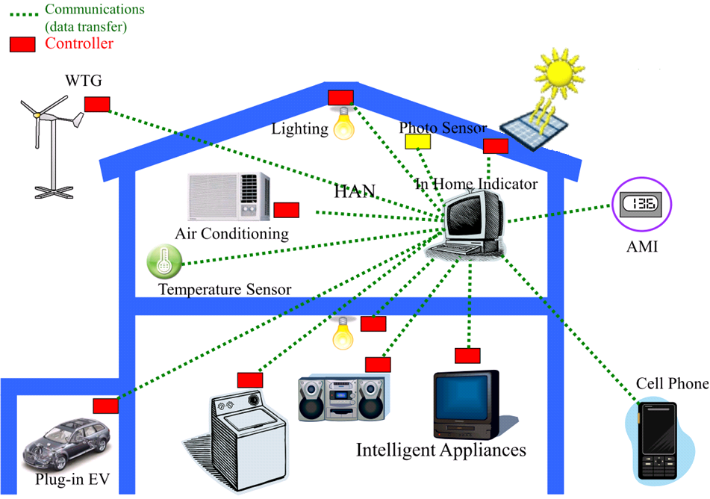
4.3 Smart Home Energy Management System
Source: Faa-Jeng Lin(2011),Strategic Initiatives of Smart Grid in Taiwan

Slide 36
5. Challenges of the Policy
5.1 Relatively Low Tariff in Taiwan
5.2 Characteristics of Taiwan’s Commercial and Residential Customers
5.3 Comparison between Industrial and Commercial/Residential Sectors
5.4 Peak vs Off-Peak Hours of Taipower System

Slide 37
5.1 Relatively Low Tariff in Taiwan
Unit: NTD/kWh
Countries/Area | Annual Average Price | Countries/Area | Annual Average Price
South Africa | 1.82 | United State | 2.96
Indonesia | 1.93 | Australia | 3.20
Sweden | 1.95 | United Kingdom | 4.60
South Korea | 2.39 | Hong Kong | 4.76
Canada | 2.49 | Spain | 5.22
China | 2.53 | Germany | 5.43
Thailand | 2.54 | Japan | 5.91
Taiwan (R.O.C.) | 2.56 | Philippine | 6.40
Source: Taiwan Power Company (2012)。

Slide 38
5.2 Characteristics of Taiwan’s Commercial and Residential Customers
Contrast to manufacture sector, commercial and residential users are relatively small, diverse and a lot of customers.
Highly populated density and diversified buildings, sometimes block two-way communication for smart meter reading.

Slide 39
5.3 Comparison between Industrial and Commercial/Residential Sectors
Manufacturing industries have possessed the largest portion (53% in 2012) on total electricity consumption.
Many factories have hired energy management expert for saving the production cost.
Unlike manufacturing factor, commercial and residential sectors normally do not have energy expert staff, due to their small percentage electricity expenditures comparing to their revenues.

Slide 40
5.4 Peak vs Off-Peak Hours of Taipower System
The peak hours are 07:30-22:30 from Monday to Friday, 15 hours a day. Others are off-peak hours.
Commercial and residential sectors include residential, shopping mall, convenient stores, restaurant, bank, school, organizations, hospital etc.
Residential sector’s electricity usage concentrated on peak hour in the evening; commercial sector is limited by the business hours, the electricity usage may concentrate on peak hours both day and night.

Slide 41
6. Conclusion:
Strategies of the Policy/Institution

Slide 42
6.1 Institutional reform
6.1.1 Government Key Agenda: Institutional/Legal Up-Date
6.1.2 Utility Company’s key agenda
6.1.3 Enterprise’s key agenda
6.1.4 PPP(public-private partnership)
6.1.5 Ad hoc organization for National Energy Efficiency Master Plan
6.1.6 Third party is the key for PPP: aggregator and ESCO

Slide 43
6.1.1 Government Key Agenda: Institutional/Legal Up-Date
DR (eg. US, 2011, “Market-based Demand Response Compensation Rule”)
Load Management: eg Time-Of-Use, Peak Time Rebate, Critical Peak Pricing
Energy Conservation: eg Discount Rate Program for Electricity Conservation
Ancillary Services: eg Interruptible/Curtailable Service
Environmental Protection: eg Green Power
Distributed Generating System (eg. US, 2013, “Revisions to Electric Reliability Organization Definition of Bulk Electric System and Rules of Procedure”)
Zero-carbon building (eg. UK 2008→2016 all new buildings)

Slide 44
6.1.2 Utility Company’s Key Agenda
Still plays a key role for electricity supply and demand market.
Should accommodate more distributed generation (DG) based on reciprocal and mutual benefits.
In order to meet the challenges of highly integrated needs among various smart grid equipment, Taipower should focus on the followings:
Demand Response (DR) energy efficiency and demand management renewable energy as distributed generation source Battery Energy Storage System (BESS) and Electric Vehicle (EV) | real-time load forecasting very short term load forecasting load-shedding control load shedding procedure abnormal behavior detection data encryption communications security

Slide 45
6.1.3 Enterprise’s Key Agenda
International Standards for energy efficiency management:
CO2 Management System: ISO14064
→ basic requirement in EU ETS (Emission Trade System)
Energy Management System: ISO50001

Slide 46
6.1.4 PPP (public-private partnership)
Government agency
Utility Company or IPP
Aggregators or ESCOs
Industrial, commercial and residential customers
Distributed Generation Installers
Banking Companies for “green financing”
All of the above can be cooperative for demand response program and energy management system.

Slide 47
6.1.5 Ad hoc organization for National Energy Efficiency Master Plan
According to the policy experience of advanced countries, an ad hoc organization should be screened and contracted by the government to enforce the National Efficiency Master Plan.
This organization can avoid the conflicting interest of utility. Being an electricity supplier, it is often contradictory to reduce its electricity sale for enforcing national electricity conservation.

Slide 48
6.1.6 Third party : aggregator and ESCO
Taiwan electricity market is still monopolized, and heavily regulated, under these circumstances, the role of aggregator may quiet be different from that of advanced countries.
Other than the general business, it is very important for government policy to encourage an aggregator or energy service company (ESCO) to participant national energy efficiency program, eg, to be responsible for overall DR+DG planning (assisting customers to install renewable energy facilities, BESS, AMI and EMS) and enforcement (conducting DR+DG) of a new building or community, and signing a wholesale electricity contract with Taipower, as an profit-sharing innovative business model.

Slide 49
6.2 Electric tariff strategies
6.2.1 Enlarging the gap between the baseline (first block) electric tariff vs the increasing-block tariff.
6.2.2 Tariff for residential smart meter customers
6.2.3 Critical Peak Pricing Program(CPP)

Slide 50
6.2.1 Enlarging the gap between the baseline (first block) electric tariff vs the increasing-block tariff.
According to the electric tariff structure of South Korea, the residential customers have more significant tariff gap among different electricity consumption levels/blocks(12 times difference between the lowest block and the highest block ) .
Since Taiwan currently also has the problem of “M-style” society and strong NIMBY(not in my back yard) effect, our recommendation is to adopt a similar electric tariff structure of South Korea.

Slide 51
6.2.2 Tariff for residential smart meter customers (1/2)
In 2013, Taipower designed a Time-of-Use program for those 10,000 residential customers, who has installed smart meters can get 23% tariff discount during off-peak period(22:30~07:30) and 27% tariff plus during peak period (07:30~22:30).
Our recommendation is that those residential customers should be allowed to choose Time-of-Use program with three periods: eg peak period (Monday to Sunday, 10:30~18:30); shoulder period (Monday to Sunday: 7:30~10:30 and 18:30~22:30); off-peak period(Monday to Sunday, 22:30~07:30).

Slide 52
6.2.2 Tariff for residential smart meter customers (2/2)
The reason are two-folds. First, smart meter can easily adopt three-period TOU with minimum transaction cost. Second, residential customers can be more flexible to operate those home appliances (such as washing machine, hair dryer, rice cooker and vacuum) from peak period shifting to shoulder period(before 10:30 pm), while it would be quiet difficult for them to shift the operation of a washing machine after 10:30 pm (either too noisy or too late).

Slide 53
6.2.3 Critical Peak Pricing Program
Taipower’s current Critical Peak Pricing(CPP) (6/1~9/30) program: 30 days/180 hours as “peaking days”
Three IOUs California’s current CPP program: only 48~ 126 hours as “peaking days”
Our recommendation is that Taipower could try to reduce those peaking-day hours so as to attract more customers to participate CPP program.

Slide 54
6.3 Technology RDDD&D strategies
AMI
Adopting smart motors with variable frequency
Two-way, real-time, interactive DR
Low carbon community
Zero-energy (or carbon) building
Micro-grid (eg a successful case at INER supported by National Energy Program, National Science Council)

Slide 55
6.4 Market-based incentive policy tools:
It is most important to establish a “healthy market” for energy efficiency and demand management program.
Adopting market-based incentive mechanism:
Pigovian tax (eg. Carbon tax, energy tax, FIT which is a negative tax/subsidy)
Caose Theorem(eg. Cap and trade, tradable certificate, RPS, RECs, TWCs)

Slide 56
6.5 Consumer Empowerment
Consumer empowerment is the core value for energy efficiency and demand management.
Customer choice is imperative as needs vary across customer classes with diverse preferences.
Customers can better manage their energy needs, and education is needed to understand application benefits and costs, and ways to capture value.
Education, demonstration, and customer awareness and acceptance are the keys to a successful energy efficiency and demand management policy.

Slide 57
Thanks for your listening,
any comments are welcome!

