Slide 1
Electricity Management for Smart Homes under Smart Grid Development
George Jyh-Yih Hsu
Professor
Department of Management Information Systems
Department of Applied Economics
National Chung-Hsing University
Taichung, Taiwan
2011/9/1

Slide 2
Outline
Introduction
Trends of Carbon Reduction and Energy Saving
Smart Grid and Electricity Management for Smart Homes in Taiwan, California and Hawaii
- 3.1 Taiwan - 3.2 California - 3.3 Hawaii - 3.4 Comparison
Benefits and Costs of Electricity Management for
Smart Homes
Conclusion
Appendix : Smart Energy Experience

Slide 3
1. INTRODUCTION

Slide 4
Introduction
The core concept of smart grid is its capability of keeping track of electricity flow in the power system by two-way digital technology that allows consumers to see how and when they use energy.
Smart grid is essential to
encouraging renewable energy deployment
transiting industries to low-carbon and clean-energy patterns
creating new “green jobs” for more employment
empowering customers to reduce their energy use and costs
building an infrastructure for long-term sustainable economic development

Slide 5
Introduction
There are many benefits of developing smart grid
enhancement of power supply reliability
voltage service quality
integration of transmission congestion relief
advanced metering infrastructure (AMI)
distributed energy resources (DER)
battery energy storage system (BESS)
usage of electric vehicles
demand response (DR)
outage response

Slide 6
Introduction
Today, policymakers and many utilities are focusing on how to accelerate the transition to a smart grid. Hawaii likewise is launching a smart grid demonstration project in Maui.
Electricity management for smart homes under smart grid development is a public policy concern. As a relatively small consumer, contrasting to large industrial customers, the benefit versus the cost of deploying new technologies for smart homes is sometimes questionable.
This presentation will address some of the key issues in relation to electricity management for smart homes with smart grid, which is partial research results of my NSC funded project and on-site research in California and Hawaii (scheduled 2011/8/9 to 2011/9/8).

Slide 7
2. TRENDS OF CARBON REDUCTION AND ENERGY SAVING

Slide 8
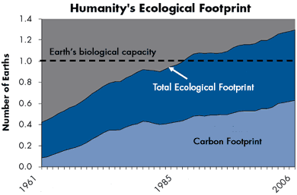
Carbon Footprint(1/2)
Source : 2003-2009 Global Footprint Network
Notes:
‹#›

Slide 9
Carbon Footprint(2/2)
The Carbon Footprint is 50 % of Humanity’s Overall Ecological Footprint and Its Most Rapidly-growing Component
Reducing Humanity’s Carbon Footprint is the Most Essential Step We Can Take to End Overshoot and Live on Earth.
Source : 2003-2009 Global Footprint Network

Slide 10
Carbon Disclosure Project(1/3)
The Carbon Disclosure Project (CDP) is an independent not-for-profit organization which holds the largest database of corporate climate change information in the world.
Some international corporations demand their suppliers to report greenhouse gas emissions and have selected the Carbon Disclosure Project as the standard system for suppliers to report through.
Source: 2003-2009 Global Footprint Network

Slide 11
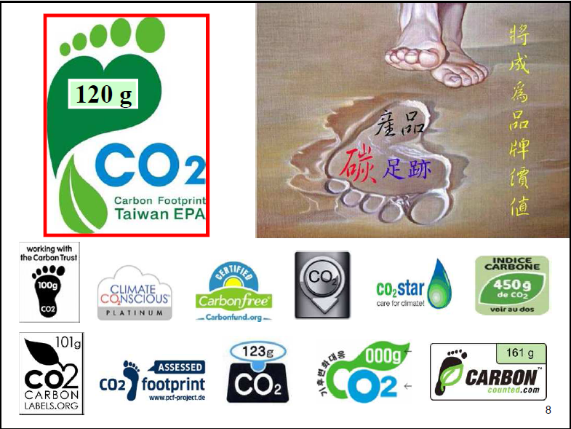
Carbon Disclosure Project(2/3)
Source: Hong Yuan Lee (2011), Adaptation Strategy of Climate Change

Slide 12
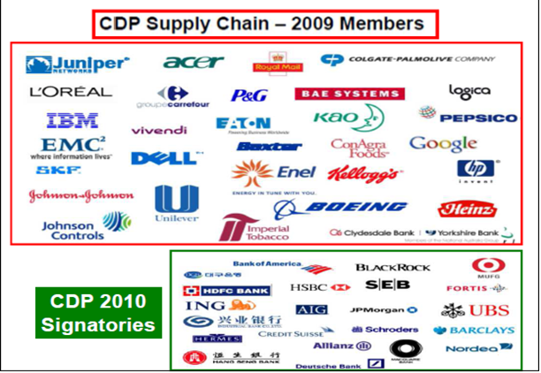
Source: Hong Yuan Lee (2011), Adaptation Strategy of Climate Change

Slide 13
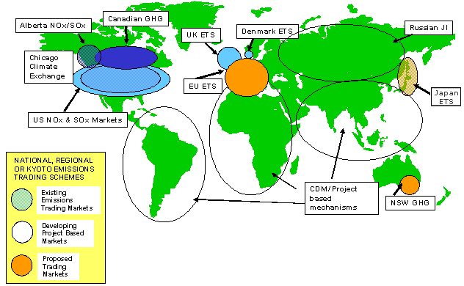
NZETS
“Carbon would become the world’s
biggest market.”

Slide 14
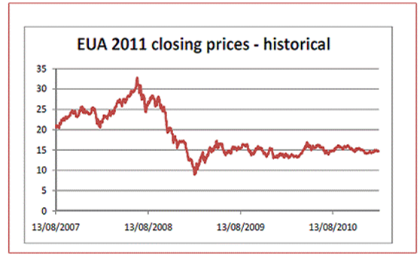
Carbon Trading Price in EU Emissions Trading Scheme (EU ETS)

Slide 15
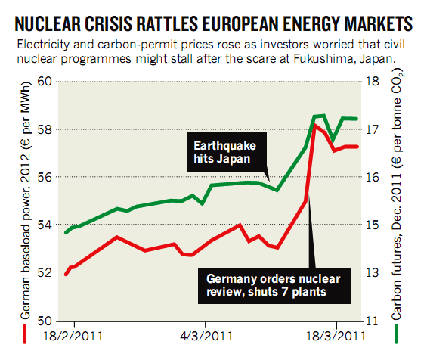
Source: http://highscope.ch.ntu.edu.tw/wordpress/?p=26735

Slide 16
3. SMART GRID AND ELECTRICITY MANAGEMENT FOR SMART HOMES
3.1 Taiwan

Slide 17
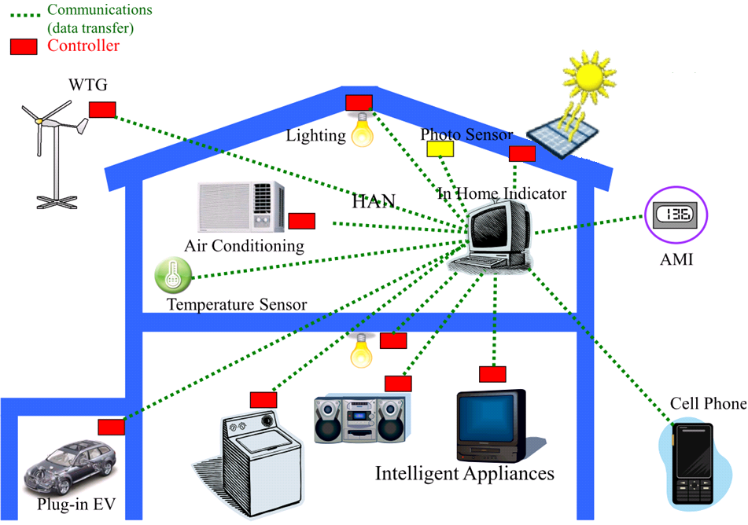
Smart Home Energy Management System
Source: Faa-Jeng Lin(2011),Strategic Initiatives of Smart Grid in Taiwan

Slide 18
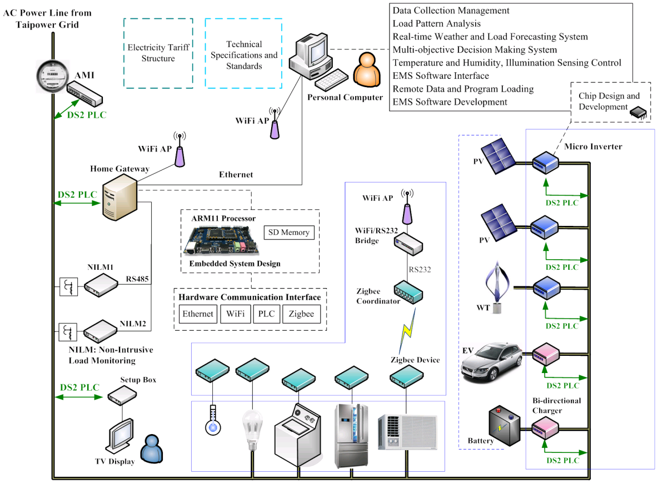
ICT Frame of Smart Home(Building) Energy Management System
Source: Faa-Jeng Lin(2011), Strategic Initiatives of Smart Grid in Taiwan

Slide 19
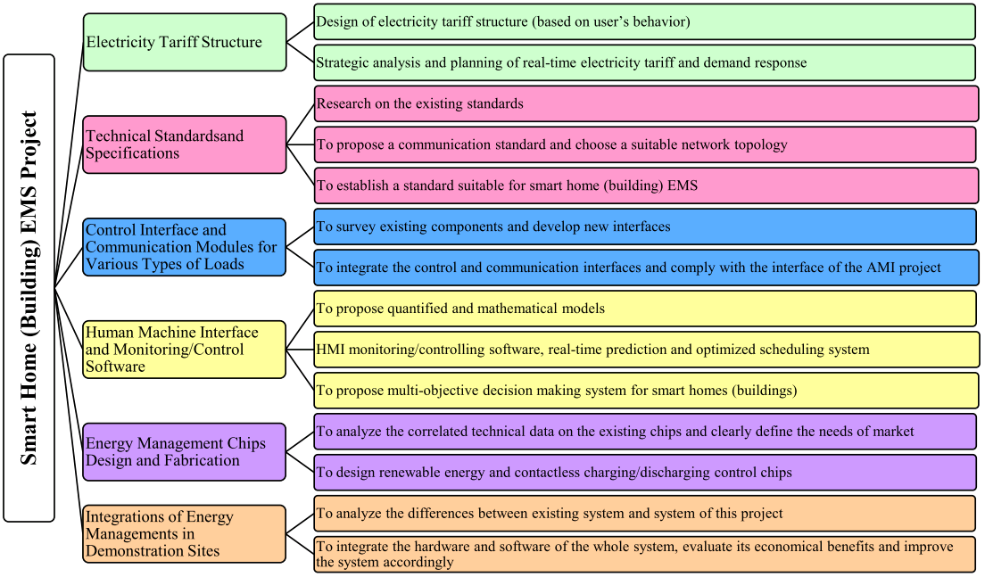
Smart Home (Building) Energy Management Pilot Project
Source : Faa-Jeng Lin(2011). Strategic Initiatives of Smart Grid in Taiwan

Slide 20
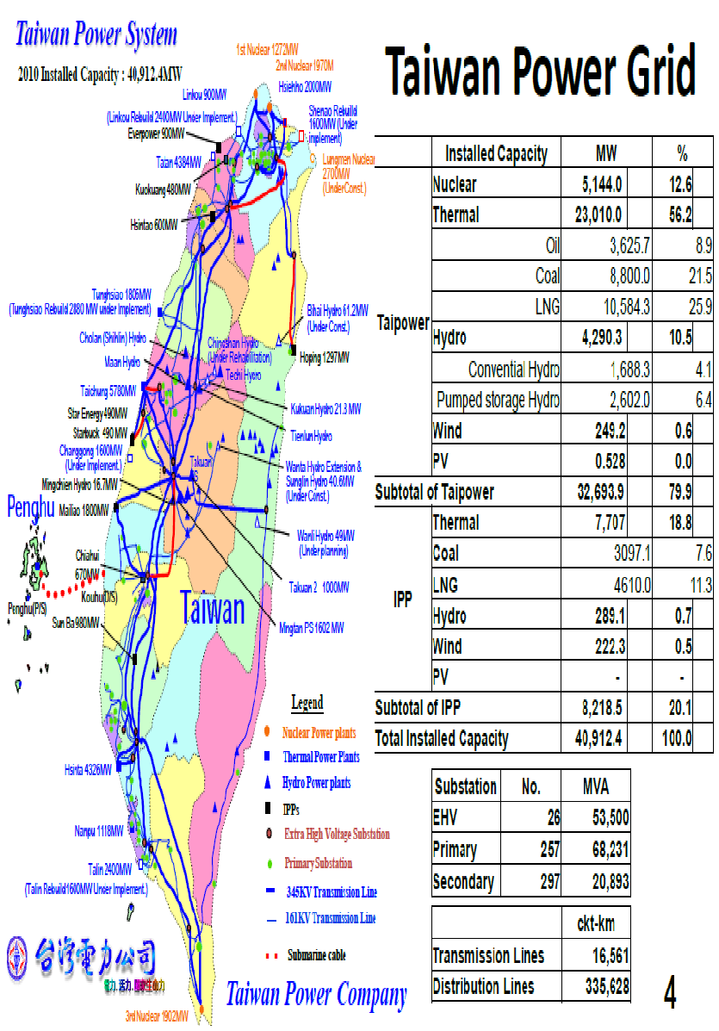
Overview of Taipower’s System
Up to year 2010:
Peak Load: 33 GW
Customers: 12.6 million
Total Generated Electricity (+IPP): 207.4 billion KWh
Sale Electricity: 193.3 billion KWh
Line Loss:4.66%
Type | nuclear | thermal | hydro | wind | solar | Total
MW | 5,144 | 30,717 | 4,579 | 471 | 1 | 40,912
% | 12.6 | 75.1 | 11.2 | 1.1 | 0.0 | 100

Slide 21
Taipower’s Vision on Smart Grid
Create a high-quality, high-efficiency, customer service-oriented, and environment-friendly power grid.
Reliable Power Supply with High Power Quality
Productivity Improvement
Carbon Footprint
Communication, Information and Power Electronics Technology Improvement
SmartGrid
Vision
Driving
Forces
Objective
A higher safety and reliability of power network
Higher efficiency of power plants
Service-oriented system
Environment-friendly grid
ICT Based
Source: Faa-Jeng Lin(2011), Strategic Initiatives of Smart Grid in Taiwan

Slide 22
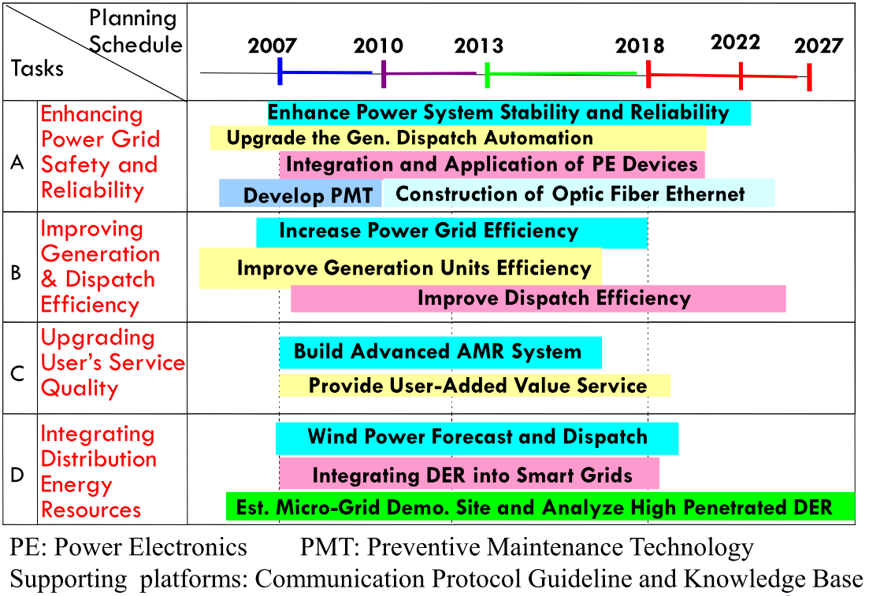
Taipower’s Smart Grid Roadmap
Source: Faa-Jeng Lin(2011), Strategic Initiatives of Smart Grid in Taiwan

Slide 23
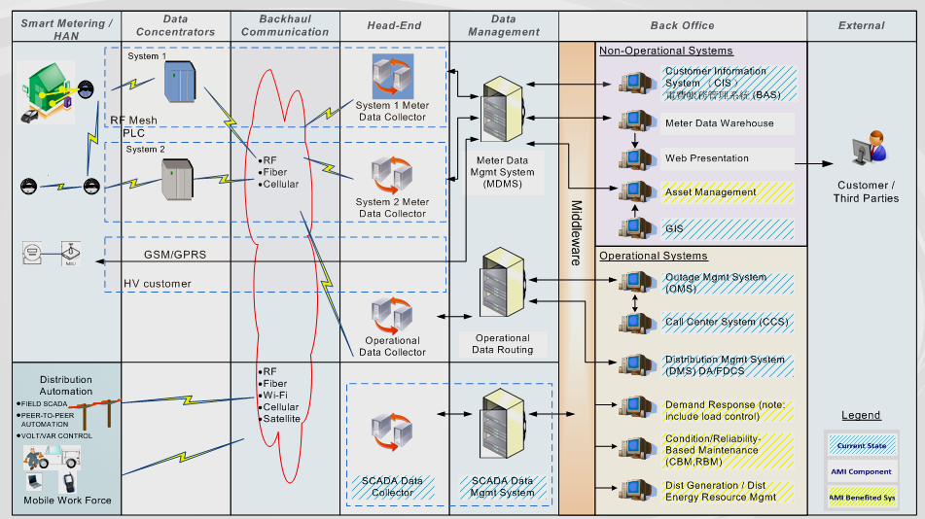
Overall AMI Architecture
Data Concent.
BackhaulComm.
Head-End
Data Managmnt.
Meter
Back Office
External
‹#›
Source: Faa-Jeng Lin(2011), Strategic Initiatives of Smart Grid in Taiwan

Slide 24
Taipower High-Voltage AMI Timeline
On June 23, 2010, Executive Yuan Approved "AMI Development Program“.
High voltage AMI totaling 23,300 meters covering 59% electricity consumption of Taiwan will be installed before 2012/12/31.
Source : Faa – Jeng Lin(2011), Strategic Initiatives of Smart Grid in Taiwan

Slide 25
Objectives of Smart Grid and AMI Project
(2010-2013)：
Complete the key technologies development of microgrid, AMI, advanced distribution automation, smart home (building) energy management pilot projects.
Complete the relevant regulations and standards of smart grid and AMI.
Hold a joint exhibition to demonstrate the developed key technologies.
(2014-2025)：
Complete key technologies transformation and commercialization.
With the installation of AMI, complete the power management system of Taipower (such as time of usage and demand response).
Tying in with the transmission and distribution projects of Taiwan Power Company, promote the developed technologies of microgrid and advanced distribution automation gradually in Taipower system.
Promote comprehensively of smart home (building) energy management technology.
Source: Faa – Jeng Lin(2011), Strategic Initiatives of Smart Grid in Taiwan

Slide 26
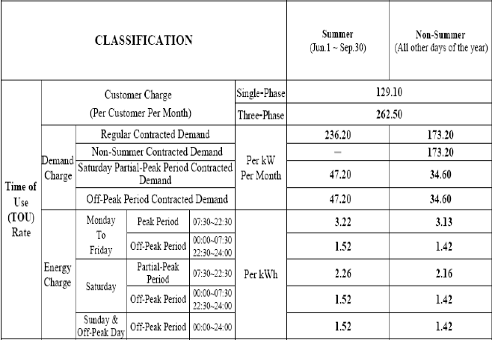
TOU Rate for Residential Sector in Taiwan
Residential customers have the option to switch from the traditional progressive pricing program to TOU rate , which are broken down into three periods: Peak, Partial Peak and Off Peak.
Source: Taiwan Power Company
Notes:
p17.5-1

Slide 27
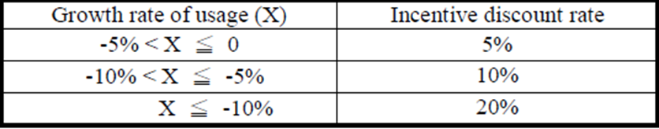
Taipower’s Electric Basic Discount Rate Program
Starting from July 1, 2008,residential household, primary and secondary schools, and public facilities of communities are entitled to Electric Basic Discount Rate program.
The annual growth rate of the amount used is calculated within a billing cycle (2 months) compared to the same period of last year as follows:
Growth rate of usage X（%）＝（A-B）÷ B × 100%
Where
A＝average usage per day (kwh) in a billing cycle
B＝average usage per day of the same month last year
Electric Basic Discount Rate
Source: Taiwan Power Company
Notes:
P17.5-2

Slide 28
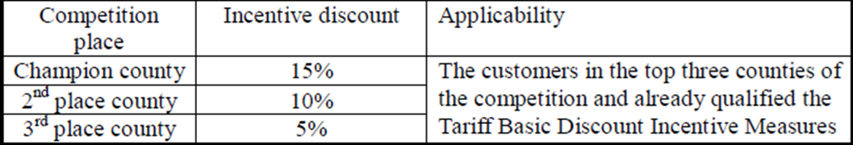

Taipower’s Incentive Discount for Counties Competition in Energy Saving Program
Apart from the incentive discount rate, there is another supplementary Incentive Discount for Counties Competition in Energy Saving.
The competition comprises of national 25 Counties and takes place every two months to be consistent with a billing cycle.
Again, the evaluation of the competition results is based on the growth rate of average usage per day (kwh) in a billing cycle of the household in the counties.
Incentive Discount For Counties Competition In Energy Saving

Slide 29
2009 Taiwan National Energy Conference
CO2 Reduction Target: 2016-2020 Emission Level Equivalent to 2008 Base. (2007 Level Is 268 Million Tons)
Government New Targets
2025 Emission Level Equivalent to 2000 Base
2025 55% Low-Carbon Energy Supply
2050 Equivalent to 50% 2000 Base
Implementing Energy Tax, Carbon Tax, Green Tax Reform, ETS (Emission Trade System)

Slide 30
3. SMART GRID AND ELECTRICITY MANAGEMENT FOR SMART HOMES
3.2 California

Slide 31
California Smart Gird and AMI
As a first step toward a smarter grid, the CPUC beginning in 2006, authorized the state’s investor owned utilities (i.e., PG&E, SDG&E, SCE) to replace conventional customer meters with advanced meters.
Advanced meters serve as a fundamental building block of the Smart Grid by providing customers with the ability to have greater control over their electricity usage.
Source: California Public Utilities Commission

Slide 32
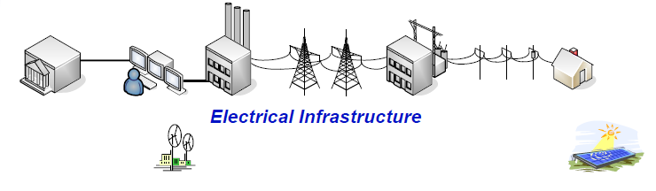
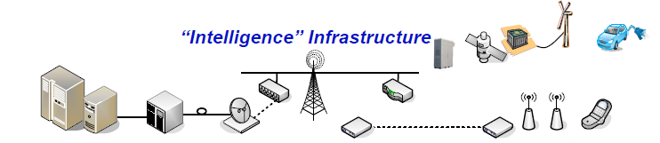
Merging Two Infrastructures
Source: Electric Power Research Institute

Slide 33
2011 California Smart Meter Deployment
PG&E 7.1 million meters
SCE 2 million meters
SDG&E 1.9 million meters
Full deployment of advanced meters across the three IOUs service territories is expected to be completed during 2012.
Source: California Public Utilities Commission

Slide 34
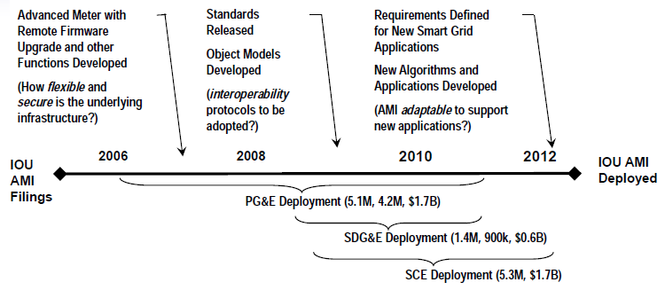
Advanced Metering Infrastructure Deployment
To what extent can careful architecting of the California smart grid enable advanced metering accommodate standards protocols SCE Deployment (5.3M, $1.7B) infrastructure to flexibly future standards, protocols, and applications that are developed after AMI deployment is well underway?
Source: Electric Power Research Institute

Slide 35
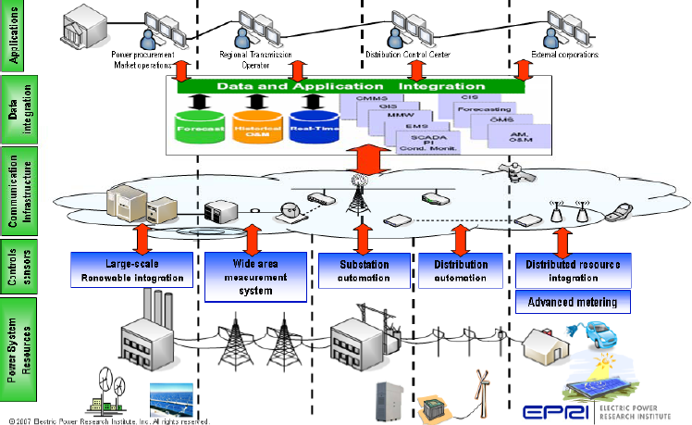
Technology at Different Levels

Slide 36
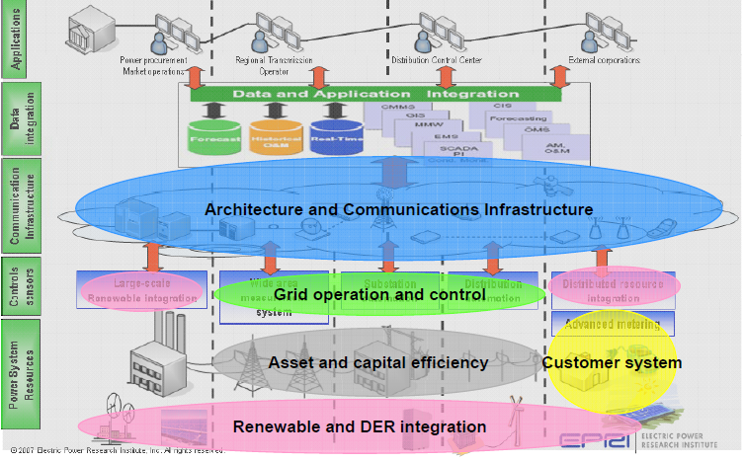
Critical Technology Areas Identified
Source: Electric Power Research Institute

Slide 37
Critical Technology Areas and Gaps(1/5)
Architecture and communications infrastructure : to support interoperable field equipment, automation, and information exchange for the smart grid with standards, methods, and tools
Communications security
Requirements development specific to accommodating distributed resources and intermittent renewable resources in grid operations, requirements repository
Management Infrastructure
Communications media assessment (standards development status, appropriateness for applications)
Source: Electric Power Research Institute

Slide 38
Critical Technology Areas and Gaps(2/5)
Grid operations and control : to automatically monitor, assess, and control the grid to ensure power quality and reliability
Wide Area Measurement System
Substation Automation, Distribution Automation, Managed Islanding
Smart metering for augmenting distribution automation

Slide 39
Critical Technology Areas and Gaps(3/5)
Renewable and distributed energy resource integration : to integrate and manage new sources of renewable energy and distributed energy resources
Interconnection
Storage and power electronics for renewables and distributed generation
Wind integration in grid and market operations
Source: Electric Power Research Institute

Slide 40
Critical Technology Areas and Gaps(4/5)
Customer system : to enable customer to be active in electricity supply chain
Smart metering, home area network, communicating thermostat, plug-in hybrid electric vehicle
Integration of wholesale/retail electricity products, enabling technologies, and different rates structures to develop solutions that better meet customer needs

Slide 41
Critical Technology Areas and Gaps(5/5)
Asset and capital efficiency : to optimize system planning and improve asset throughput
“Urban planning” tools for power grid
Condition based monitoring
Workforce effectiveness : to maximize workforce productivity, effectiveness, and safety through application of enabling tools, technologies and training
Training, O&M processes
Source: Electric Power Research Institute

Slide 42
California Renewable Energy Development
According to Governor Jerry Brown, California will add 20 GW electricity from renewable resources with 12GW localized electricity generation and 8GW from large-scale renewable energy projects by 2020.
Governor Brown signed into law to require 33% energy be renewable by 2020.
SCE already had 19.4% of electricity generated from renewable in 2011 which is among the highest ones over 3000 utilities in the U.S.

Slide 43
California Launches RAM to Procure 1GW of Renewable Energy
The California Public Utilities Commission (CPUC) unanimously approved the RAM (Renewable Auction Mechanism) policy, which is quite different from FIT(Fit-In-Tariff) and RPS (Renewable Portfolio Standard), to encourage and streamline the development and procurement of renewable energy from projects in the 1MW-20MW size range.
2011 Capacity Allocation for RAM Procurement and Per Auction
IOUs | Total Program Capacity(MW) | Per auction(MW)
SCE | 259.4 | 65
PG&E | 420.9 | 105.2
SDG&E | 80.7 | 20.2
Total | 761 | 190.25
Source: California Public Utilities Commission, CPUC
Source: CPUC Resolution 4414,P56

Slide 44
3. SMART GRID AND ELECTRICITY MANAGEMENT FOR SMART HOMES
3.3 Hawaii

Slide 45
Maui Smart Grid Project Overview
Maui Smart Grid Project is a demonstration project funded through U.S. Department of Energy (DOE), Renewable and Distributed Systems Integration (RDSI) program
RDSI is a R&D program focusing on grid integration of distributed energy resources
In 2007, the RDSI program issued an RFP for demonstration projects
HNEI-led team won one out of 9 awards - 80 applicants
Project total budget of $15 million from 2009-2013
$7 million DOE funds, $8 million cost share with partners
Source : HAWAII NATURE ENERGE INSTITUTE

Slide 46
Maui Smart Grid Project Objectives
Reduce distribution circuit peak loading by >15%
By demand response, switching peak loads to energy storage, and reducing voltage
Improve service quality
By using Integrated volt/var control, outage management
Enable consumers to manage their energy use to minimize electric bills
By using customer portals and advanced home energy gateways for a few homes
Support grid stability
Controllable loads, storage, and improved voltage/current information will improve grid stability
Enable greater utilization of as-available renewable energy sources
By providing measurement and estimation of distributed PV to the utility operator
Source : HAWAII NATURE ENERGE INSTITUTE

Slide 47
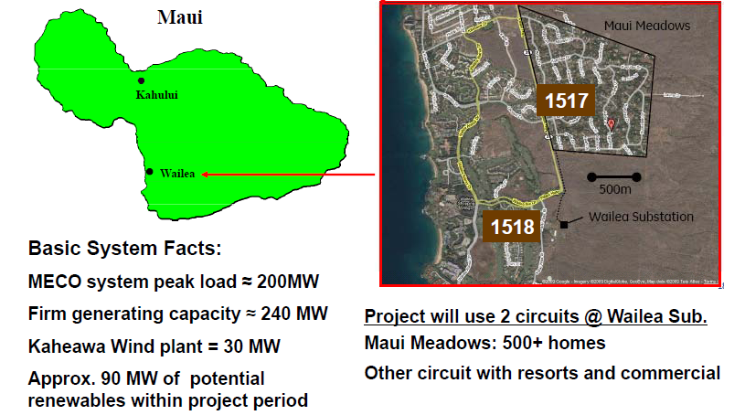
Project Located in Wailea, Maui
Source : HAWAII NATURE ENERGE INSTITUTE

Slide 48
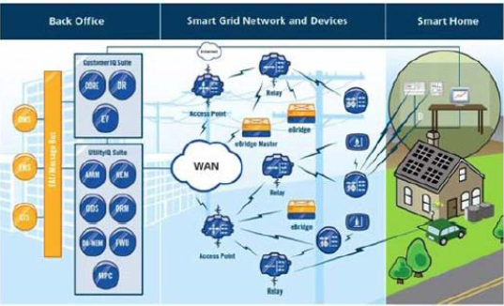
Advanced Metering Infrastructure (AMI) Providing two-way communications to distribution system assets
AMI supports:
voltage monitoring
demand response
PV monitoring
Wireless mesh network
Source : HAWAII NATURE ENERGE INSTITUTE

Slide 49
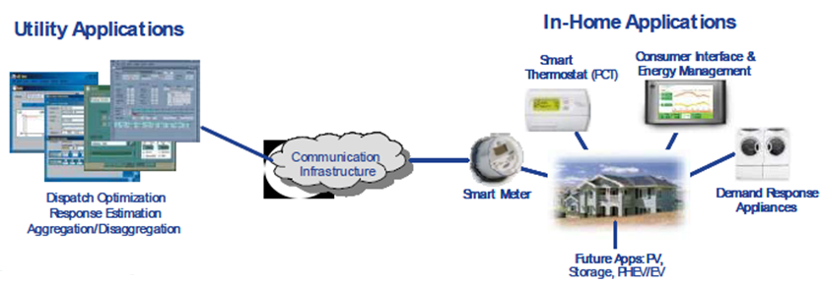
Demand Response Management System (DRMS) Manage load during system events and peak load
Load reduction during peak periods
Contribute to 15% peak load reduction
Increase energy consumption during off-peak hours
Increase energy production from renewable generation by shifting energy use from peak to off-peak hours
Source : HAWAII NATURE ENERGE INSTITUTE

Slide 50
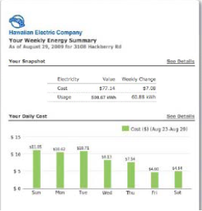
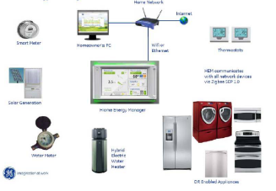
Home Energy Management System (HEMS) Residential consumer portal
Monitor electricity usage & solar PV production
Programmable thermostat, load control switches, and “Gateway”
Demand response enabled comms for smart appliances
Communications: Supports Ethernet, WiFi , Zigbee SEP 1.0
Interface: In-home display or web interface
Source : HAWAII NATURE ENERGE INSTITUTE

Slide 51
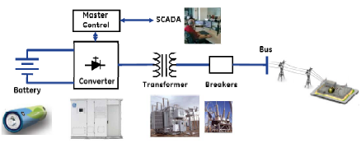
Battery Energy Storage System (BESS) Multiple Benefits
BESS located at Wailea Substation
Manage peak load
Discharge for 1-2hr during peak
Voltage regulation
Manage variability caused by load and PV
Renewables Integration
Non-spinning reserve rapidly inject power, and bridge to fast-start generation.
Reduce wind curtailment charge off peak during excess energy periods
Source : HAWAII NATURE ENERGE INSTITUTE

Slide 52
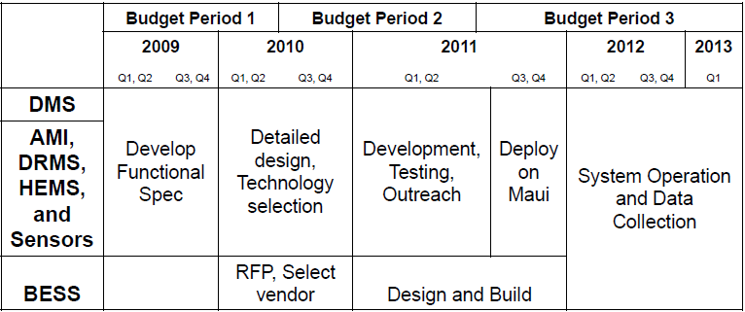
Maui Smart Grid Project Timeline
Source : HAWAII NATURE ENERGE INSTITUTE

Slide 53
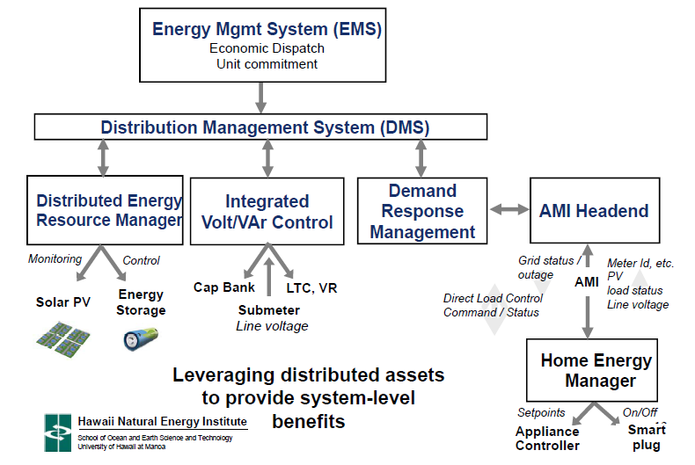
Demonstrating New DMS Functions
Home Energy Manager
Source : HAWAII NATURE ENERGE INSTITUTE

Slide 54
Maui Smart Grid Project Objectives Distributed Resources for Transmission-level Support
 | DMS | AMI,DRMS,HEMS ,and Monitoring | BESS
Reduce peak load | Aggregate DER and provide dashboard control Volt/VAR control | Enable direct load control TOU price(in future) | Discharge energy to reduce load
Improve service quality | Provide visibility to operator Improved outage mgmt Volt/VAR optimization | Voltage monitoring validates DMS load flow | Can help manage voltage
Inform consumer decisions |  | Communicate prices Real-time display Energy mgmt system
Grid stability | Visibility on PV output Aggregate DER and provide dashboard control | Real-time monitoring of PV Enable load control | Discharge energy during system events
Increase RE utilization | Provide reserve support(potentially reduce reserves) | Load shifting | Charge during off-peak
Source : HAWAII NATURE ENERGE INSTITUTE

Slide 55
Hawaiian Electric Company (island of Oahu)
Rate Schedule | Average cents per kilowatt hour (2010)
Residential | 25.47
"P" Large power use businesses | 20.09
"J" Medium power use businesses | 22.27
"G" Smaller power use businesses | 26.87
"H" Commercial cooking, heating, air conditioning & refrigeration | 22.55
"F" Street and Park Lighting | 23.49
Sources: Hawaiian Electric Co.

Slide 56
Hawaii Electric Light Company (island of Hawaii)
Rate Schedule | Average cents per kilowatt hour (2010)
Residential | 36.31
"P" Large power use businesses | 29.26
"J" Medium power use businesses | 32.27
"G" Smaller power use businesses | 40.29
"H" Commercial Cooking and Heating | 33.59
"F" Street and Park Lighting | 33.95
Sources: Hawaiian Electric Co.

Slide 57
Maui Electric Company (Maui County)
Rate Schedule | Maui | Molokai | Lanai
 | Average cents per kilowatt hour (2010)
Residential | 29.45 | 35.78 | 37.11
"P" Large power use businesses | 26.19 | 31.52 | 35.27
"J" Medium power use businesses | 28.83 | 36.08 | 40.22
"G" Smaller power use businesses | 32.39 | 44.44 | 41.38
"H" Commercial cooking, heating, air conditioning & refrigeration | 29.15 | 33.96 | 36.90
"F" Street and Park Lighting | 27.46 | 34.27 | 36.16
Sources: Hawaiian Electric Co.

Slide 58
HECO Energy Efficiency Program Energy Saving Results(from 1996-2009)
Targeting residential and commercial sectors by providing rebates and other incentives
Reduce load demand by 169 MW
Avoided use of 1.6 million barrels of oil annually
Reduced CO2 by 864,000 tons per year
Some of the programs’ highlights :
More than 1.8 million compact fluorescent lights sold
More than 50,000 solar water heaters installed
More than 39,000 rebates issued for Energy Star appliances
Beginning July 1, 2009, SAIC replaced HECO to implement energy efficiency program in Hawaii state.
Source:http://www.renewablehawaii.com/portal/site/heco/menuitem.508576f78baa14340b4c0610c510b1ca/?vgnextoid=5294bf099e812210VgnVCM1000005c011bacRCRD&vgnextfmt=default&cpsextcurrchannel=1

Slide 59
Hawaii Clean Energy Initiative
Hawaii Clean Energy Initiative was signed between the State of Hawaii and the Hawaiian Electric companies in the chambers of Governor Linda Lingle on October 20, 2008
In 2009, Hawaii State Legislature enacted this goal into law by establishing a renewable portfolio standard(RPS) of 40% and an energy efficiency standard of 30% by 2030 in Act 155.
Sources: Hawaiian Electric Co.

Slide 60
Mandated RPS and HECO’s Current Performance
Year | Mandated % From Renewable Energy Sources | Hawaiian Electric RPS | Exceeds Goal
2005 | 8% | 11% | 3%
2006 | _ | 13.8% | _
2007 | _ | 16.1% | _
2008 | _ | 18% | _
2009 | _ | 19% | _
2010 | 10% | 20% | 10.7%
Energy efficiency and solar water heating are no longer included in RPS
2015 | 15% | _ | _
2020 | 25% | _ | _
2030 | 40% | _ | _
Source:2010 Corporate Sustainability Report , Hawaiian Electric Company,p7

Slide 61
Hawaii State Law Requirements
Year 2010:
10 % of the company’s sales must be met by using renewable energy resources to generate electricity and energy savings brought about by technologies such as energy efficiency programs and solar water heaters.
Source:2010 Corporate Sustainability Report , Hawaiian Electric Company,p7

Slide 62
Hawaii State Law Requirements
Year 2015
15 % of the company’s sales must be generated from renewable resources. The
law establishes a separate Energy Efficiency Portfolio Standard, and therefore energy efficiency savings from solar water heating and energy efficiency technologies will no longer count toward the RPS.
Source:2010 Corporate Sustainability Report , Hawaiian Electric Company,p7

Slide 63
HECO’s Power Development Plan
HECO has planned to achieve 25%, 40% electricity generated from renewable in 2020 and 2030 respectively.
Estimated 300 MW new, firm generating capacity would be needed for HECO to replace lost capacity from 4 to be retired generating units and growing load demand, and solicitation for proposals is planned in 2011.

Slide 64
3. SMART GRID AND ELECTRICITY MANAGEMENT FOR SMART HOMES
3.4 Comparison

Slide 65
Comparison of Per Capita Electricity Use in the US(HI & CA) and TW
U.S. Per Capita Electricity Use by State in 2009
Ranking | State | Population(thousands) | kWh(millions) | kWh per capita
1 | Wyoming | 544 | 16,556 | 30,418
2 | Kentucky | 4,314 | 88,796 | 20,583
3 | North Dakota | 647 | 12,594 | 19,470
33 | United States | 307,007 | 3,575,450 | 11,646
48 | Hawaii | 1,295 | 10,126 | 7,818
49 | Rhode Island | 1,053 | 7,800 | 7,406
50 | New York | 19,541 | 139,729 | 7,150
51 | California | 36,962 | 257,275 | 6,961
Sources：California Energy Commission
Taiwan Per Capita Electricity Use in 2007
State | Population(thousands) | kWh(millions) | kWh per capita
Taiwan | 22,87 | 156,000 | 6,821
Sources：Taiwan Energy Bureau

Slide 66
2009 Average Residential Electric Rate Comparison
Country | AVG price per(US$)) | Country | AVG price per(US$)
Malaysia | 0.0810 | Singapore | 0.1871
Mexico | 0.0816 | Philippines | 0.1919
South Korea | 0.0849 | Czech | 0.1983
Taiwan | 0.0854 | Sweden | 0.2004
Thailand | 0.1012 | Hungary | 0.2128
America | 0.1198 | England | 0.2128
Hong Kong | 0.1224 | Portugal | 0.2221
Norway | 0.1415 | Japan | 0.2355
New Zealand | 0.1615 | Luxembourg | 0.2448
France | 0.1642 | Ireland | 0.2634
Swiss | 0.1694 | Netherlands | 0.2665
Poland | 0.1725 | Italy | 0.2933
Finland | 0.1797 | Denmark | 0.3770
Source :Taiwan power company (http://www.taipower.com.tw/left_bar/QnA/electrical_bill_idea.htm)
Notes:
32

Slide 67
Comparison between Taiwan and US
State-owned (TaiPower) vs. IOUs(HECO, PG&E, SCE, SDG&E )---> implying legal/hearing process in US.
Monopolized (Taiwan) vs. liberalized or less regulated (US) electricity market.
Electricity demand structures: Taiwan (industrial sectors 52%) vs. US (industrial sectors 25%)
Vast lands (US) vs. island country (Taiwan) ---> implying relatively higher meter reading avoided costs in US.
Residual capital value of the depreciated grid and meters : Taiwan(relatively high) vs. US(relatively low)
Quite a few aged buildings in Hawaii and California have only one aggregate meter (US).
Notes:
P51.5

Slide 68
Comparison of Benefits and Costs of EMSH between Taiwan and US
Benefits(Avoided Costs):
1. Meter-reading manpower cost: relatively high (US).
2. Load shifts from peak to off-peak under TOU rates:
US (potentially high, but diversified over various states)
vs. Taiwan (relatively low and uniformed).
3. Incentives of electric rate by participating demand
response program: US potentially higher than Taiwan.
Costs:
Manpower cost for installing smart meter: US(relatively
high) vs. Taiwan (relatively low).
Notes:
P54.5

Slide 69
4. BENEFITS AND COSTS OF ELECTRICITY MANAGEMENT FOR SMART HOMES

Slide 70


Different Approaches for Benefits Cost Ratio (BCR)
There are various perspectives for BCR, including:
Participant Cost Test (PCT)
Program Administrator Cost Test (PAC)
Ratepayer Impact Measure (RIM)
Total Resource Cost Test (TRC)
Societal Cost Test (SCT)

Slide 71
Participant Cost Test
Perspective of the Participating Customer
Benefits | Costs
Incentive payments Bill saving realized Applicable tax credits or incentives | Incremental equipment costs Incremental installation costs
Source : Standard Practice Manual : Economic Analysis of Demand-Side programs and Projects

Slide 72
Program Administrator Cost Test
Perspective of Utility, Government Agency, or Third Party Implementing the Program
Benefits | Costs
Energy-related costs avoided by the utility Capacity-related costs avoided by the utility, including generation, transmission, and distribution | Program overhead costs Utility/program administrator incentive costs Utility/program administrator installation costs
Source : Standard Practice Manual : Economic Analysis of Demand-Side programs and Projects

Slide 73
Ratepayer Impact Measure
Perspective of : Would Rates Need to Increase?
Benefits | Costs
Energy-related costs avoided by the utility Capacity-related costs avoided by the utility, including generation, transmission, and distribution | Program overhead costs Utility/program administrator incentive costs Lost revenue due to reduced energy bills
Source : Standard Practice Manual: Economic Analysis of Demand-Side programs and Projects

Slide 74
Total Resource Cost Test
Perspective of All Utility Customers(Participants and Non-Participants) in the Utility Service Territory
Benefits | Costs
Energy-related costs avoided by the utility Capacity-related costs avoided by the utility ,including generation, transmission, and distribution Additional resource saving(e.g., gas and water if utility is electric) Monetized environmental and non-energy benefits Applicable tax credits | Program overhead costs Program installation costs Incremental measure costs(whether paid by the customer or the utility)
Source : Standard Practice Manual:Economic Analysis of Demand-Side programs and Projects

Slide 75
Societal Cost Test
Perspective of All in the Service Territory , State, or Nation as a Whole
Benefits | Costs
Energy-related costs avoided by the utility Capacity-related costs avoided by the utility , including generation ,transmission , and distribution Additional resource saving( e.g., gas and water if utility is electric) Non-monetized benefits(and costs) such as cleaner air or health impacts | Program overhead costs Program installation costs Incremental measure costs(whether paid by the customer or the utility)
Source : Standard Practice Manual : Economic Analysis of Demand-Side programs and Projects

Slide 76
5. CONCLUSION

Slide 77
Conclusion(1/5)
The role of utility: from WEB 1.0 to WEB2.0
Taiwan advantage: from IT (Information Technology) country to ET (Energy Technology) country.
Green IT---> EMSH(Electricity/Energy Management for Smart Homes
EICT (Energy Information Communication Technology ) ---> EMSH

Slide 78
Conclusion(2/5)
The smart grid will link electricity with communications and computer control to create a highly automated, responsive, and resilient power delivery system that will both optimize service and empower customers to make informed energy decisions.
With smart grid providing coordination between the renewable generation and storage on the power system and demand response for customer loads, greater use of local renewable electricity generation is practical.

Slide 79
Conclusion(3/5)
With improved forecasting tools, the grid operators will have better information about resource variability and can make more informed dispatch decisions to maintain system reliability.
Architecture is key to integrate the different aspects of the smart grid.
A collaborative effort among all the stakeholders is needed to develop a smart grid vision.

Slide 80
Conclusion(4/5)
Storage technologies can be applied on the transmission and distribution system to regulate intermittency from renewable output and maintain system voltages at reliable levels.
Demand response can ease the integration of renewable by curtailing consumers’ electricity use to cope with instability of renewable generation.
Combining demand response with electric energy storage in a system enhances the value and capabilities of both measures.

Slide 81
Conclusion(5/5)
Customer choice is imperative as needs vary across customer classes with diverse preferences.
Customers can better manage their energy needs, and education is needed to understand application benefits and costs, and ways to capture value.
Education, demonstration, and customer awareness and acceptance are the keys to a successful Smart Grid and EMSH.

Slide 82
APPENDIX : SMART ENERGY EXPERIENCE

Slide 83


Slide 84


Slide 85
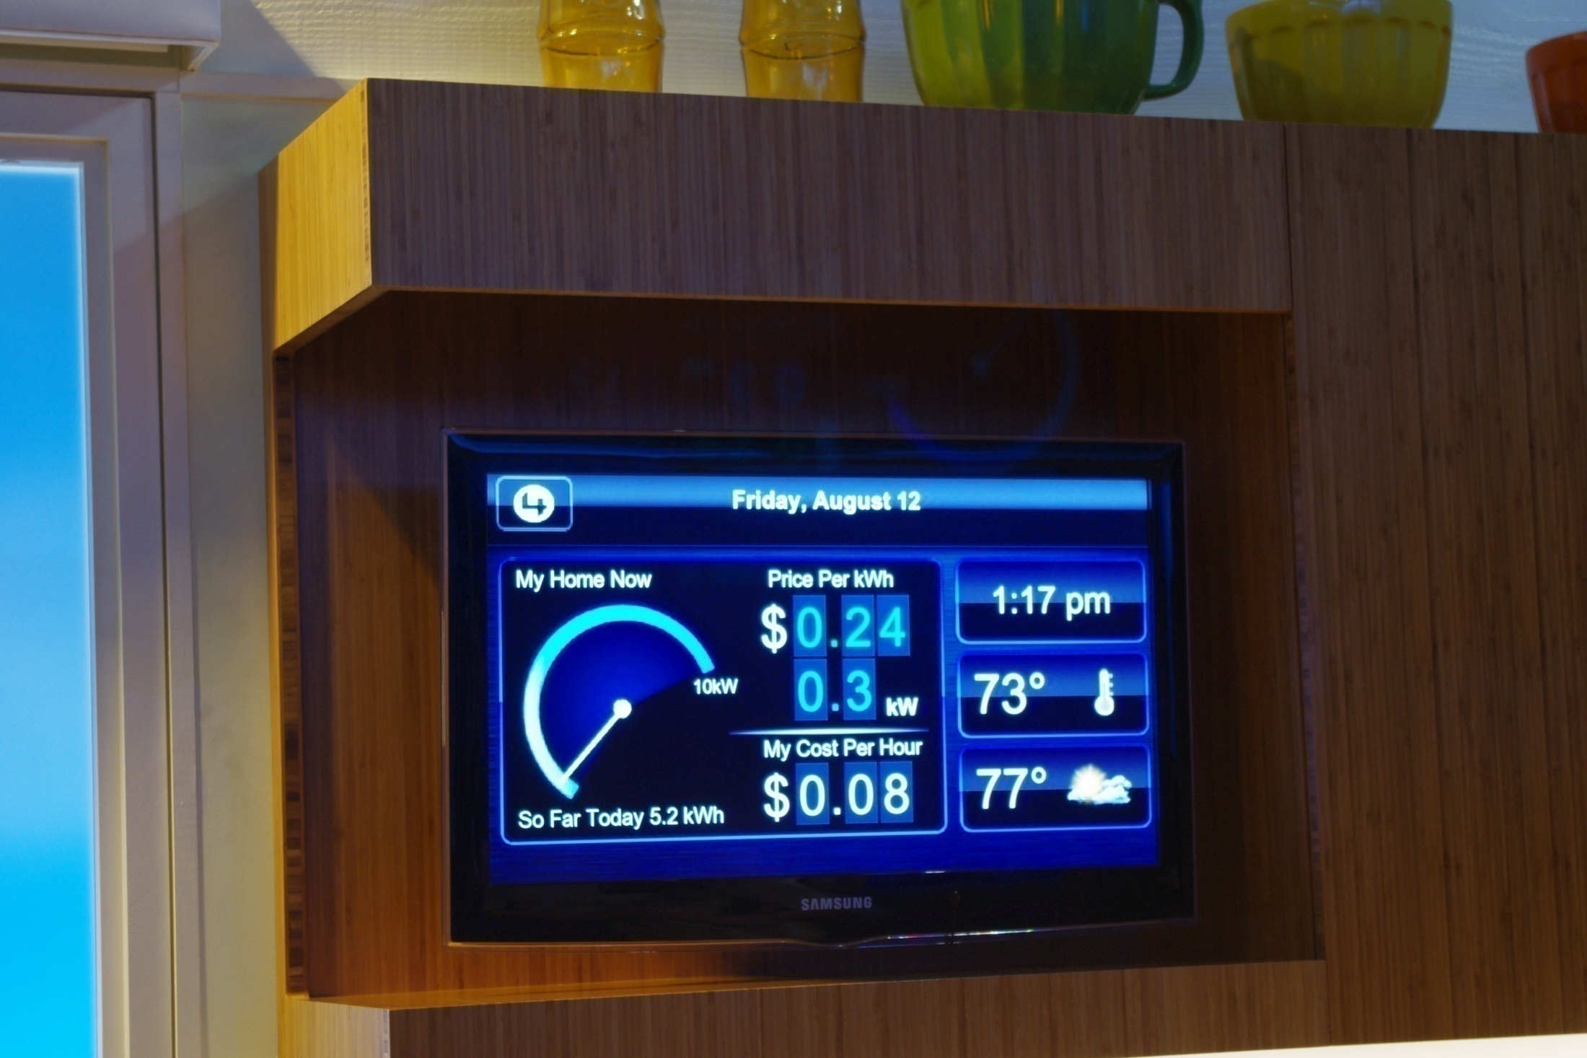

Slide 86
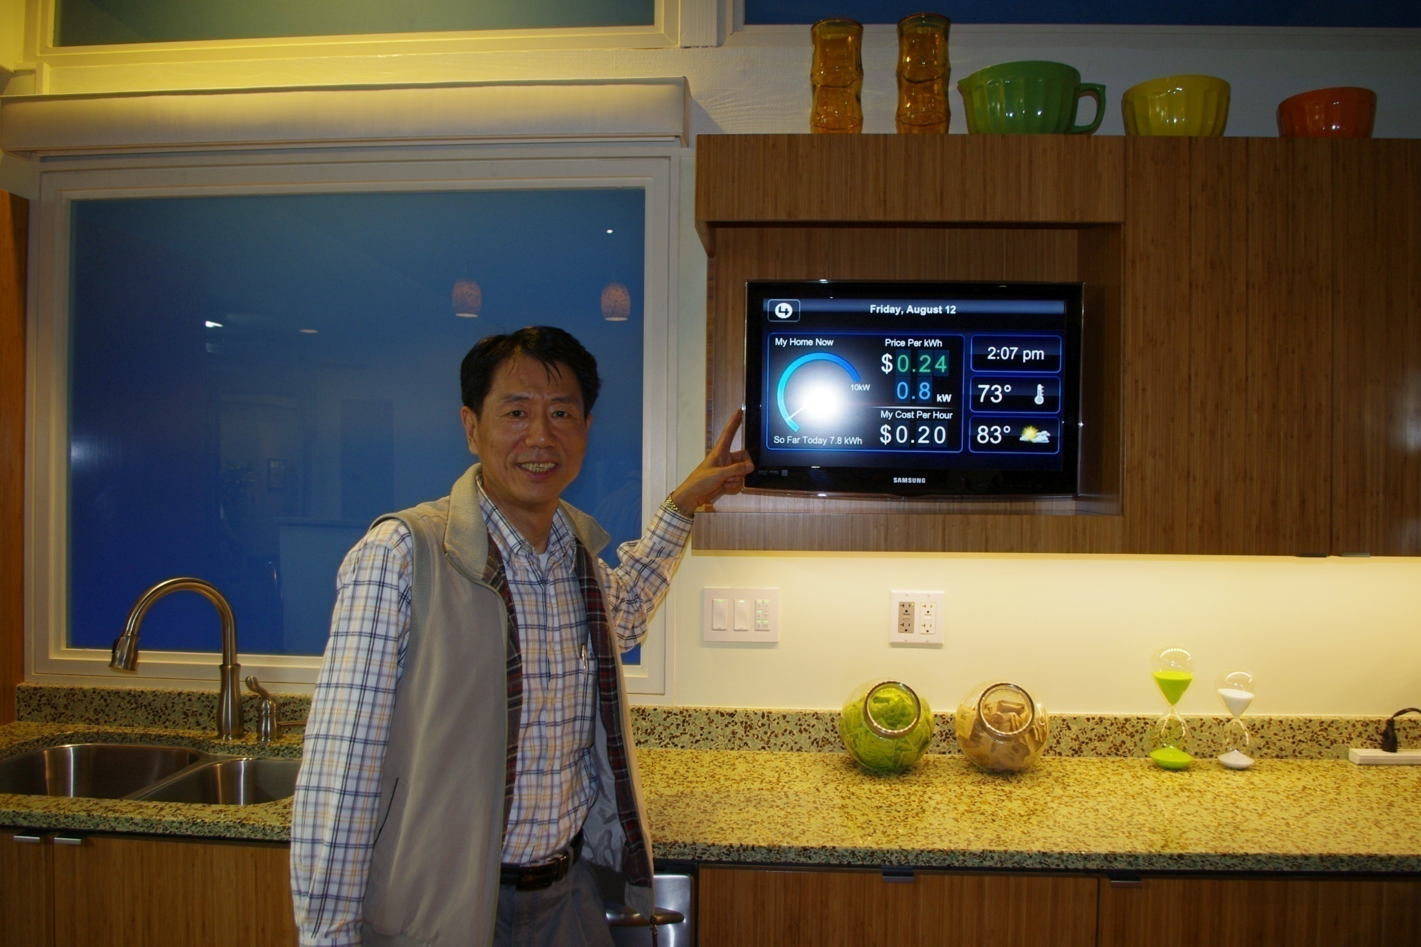

Slide 87
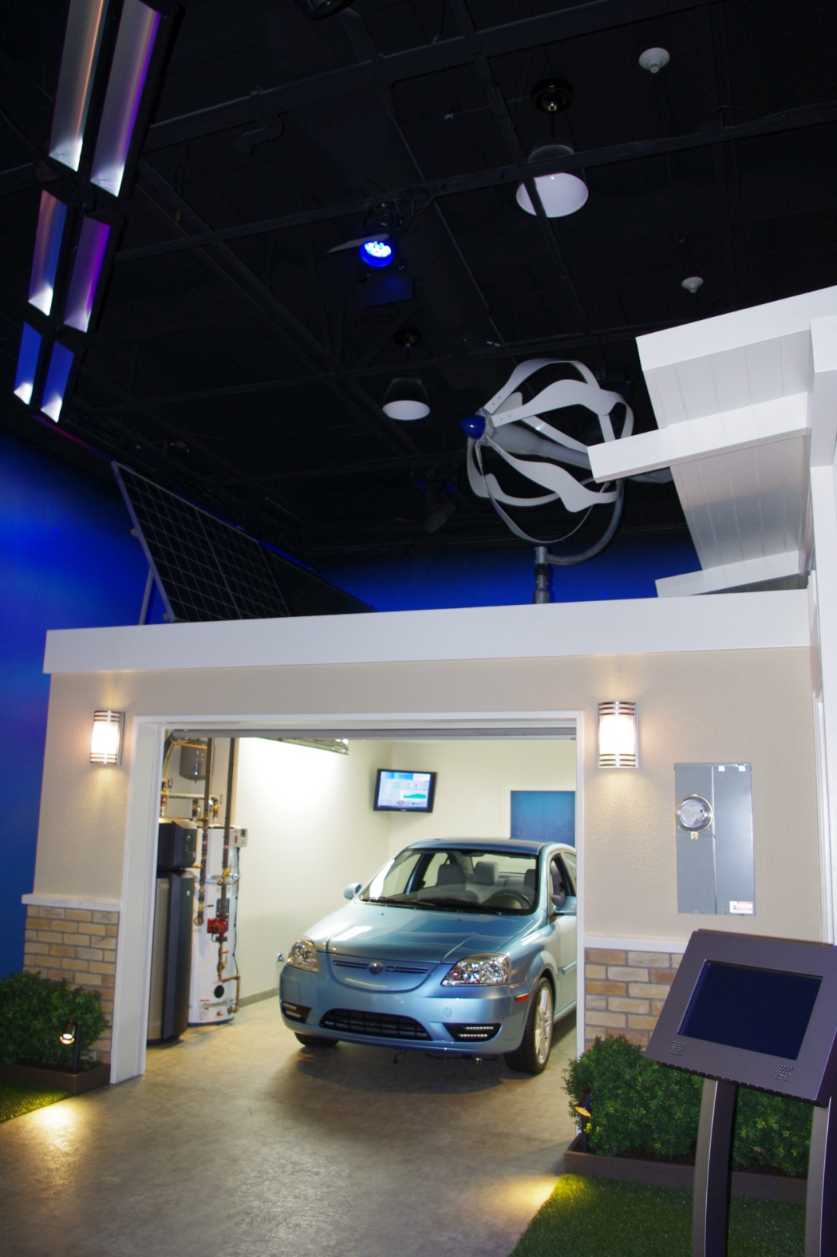

Slide 88
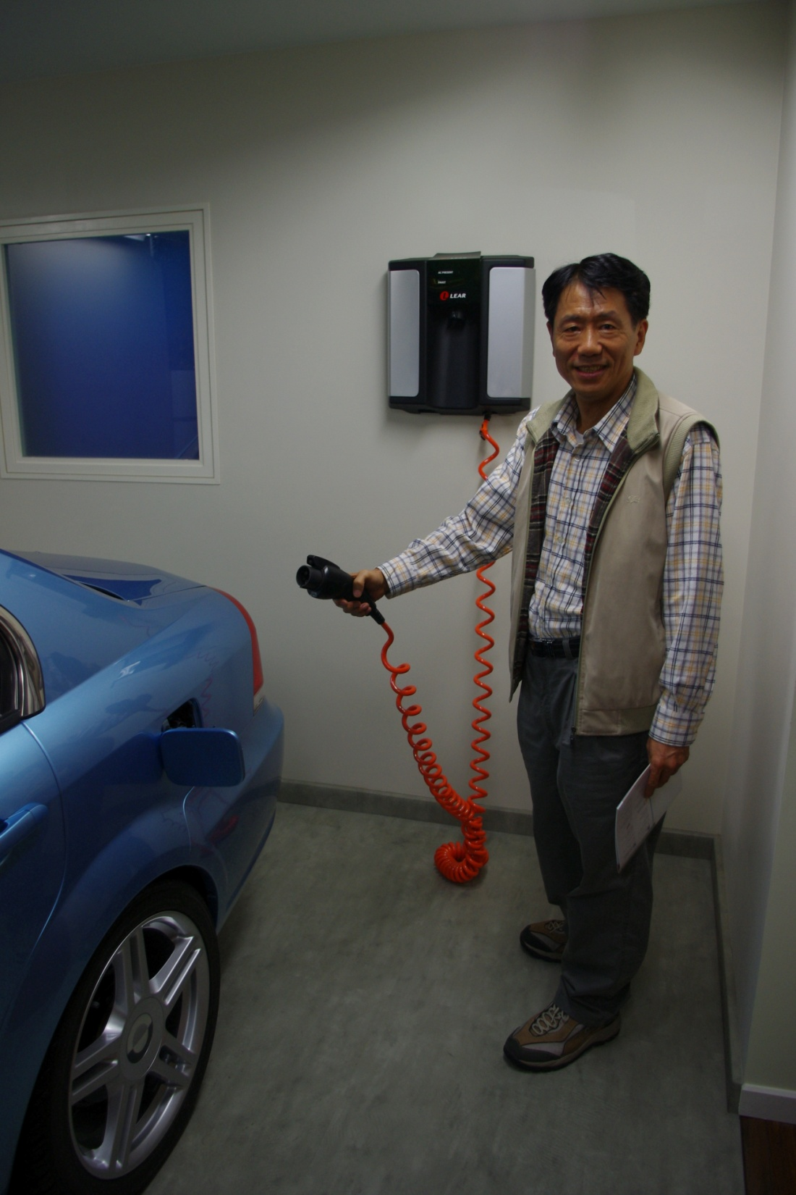

Slide 89
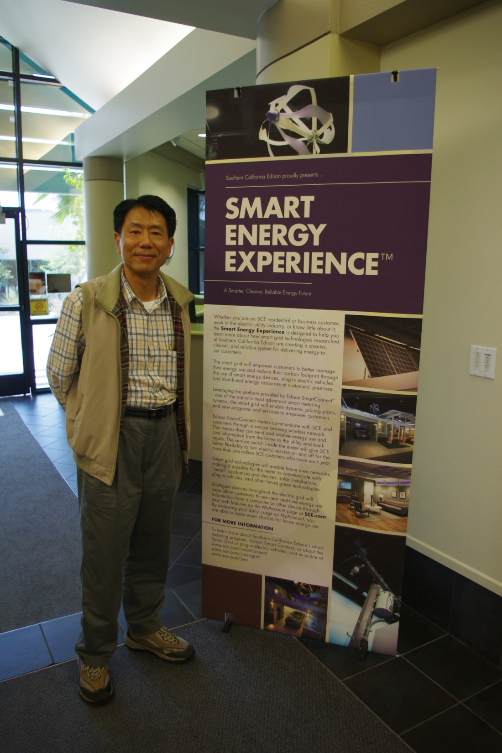

Slide 90
THANK YOU FOR YOUR ATTENTION Q & A

