Slide 1
From IT to ET: A Critical Time 從 IT 邁向 ET 的關鍵時刻
Jyh-Yih Hsu (許志義)
Professor
Department of Management Information Systems
Department of Applied Economics
National Chung-Hsing University
2013/6/25

Slide 2
Outlines
1. Introduction: From IT to ET
2. Strengths of Renewable Energy
3. Weakness of Renewable Energy
4. New Trends
Energy Storage System and Demand Response
Powerful Forecasting Tools
Renewable Energy Certificate (REC)
Advance Meter Infrastructure (AMI)
From AMI to Smart Grid
5. Conclusions

Slide 3
Introduction: From IT to ET
Comparative advantage of Taiwan:
Information Technology (IT) → Energy Technology (ET)
ET → Renewable energy → distributed energy resources
Paradigm Shift: Electricity WEB 1.0 → WEB2.0 (Prosumers = producers + consumers)
Empowerment → customers

Slide 4
Strengths of Renewable Energy
Indigenous → national energy security
Clean, smaller footprint, and soft path → Environmental-Friendly
Abundant supply
Variable cost is nil

Slide 5
Weakness of Renewable Energy
Low energy density (less conversion efficiency, e.g. PV smaller than 19%)
Intermittency/periodicity of supply
Geographical variation
Generally smaller sizes (but large-scale centralized projects have emerged, e.g., 750 MW PV in Riverside County, California; 630 MW offshore wind farm London Array project, UK)

Slide 6
New Trends: Energy Storage System and Demand Response
Adopting electric energy storage system and demand response (DR) can enhance the share of renewable energy portfolio in Taiwan.
Storage technologies can be applied on the transmission and distribution system to regulate intermittency from renewable output and maintain power system voltages at reliable levels.
DR can solve the problem of instability of renewable generation by curtailing customers’ electricity use.
Combining demand response with electric energy storage in power system enhances the value and capabilities of both measures.

Slide 7
New Trends: Powerful Forecasting Tools
With improved forecasting tools (by supercomputer), the grid operators get better information about resources variability and can make better dispatch decisions to maintain power system reliability.
Advanced synchronized real-time forecasting tool and simulation capabilities, as well as “big data” from smart meters and advanced grid measurement instruments called "phasor measurement unit (PMU)," can address the challenges of mitigating renewable instability and reducing CO2 emissions, while limiting the financial burden on electricity customers.

Slide 8
New Trends: Renewable Energy Certificate (REC)
According to Coase Theorem (Nobel Prize in Economics 1991), market players with high marginal costs of producing renewable energy would buy RECs from market players with low marginal costs of producing renewable energy.
Allowing REC exchange in the market can achieve the RPS (Renewable Portfolio Standard) under policy regulation.
In Taiwan, RECs should be issued to market players who do not sell electricity from renewables to Taipower with FIT (feed-in-tariff) guaranteed rates and, instead, utilize renewable electricity generated by themselves.
REC promotes green industries and green jobs of renewables.

Slide 9
New Trends: AMI (Advanced Meter Infrastructure)
23,000 smart meters have been installed for all large industrial customers in 2013, Taiwan
10,000 residential customers in 2013, 2014, Taiwan
It is expected 6 million smart meters will be installed for the residential sector in Taiwan in the future.

Slide 10
Six Perspectives of AMI
1. Smart Meter
2. Smart Meter + IHD (In-Home Display)
3. Smart Meter + IHD + HEMS (Home Energy Management System)
4. Smart Meter + IHD + HEMS + Renewables
5. Smart Meter + IHD + HEMS + Renewables+ BESS (Battery Energy Storage System)
6. Smart Meter + IHD + HEMS + Renewable power + BESS + DR (Demand Response)

Slide 11
New Trends: From AMI to Smart Grid
The next step beyond AMI is to develop smart grid.
The smart grid links electricity with computer and communications control to create a highly automated, responsive, and resilient power delivery system that will both optimize service and empower customers to make better-informed energy decisions.
With smart grid providing coordination between the renewable generation and storage on the power system and demand response for customer loads, greater use of local renewable electricity generation can be practical.

Slide 12
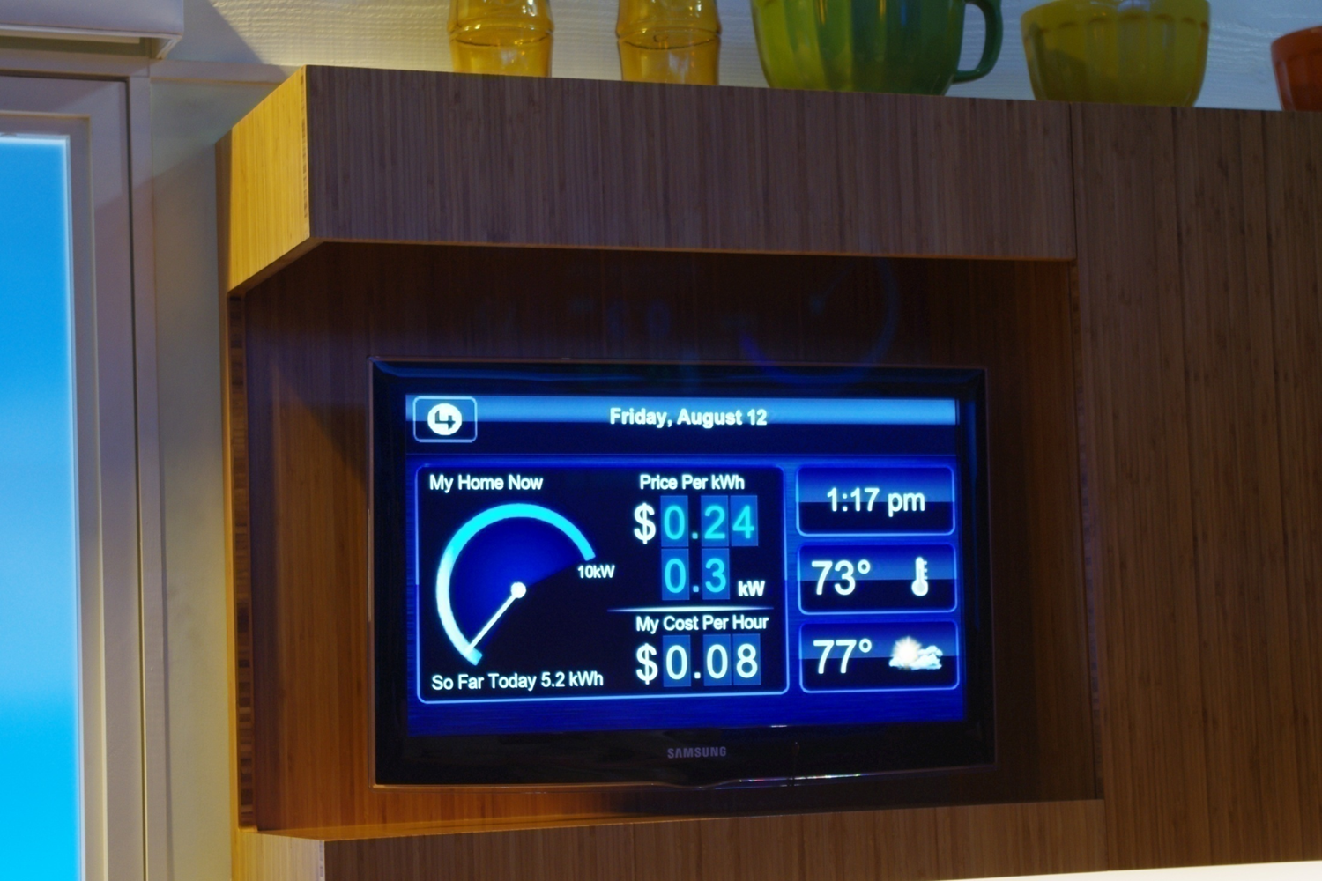
Source: Hsu (2011) “Electricity Management for Smart Homes under Smart Grid,” presented in John A. Burns Hall, Room 3012, East-West Center, Hawaii, U.S.A.
Notes:
Source: Hsu (2009)

Slide 13
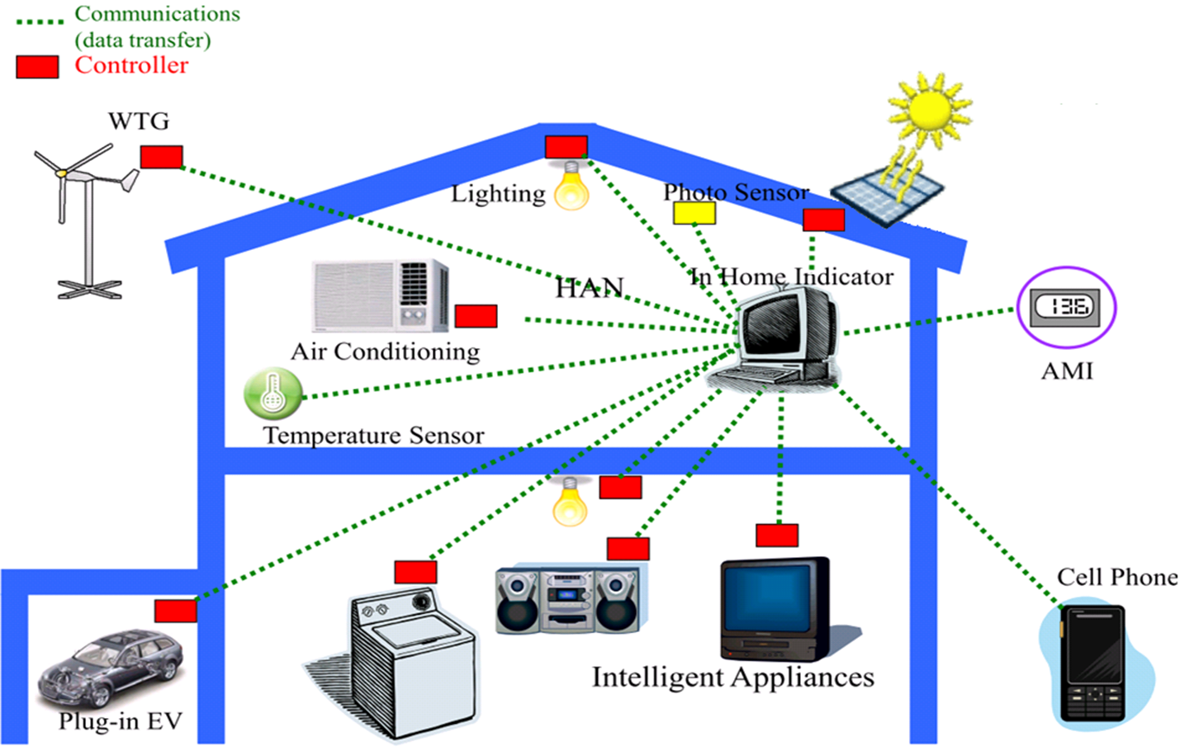
Smart Home Energy Management System
Source: Faa-Jeng Lin (2011),Strategic Initiatives of Smart Grid in Taiwan
Notes:
Source

Slide 14

Conclusions
Electricity: Multi-inputs/alternatives → single output (homogenous)
Now is a critical time for Taiwan at the crossroad of energy alternatives to be chosen.
We have to cope with the challenges and opportunities of ET!

Slide 15
Thank You.
Q&A

