Slide 1
Energy Economics and Policy Analysis: the Taiwan Experience
HSU, JYH-YIH
DIRECTOR, CENTER FOR INDUSTRIAL DEVELOPMENT RESEARCH
PROFESSOR, DEPARTMENT OF MANAGEMENT INFORMATION SYSTEMS
PROFESSOR, DEPARTMENT OF APPLIED ECONOMICS
NATIONAL CHUNG HSING UNIVERSITY, TAICHUNG, TAIWAN
2012/4/23

Slide 2
Outline
I. Introduction…………………………………………………………….3
II. Energy and Economic Development…………………………7
III. Electric Power Industry (Public Utility)………...........…29
IV. Energy Policy Analysis…………………………………………….55
V. Current Policy: From IT to ET(Energy Technology)....82
VI. Conclusion…………………………………………………………….89

Slide 3

I. Introduction

Slide 4
The Role of Energy
Major Resource of Industrial and Residential Activities
Largest Commodities in Trade for the Modern Economies
Main Sources of Environmental Pollution
Source: Hsu, Jyh-Yih (2009), Policy for Sustainable Energy Development.

Slide 5
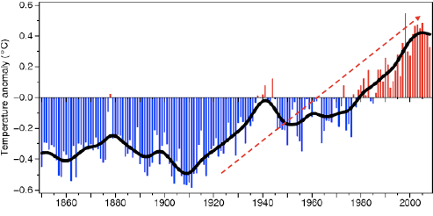
Trend of Temperature Anomaly
Source：Intergovernmental Panel on Climate Change，IPCC

Slide 6
Energy and Global Warming
1. Fossil Fuels
Coal, petroleum and natural gas.
2. Renewable Energy
solar, wind, ocean, hydropower, biomass, geothermal, and biofuels
3. Nuclear Energy
4. Electricity vs. Fossil Fuels
secondary energy
multi-inputs, single output
electricity is the key energy for sustainable development
Source: Hsu, Jyh-Yih (2009), Policy for Sustainable Energy Development.

Slide 7
II. Energy and Economic Development

Slide 8
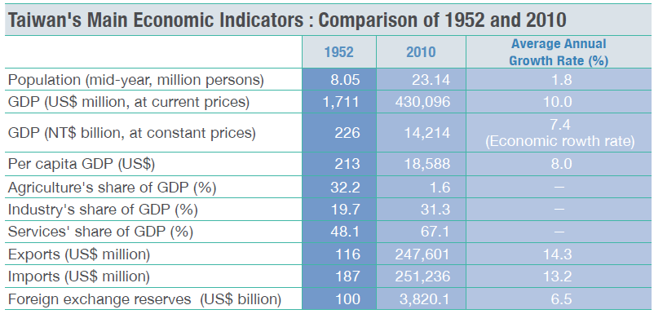
Taiwan‘s Economic Development Indicators
Source: CEPD(2011), Economic Development, R.O.C. (Taiwan)

Slide 9
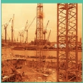
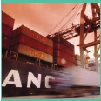
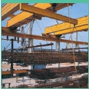
Strategies of Economic Development (1/3)
In Pursuit of Stability and Self-sufficiency
Implementing a land-reform program, stimulating agricultural production, and promoting economic stability
Developing labor-intensive import-substituting industries to reduce the trade deficit
Expanding Exports of Light Industry
Encouraging saving, investment, and exports
Introducing new agricultural products
Establishing export-oriented industries and export-processing zones
1950s
Developing Basic and Heavy Industries
Improving infrastructural facilities and eliminating transport bottlenecks
Establishing intermediate-goods industries
Developing basic and heavy industries
1960s
1970s
Source: CEPD(2011), Economic Development, R.O.C. (Taiwan)

Slide 10


Strategies of Economic Development (2/3)
1980s
Economic Liberalization and Technology-intensive Development
Restructuring industrial production and expanding R&D spending
Pursuing economic liberalization and internationalization
Expanding domestic demand to improve the trade imbalance
1990s
Coping with Change and Setting New Priorities
Implementing the Six-Year National Development Plan to bolster infrastructure
Using the BOT approach to encourage the private sector to participate in public construction
Promoting telecommunications liberalization
Balancing economic and social development to improve living quality
Developing Taiwan into an Asia-Pacific Regional Operations Center
Source: CEPD(2011), Economic Development, R.O.C. (Taiwan)

Slide 11

Strategies of Economic Development (3/3)
2000s
Industrial Renovation and Global Linkage
Actively implementing the i-Taiwan 12 Projects to bolster the nation's capital stock by expanding public investment and boosting private investment.
Promoting industrial remodeling by developing six major emerging industries and four emerging intelligent industries, building an "intelligent Taiwan," increasing R&D inputs, and creating industrial innovation corridors and new high-tech industrial clusters, to raise the rate of technological progress.
Speeding up global connection, enhancing cross-strait and global logistics capabilities, ECFA(Economic Cooperation Framework Agreement) and bringing national economic and trade systems into line with the world, to raise Taiwan's economic efficiency.
Source: CEPD(2011), Economic Development, R.O.C. (Taiwan)

Slide 12
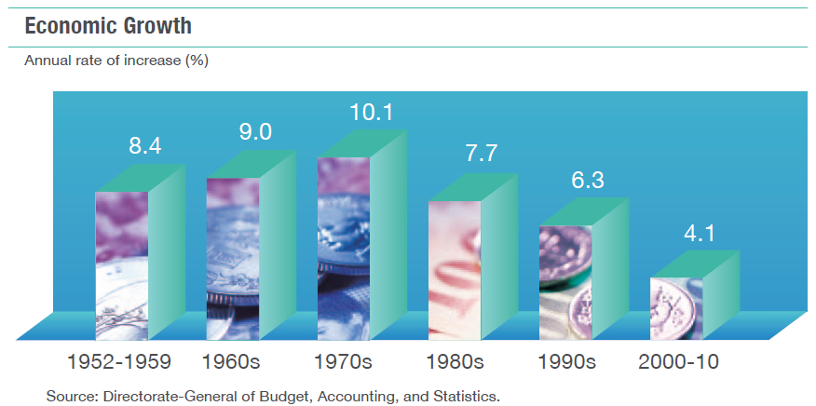
Economic Growth Rate
Source: CEPD(2011), Economic Development, R.O.C. (Taiwan)

Slide 13
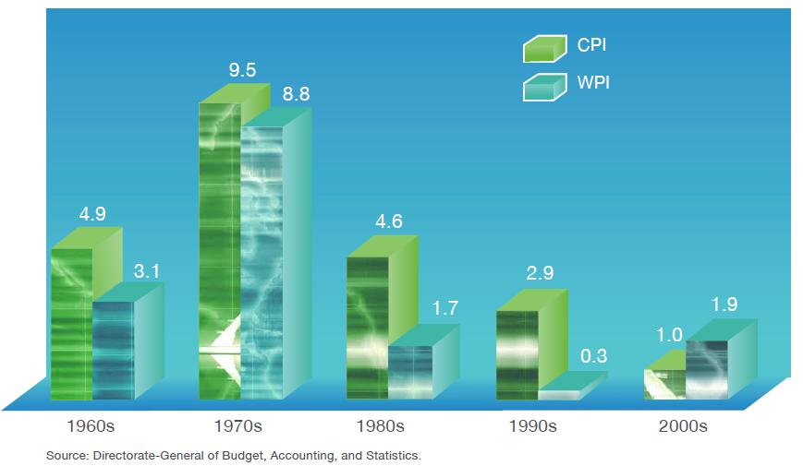
Change in Price Indexes
Annual rate of increase (%)
Source: CEPD(2011), Economic Development, R.O.C. (Taiwan)

Slide 14
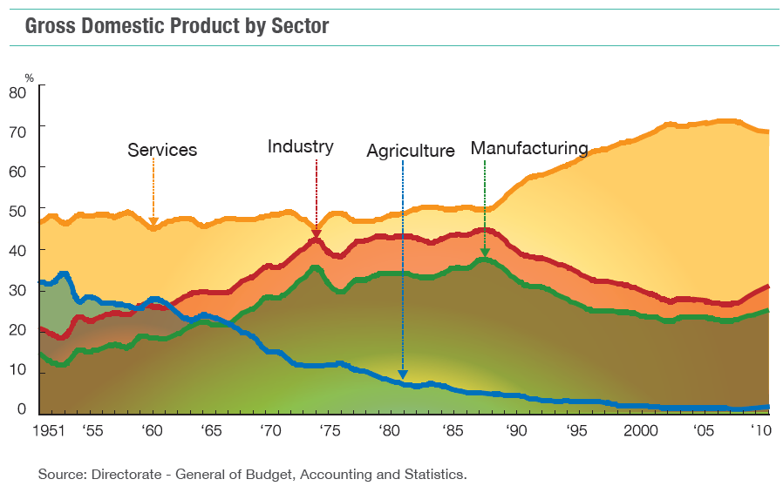
Production Structure
Source: CEPD(2011), Economic Development, R.O.C. (Taiwan)

Slide 15
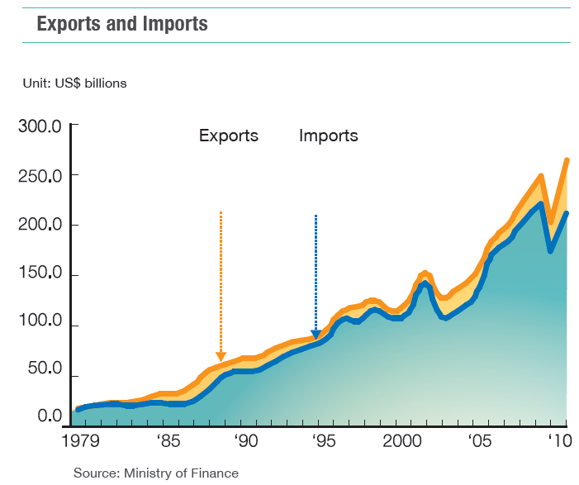
Trade
Source: CEPD(2011), Economic Development, R.O.C. (Taiwan)

Slide 16
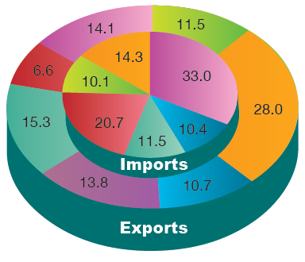
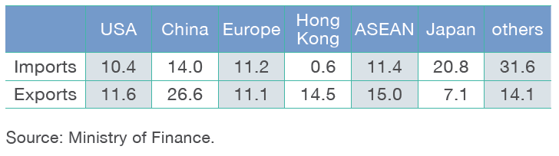
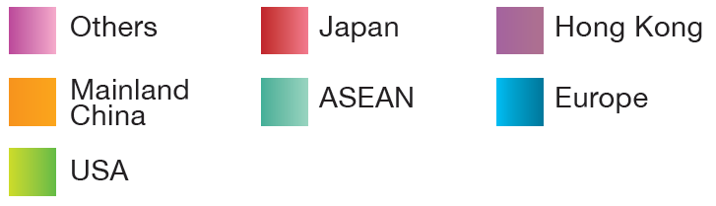
Trade Partners in 2010
Source: CEPD(2011), Economic Development, R.O.C. (Taiwan)

Slide 17
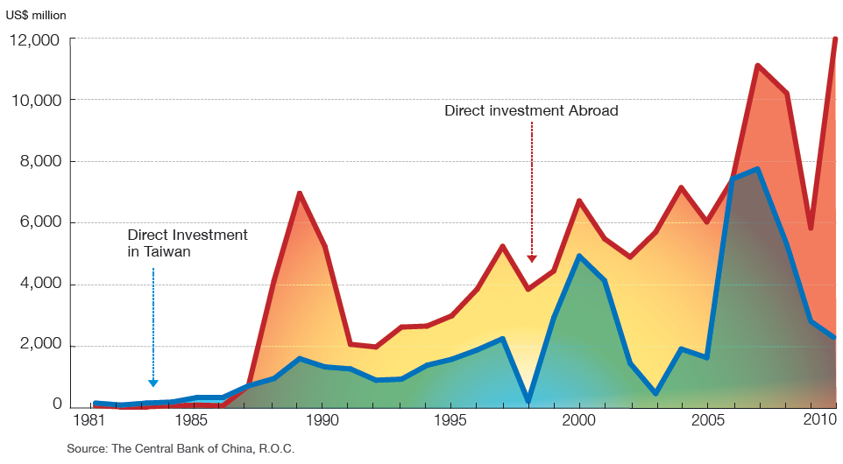
Inward and Outward Foreign Direct Investment
Source: CEPD(2011), Economic Development, R.O.C. (Taiwan)

Slide 18
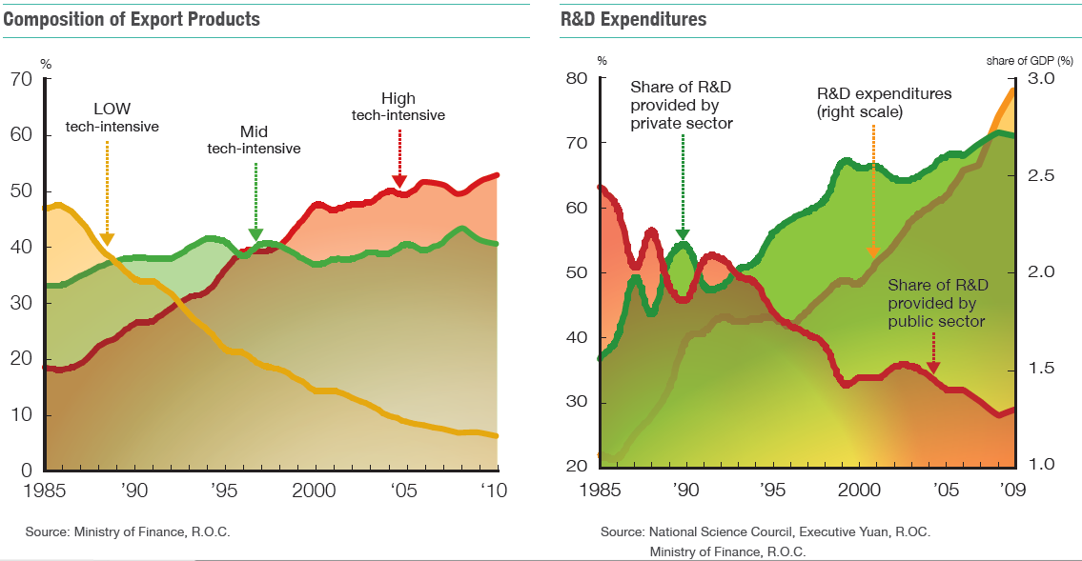
Science and Technology
Source: CEPD(2011), Economic Development, R.O.C. (Taiwan)

Slide 19
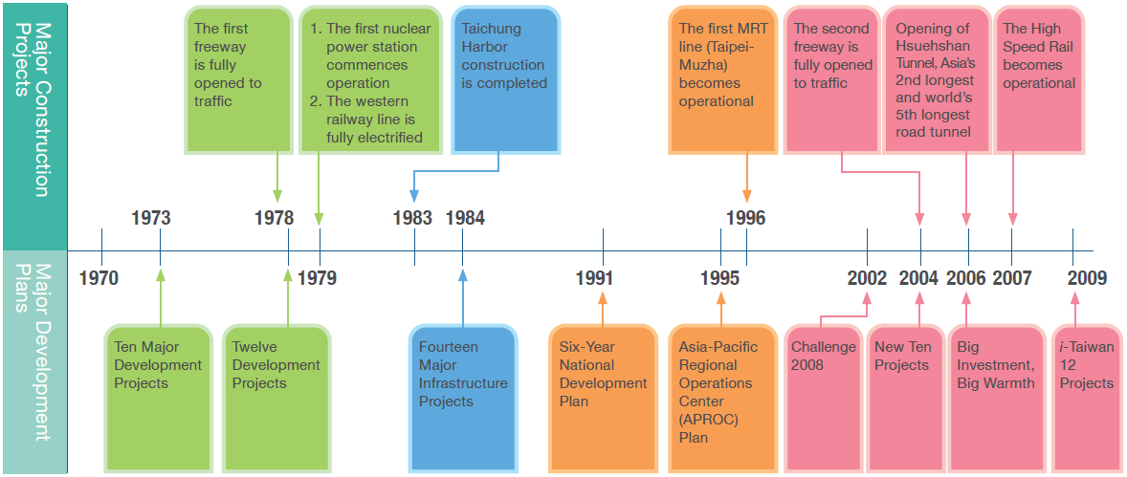
Infrastructural Development
Source: CEPD(2011), Economic Development, R.O.C. (Taiwan)

Slide 20
i-Taiwan 12 Projects (1/2)
Twelve prioritized public construction projects to regenerate Taiwan’s economic miracle.
Investment of NT$3.99 trillion within eight years since 2008.
Creating job opportunities for 120,000 people each year.
Source: www.cepd.gov.tw/encontent/dn.aspx?uid=7910

Slide 21
i-Taiwan 12 Projects (2/2)
A Fast and Convenient Islandwide Transportation Network
Kaohsiung Free Trade Zone and Eco-Port
Taichung Asia-Pacific Sea and Air Logistics Hub
Taoyuan International Air City
Intelligent Taiwan
Industrial Innovation Corridors
Urban and Industrial Zone Renewal
Farm Village Regeneration
Coastal Regeneration
Green Forestation
Flood Prevention and Water Management
Sewer Construction
Source: www.cepd.gov.tw/encontent/dn.aspx?uid=7910

Slide 22
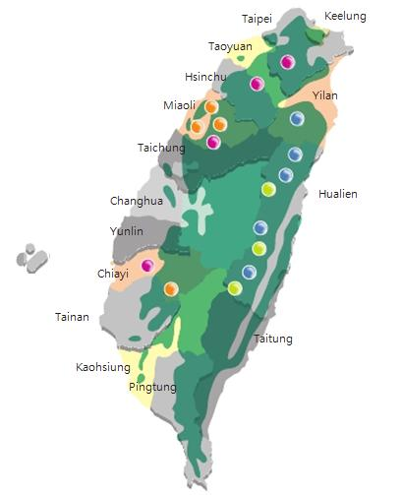
Geographic Features and Natural Resources
POPULATION & NATURAL RESOURCES
TOTAL AREA
TOTAL POPULATION
POPULATION DENSITY
36,191 Km²
23,141,628
639 /km²
RESERVES
COAL
NATURAL GAS
MARBLE
103 Million M.T.
7 Billion M3
297 Billion M.T.
DOLOMITE
110 Million M.T.
FOREST
367 Million M3
Source: CEPD(2011), Economic Development, R.O.C. (Taiwan)

Slide 23
Energy Supply in Taiwan
 | Indigenous |  |  |  |  |  |  | Imported
Year | Total | Coal | Crude Oil | Natural Gas | Conventional Hydro Power | Solar Photovoltaic& Wind Power* | Solar Thermal | Total | Coal and Coal Products | Crude Oil and Petroleum Products | LNG | Nuclear Power
2001 | 1.26 | - | 0.04 | 0.70 | 0.45 | 0.00 | 0.07 | 98.74 | 32.85 | 50.68 | 5.73 | 9.48
2002 | 1.05 | - | 0.04 | 0.69 | 0.23 | 0.00 | 0.07 | 98.95 | 33.22 | 49.48 | 6.16 | 10.09
2003 | 0.96 | - | 0.04 | 0.61 | 0.24 | 0.00 | 0.07 | 99.04 | 32.71 | 51.04 | 6.01 | 9.27
2004 | 0.86 | - | 0.03 | 0.52 | 0.23 | 0.00 | 0.07 | 99.14 | 32.46 | 51.47 | 6.73 | 8.48
2005 | 0.74 | - | 0.02 | 0.36 | 0.28 | 0.01 | 0.07 | 99.26 | 32.03 | 51.82 | 6.89 | 8.52
2006 | 0.69 | - | 0.02 | 0.30 | 0.28 | 0.02 | 0.07 | 99.31 | 32.47 | 51.21 | 7.32 | 8.32
2007 | 0.66 | - | 0.01 | 0.25 | 0.29 | 0.03 | 0.07 | 99.34 | 32.38 | 51.50 | 7.43 | 8.03
2008 | 0.65 | - | 0.01 | 0.22 | 0.29 | 0.04 | 0.08 | 99.35 | 32.70 | 49.88 | 8.41 | 8.37
2009 | 0.63 | - | 0.01 | 0.23 | 0.26 | 0.05 | 0.08 | 99.37 | 30.50 | 51.77 | 8.39 | 8.71
2010 | 0.61 | - | 0.01 | 0.18 | 0.28 | 0.07 | 0.08 | 99.39 | 32.09 | 49.03 | 9.98 | 8.28
Unit：%
Source: MOEA(2011), TAIWAN ENERGY STATISTICS

Slide 24
Energy Consumption in Taiwan
Year | Coal & Coal |  | Petroleum |  | Natural Gas |  | Electricity |  | Solar Thermal |  | Heat |  | TOTAL
 | 10³ KLOE | % | 10³ KLOE | % | 10³ KLOE | % | 10³ KLOE | % | 10³ KLOE | % | 10³ KLOE | % | 10³ KLOE | %
2001 | 6,713.9 | 6.92 | 40,684.6 | 41.92 | 2,261.1 | 2.33 | 47,290.0 | 48.72 | 81.1 | 0.08 | 24.7 | 0.03 | 97,055.4 | 100
2002 | 7,411.4 | 7.37 | 41,744.4 | 41.54 | 2,332.1 | 2.32 | 48,897.4 | 48.66 | 84.3 | 0.08 | 28.2 | 0.03 | 100,497.9 | 100
2003 | 7,553.8 | 7.24 | 43,525.0 | 41.70 | 2,172.7 | 2.08 | 50,996.3 | 48.86 | 87.9 | 0.08 | 33.8 | 0.03 | 104,369.5 | 100
2004 | 7,561.3 | 6.95 | 45,678.0 | 42.00 | 2,305.6 | 2.12 | 53,088.4 | 48.81 | 92.7 | 0.09 | 34.1 | 0.03 | 108,760.0 | 100
2005 | 7,426.0 | 6.68 | 45,772.2 | 41.17 | 2,300.7 | 2.07 | 55,454.7 | 49.88 | 97.5 | 0.09 | 117.3 | 0.11 | 111,168.3 | 100
2006 | 7,958.0 | 7.00 | 45,537.0 | 40.04 | 2,313.7 | 2.03 | 57,662.2 | 50.70 | 102.4 | 0.09 | 165.9 | 0.15 | 113,739.3 | 100
2007 | 8,764.9 | 7.35 | 48,538.3 | 40.72 | 2,416.1 | 2.03 | 59,156.7 | 49.63 | 105.5 | 0.09 | 206.8 | 0.17 | 119,188.3 | 100
2008 | 8,338.0 | 7.21 | 45,979.5 | 39.74 | 2,489.9 | 2.15 | 58,619.6 | 50.67 | 109.5 | 0.09 | 162.9 | 0.14 | 115,699.4 | 100
2009 | 7,681.9 | 6.79 | 46,759.2 | 41.35 | 2,494.3 | 2.21 | 55,728.7 | 49.29 | 113.2 | 0.10 | 295.8 | 0.26 | 113,073.0 | 100
2010 | 10,019.4 | 8.33 | 48,395.8 | 40.23 | 2,965.7 | 2.47 | 58,466.1 | 48.60 | 114.3 | 0.10 | 346.8 | 0.29 | 120,308.0 | 100
Source: MOEA(2011), TAIWAN ENERGY STATISTICS

Slide 25
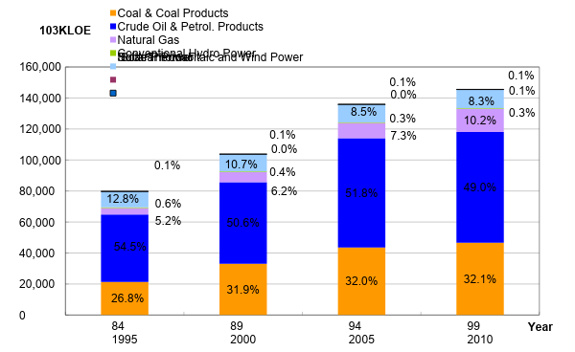
Taiwan Energy Supply Structure
Source: MOEA(2011), TAIWAN ENERGY STATISTICS

Slide 26
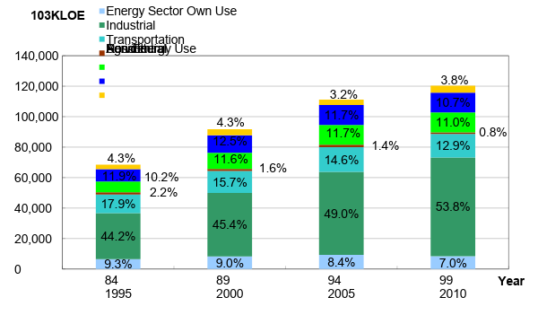
Taiwan Energy Consumption Structure
Source: MOEA(2011), TAIWAN ENERGY STATISTICS

Slide 27
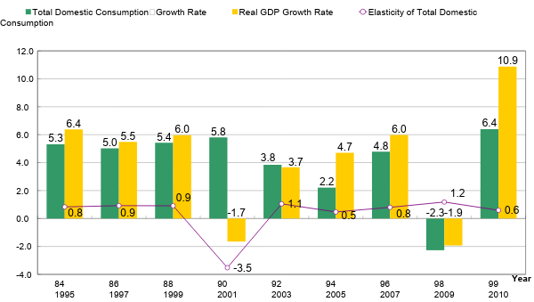
Growth Rate of Energy Consumption and Real GDP
Source: MOEA(2011), TAIWAN ENERGY STATISTICS

Slide 28
Sustainable Development
Sustainable development is a pattern of resource use, that aims to meet human needs while preserving the environment so that these needs can be met not only in the present, but also for generations to come.
Key Question: Can economic development be sustainable?

Slide 29
III. Electric Power Industry
(Public Utility)

Slide 30
Public Utility
Role and Importance of the Public Utility
Significance of the Public Utility Policy
Studied Scope
The Core Value of Public Utilities
Supply Planning of the Public Utility
Demand Management of the Public Utility
Utility Pricing Policy and Regulation
Utility Deregulation Policy

Slide 31
The Core Value of Public Utilities(1/2)
Option Demand /Value—a non-use value, a potential value, an external economy
Anytime Option—always reliable; instantly available
Anywhere Option—all those pipes/wires and meters coverage areas
Any Amount Affordable—due to stable tariffs and depend on the consumer’s budget constraint, energy conservation consciousness, lifestyle and weather conditions

Slide 32
The Core Value of Public Utilities(2/2)
Outage Cost Very High (Reflecting the Loss of Option Demand and Option Value)
Shadow Price (Marginal Utility) Very High During Shortage
Shadow Price (Marginal Utility) Close/Equal to Zero When Abundant
Marginal Cost Normally Very Low (Reserve Margin Is Very Important)

Slide 33
Supply Planning of the Public Utility(1/5)
Attributes of the Utility Supply
Natural Monopoly (AC Decreases When Scale Increases), i.e. Economy of Scale
Capital-Intensive (e.g. Electric Utility Alone Represents More Than 30% of the Total Capital Formation in Developing Countries)
Supply Is Subject to Meet the Needs of Demand (Reserve Margin Needed)
Long-term Planning with Significant Lead Time
Large Land Requirement (Social Capital Assets Utilized for Piping Networks)
Electric Power: Multi-inputs for Producing A Single and Homogeneous Output

Slide 34
Supply Planning of the Public Utility(2/5)
Evaluation of the Feasibility of Supply Alternatives
Technical Feasibility
Economic Feasibility
Financial Feasibility
Environmental Feasibility
The General Public’s Acceptance Feasibility

Slide 35
Supply Planning of the Public Utility(3/5)
Key Concepts of Public Utility Economics
Economic Cost vs. Accounting Cost of Supply Alternatives
Economics of Single Alternative vs. Economics of the Whole System vs. Economics of the Nation
Optimization (Global Optimization) vs. Simulation (Local Optimization) for Supply Alternatives
NPV vs. BCA vs. IRR of Supply Alternatives
Environmental Cost and Others External Costs (Direct/Indirect, Plant on-site/off-site, Tangible/Intangible)
Benefits Should Be Also Considered
Importance of Option Demand and Option Value

Slide 36
Supply Planning of the Public Utility(4/5)
Taiwan’s Experience
Least-Cost(Cost-effective) Planning Approach
Ad hoc Review Committee for Supply Alternatives Selection (e.g. Power Generation Alternatives)
Environmental Concerns Highly Increased (e.g. Kyoto Protocol on CO2 Emission and Circulation-type of Resource Uses, and WEEE, RoHS, EUP)
Nuclear, Coal-fired and Hydro Power Plants Not Easily Accepted by the Environmentalists and the General Public

Slide 37
Supply Planning of the Public Utility(5/5)
Taiwan’s Experience
Renewable Power Generation Being Promoted by Laws and Government’s Measures
LNG Power Plant Also Exists Problems, e.g. Storage Terminals and Piping Transmission
Water Shortages Occasionally Happened and Causes Great Social and Political Concerns
25 City Gas Utility Companies are not Enough Economy-of-Scale

Slide 38
Demand Management of the Public Utility(1/4)
Attributes of the Utility Demand
Collective Consumption
Inelasticity of Demand
Market Segmentation by Piping (e.g. Voltages or Pressures) and Meters
Derived Demand Normally Greater Than Final Demand (e.g. Taiwan’s Experience)

Slide 39
Demand Management of the Public Utility(2/4)
Economics of Outage Cost
Importance of Outage Cost
Economic Meanings of Outage Cost (Social Cost, Shadow Price and WTP)
TC (Total Cost) = SC (Supply Cost) + OC (Outage Cost)
Diagram of the Above Equation
Types of Outage Cost

Slide 40
Demand Management of the Public Utility(3/4)
Demand-Side Management (DSM)
Economic Meaning of DSM (Industries, Processes, End-uses; Households, Activities, End-uses)
Objectives of DSM
Alternatives of DSM (e.g. Electric Power TOU Rate, Seasonal Rate, Interruptible/Curtailable Rate, Direct Rebate, Commercial Advertisement, Education, ESCo. etc.)
Evaluation/Selection of DSM Alternatives
Enforcement of DSM
Evaluation/Adjustment of DSM Program

Slide 41
Demand Management of the Public Utility(4/4)
Taiwan’s Experience
TOU Electric tariff
Seasonal Electric tariff
7 Types of Interruptible/Curtailable Electric Rate
Air-Conditioning Ice-Cooling Storages and Heat Pumps
Significant Amount of Cogeneration (16.3% in 2010)
Fuel Cells under Promotion
ESco Being Encouraged
Education and Promotion on Energy/Water Conservation, e.g. Conservation Ideas/Pictures/Figures Printed on the Electricity and Water Bi-Monthly Bills
Source: www.tri.org.tw/ele/page/03.html

Slide 42
7 Types of Interruptible/Curtailable Electric(1/2)
Scheduled Load Reduction Program (A)
From May to December, 1 weekday per week, 10:00 a.m. ~ 5:00 p.m., totally 7 interruptible hours per chosen interruptible day.
20% discount on demand charges for contracted reduction load.
Scheduled Load Reduction Program (B)
Free to choose from May to October. 10:00 a.m. ~ 12:00 a.m. and 1:00 p.m. ~ 5:00 p.m., totally 6 interruptible hours per day.
10%~ 75% discount on yearly demand charges for the contracted reduction
Scheduled Load Reduction Program (C)
Free to choose from July to October. 8 day per month, 10:00 a.m. ~ 5:00 p.m., totally 7 interruptible hours per chosen interruptible day.
40% discount on demand charges for contracted reduction load.
Scheduled Load Reduction Program (D)
Free to choose from August to September . Free to choose form 1:00 p.m. ~ 3:00 p.m. per weekday.
30% ~50% per interrupted billing month discount on demand charges for the contracted reduction load.

Slide 43
7 Types of Interruptible/Curtailable Electric(2/2)
Forced Load Curtailment Program (E)
Interrupt load demand accordingly on receipt of TPC’s 2-hour advance notice.
Rate discount on demand charges for contracted curtailment load is 20%~40% per request.
Forced Load Curtailment Program (F)
July to June of next year, , Interrupt load demand accordingly on receipt of TPC’s request, extent of 25 requests/250 hours per contract year.
Rate discount on demand charges for contracted curtailment load is 20%~55% per request.
Forced Load Curtailment Program (G)
July to June of next year, Interrupt load demand accordingly on receipt of TPC’s request, extent of 40 requests per contract year.
Rate discount on demand charges for contracted curtailment load is 10% per request.

Slide 44
Utility Pricing Policy and Regulation (1/8)
Impacts and Principles of Utility Pricing
Impacts of Utility Pricing on Social-Economic Development
Welfare of the general public
The development of Rural Areas
The competitiveness of Industries
The fiscal situation of governments for those state-owned utilities.

Slide 45
Utility Pricing Policy and Regulation (2/8)
Impacts and Principles of Utility Pricing
Principles for Setting Utility Tariffs
Economic efficiency
Fairness among consumer groups
Fair rate of return for the utility
Other social-economic objectives (e.g. discount rates for military, rural or power plant-site consumers).

Slide 46
Utility Pricing Policy and Regulation (3/8)
Pricing Models of a Natural Monopolist
MC = MR (Profit max) Pc
MC = P (welfare max) Pa
AC = P (fair return) Pb
Second Best Pricing (Ramsey pricing)(Cost-plus Pricing)
“Price-cap” Method
Most Utility Policies Adopt “Cost-plus” Regulatory Scheme

Slide 47
Utility Pricing Policy and Regulation (4/8)
P
MR: Marginal Revenue
AR: Average Revenue
MC: Marginal Cost
AC: Average Cost
Pd
C
Pc
B
Pb
D
P
AC
E
A
Pa
MC
MR
AR
Qc
Qb
Qa
Q

Slide 48
Utility Pricing Policy and Regulation (5/8)
Problems of Cost-Plus Pricing
Allocative Inefficiency (MC not equal to P)
Technical Inefficiency (eg. A-J Effect)
X-inefficiency
Moral Hazard
Adverse Selection
Incentive Compatibility Needed

Slide 49
Utility Pricing Policy and Regulation (6/8)
Utility Tariffs in Practice
Industrial Users
Two-Part Tariff
Capacity charge (and customer charge)
Energy charge
Peak-load vs. off peak-load pricing (time of use; TOU)
Residential Users
Single charge/Energy charge
Accumulated increasing block rates (for conservation and “distributive justice” of the low income groups)
Interruptible and curtailable rates for specific users

Slide 50
Utility Pricing Policy and Regulation (7/8)
Taiwan Experience
Cost-plus Regulation
Administrative control and implemented measures by MOEA
“Prudent review” procedures
“Used and useful” accounting principle
Accumulated increasing block rates of electric utility supply

Slide 51
Utility Pricing Policy and Regulation (8/8)
Examples of Electric Utility Policy
IPP
Cogeneration
Renewable power generation
Deregulation: ISO, PX, and three majors markets, including whole sale generation power market, transmission congestion management market, ancillary services (12 kinds) market.

Slide 52
Utility Deregulation Policy(1/3)
Problems of Regulation
Regulation Deprivation
Regulation Captive
Regulation Misleading
Due to the long “lead-time” with unforeseeable future and causing over-supply or under-supply of the utility capacity
Due to the political or non-professional intervenes
Captive Customers Shouldering All Investment Risks and Costs

Slide 53
Utility Deregulation Policy(2/3)
“Digital Revolution” Accelerating the Pace of Deregulation
Internal and External Information/Transaction Cost Down Significantly
“Unbundling” the Value-Chain of the Utility Supply Industry
Segmenting the Market Components between Contestable Ones and Monopoly Ones

Slide 54
Utility Deregulation Policy(3/3)
“Digital Revolution” Accelerating the Pace of Deregulation
Competition Mechanism for the Market Components with Contestability Attribute(No More Price and Quantity Regulation, and Focusing on “Fair Trade” Regulation)
Government’s Price and Quantity Regulation on the Market Components with Natural Monopoly Attribute(the Network of Transmission and Distribution)

Slide 55
IV. Energy Policy Analysis

Slide 56
Concept of Market Failure
Public goods
Natural monopoly
Externalities
Bounded rationality
Information asymmetry

Slide 57
Public Goods
Public good is a good that is non-rival and
non-excludable
Non-rivalry means that consumption of the good by one individual does not reduce availability of the good for consumption by others
Non-excludability that no one can be effectively excluded from using the good.
Examples: national defense, air, sunshine, wind (Also termed environmental goods)

Slide 58
“Externality” of Energy Utilization
The problem of externality is rooted from ” The Law of Thermodynamics”
(1) The First Law of Thermodynamics
The Law states that energy cannot be created or destroyed; rather, the amount of energy lost in a steady state process cannot be greater than the amount of energy gained.
(2) The Second Law of Thermodynamics
Energy systems have a tendency to increase their entropy rather than decrease it.
Source: Hsu, Jyh-Yih (2009), Policy for Sustainable Energy Development.

Slide 59
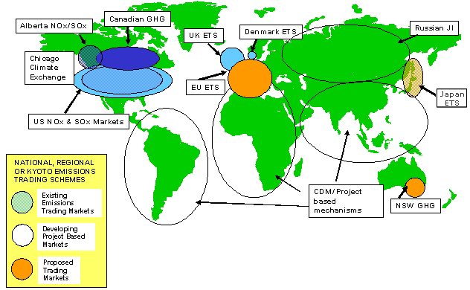
NZETS
“Carbon would become the world’s
biggest market.”

Slide 60
Comparison of Four Policy Tools
Methods for Internalizing environmental externalities:
Liability laws in general
Emission trade based on Coase theorem
Emission Standard
Taxation based on Pigouvian tax
Source: Ahmed M. Hussen(2009), Principles of Environmental Economics

Slide 61
Balancing Marginal Control Cost(MCC) and Marginal Damage Cost(MDC) by Liability Laws
Assuming “Polluter-pays principle”.
Assuming full and accurate information on MDS and MCC.
P
MCC (Marginal control cost)
MDC
$
T
Dead-Weight-Loss from over control
U
R
S
DWL from Over pollution
V
Z
0
W_{f}
Pollutant
W_{e}
W_{j}
W*
Source: Ahmed M. Hussen(2009), Principles of Environmental Economics

Slide 62
Disadvantages of Liability Laws
Legal process in general is expensive and prolong.
It is unfair to those victims who pursue liability laws without legal resources.
Transaction cost could be very high, including identify the cause and effect. Particularly, when there are multiple pollution sources and/or polluters. －transaction cost is one of the social costs.
What about garbage throwing, illegal spitting or smoking??And why these cases can work??
Source: Ahmed M. Hussen(2009), Principles of Environmental Economics

Slide 63
Coase Theorem(1/2)
Ronald Harry Coase (1910) describes the economic efficiency of an economic allocation or outcome in the presence of externalities.
The theorem states that if trade in an externality is possible and there are no transaction costs, bargaining will lead to an efficient outcome regardless of the initial allocation of property rights.

Slide 64
Coase Theorem(2/2)
Property rights assigned for A(factory) or B(resident).
Transparent and full information of polluter (factory) and victim(resident).
Transaction cost =0
P
Marginal Benefit to A
P
Marginal Damage to B
Social Optimal
B
A
Q
E*
B’s action
A’s action
Source: Ahmed M. Hussen(2009), Principles of Environmental Economics

Slide 65
Disadvantages of Coase Theorem
Asymmetric information on polluters and victims.
Property rights assignment could be a problem.
Property rights and income distribution issue.
The “only” optimal equilibrium may not be optimal (eg. The optimal pollution level may cause actual disaster of one party/side.)
International pollutions such as acid rain, global warming and ozone depletion could be more complicated.
Source: Ahmed M. Hussen(2009), Principles of Environmental Economics

Slide 66
Emission Trade System
Relatively Less Participants
Universal Price (Buy & Sale) Across Nations
Carbon Price May Vary and Uncertain
Conformable with the principle of cap set by Kyoto Protocol.
Base on the Caose theorem
Source: Hsu, Jyh-Yih (2009), “Policy Towards a Low-carbon Sociality”

Slide 67
Emission Standard as a Policy Tool
Emission standard has various types:
Within per unit of time
Air and/or water quality level control
(eg. CO2 concentration: 450ppm)
Technical standards for emission discharge
This is also termed as “command and control“ regulation.
Source: Ahmed M. Hussen(2009), Principles of Environmental Economics

Slide 68
Emission Standard as a Policy Tool
Adjusting process for seeking optimal emission standard level:
from 75 25 50
A relationship between mitigation and adaptation.
P
MCC
MDC
F
W*
0
25
W_{e}
75
100
Pollutant
50
Source: Ahmed M. Hussen(2009), Principles of Environmental Economics

Slide 69
Cost-effectiveness of Emission Standards
A case of multiple polluters(MCC1 and MCC2).
Cost-effectiveness of emission standards are polluter 1 at 75,
polluter 2 at 125.
P
MCC₁
MCC₂
Dead-Weight-Loss of emission standard 100
N
K
L
M
0
75
100
200
Polluter1
Polluter2
200
125
100
0
Source: Ahmed M. Hussen(2009), Principles of Environmental Economics

Slide 70
Disadvantages of Emission Standards
It violates the spirit of ”free market”.
Administrative cost could be very high, which is social opportunity cost. It represents some kind of “government failure”.
Collusion might exist(bias for setting market entry barrier).
Setting emission standard optimal level is difficult.
It neglects “economic efficiency”.
Source: Ahmed M. Hussen(2009), Principles of Environmental Economics

Slide 71
Incentives for Technology Improvement
Polluter in general will seek for technology improvement(from MCC0
to MCC1).
Original total MCC0 is A+B; now total MCC₀’ is D+B.
P
MDC₀
MCC₀
Comparison between A and D determines whether the total MCC increases or decreases.
MCC₀’
A
D
B
0
Pollutant
W_{n}
W_{e}
W*
Source: Ahmed M. Hussen(2009), Principles of Environmental Economics

Slide 72
Pigouvian Tax
From Arthur Cecil Pigou (1877 – 1959)
Pigovian tax is a tax levied on a market activity that generates negative externalities.
P
MCC
S
T
0
W_{e}
W
Pollutant
Source: Ahmed M. Hussen(2009), Principles of Environmental Economics

Slide 73
Optimal Level of Pigouvian Tax
P
MCC
MDC
S
t_{e}
0
W_{e}
Pollutant
Source: Ahmed M. Hussen(2009), Principles of Environmental Economics

Slide 74
Energy/Carbon Tax (1/2)
Covers Most Walks of Society
Different Tax Level for Different Countries (e.g. Exchange Rate, Tax Level, Money Purchasing Power)
Maybe Against Distributed Equity
Carbon Pricing Is Certain in Short-Run
Base on Pigouvian tax
Source: Hsu, Jyh-Yih (2009), “Policy Towards a Low-carbon Sociality”

Slide 75
Energy/Carbon Tax(2/2)
Advantage
Double dividends.
Encouraging energy saving industry.
Adjusting Long-term industrial structure.
Disadvantage
Difficult to adjust for short-term industrial structure.
May influence the affordability of low-income households.
Difficult to set the optimal tax rate and to meet the cap by Kyoto Protocol.
Source: Hsu, Jyh-Yih (2010), “The promotion and impact of Energy/Carbon tax ”.

Slide 76
Green Tax Reform
Implementing Energy/Carbon tax.
Replacing fuel tax and vehicle license tax.
Reducing Income tax rate.
Utilizing energy/carbon tax to encourage R & D, project investment of reducing carbon emissions and carbon reduction.
Subsiding public transportation and low-income households with energy saving projects.
Double-dividends effects.
Source: Hsu, Jyh-Yih (2009), “Policy Towards a Low-carbon Sociality”

Slide 77
Other Policy Tools
RDD&D(Research, Development, Demonstration and Deployment)
Education & Dissemination
Information Disclosure
Direct Investment and Operation by Government
Source: Hsu, Jyh-Yih (2009), Policy for Sustainable Energy Development.

Slide 78
Framework of Taiwan’s Sustainable Energy Policy
June 2008
Objective
Win-Win-Win Solution for Energy, Environment and Economy
Target
Improving energy efficiency
Developing clean energy
Securing stable energy supply
Source: MOEA website

Slide 79
Taiwan National Energy Conference
Held in April 2009
CO2 Reduction Target: 2016-2020 Emission Level Equivalent to 2008 Base.
New Government Targets (2008/5)
2025 Emission Level Equivalent to 2000 Base
2025 55% Low-Carbon Energy Supply
2050 Equivalent to 50% 2000 Base
Implementing Energy Tax, Carbon Tax, Green Tax Reform, ETS (Emission Trade System)
Source: Hsu, Jyh-Yih (2009), TOWARDS A LOW-CARBON ECONOMY

Slide 80
Related laws
2009 July
“Act For the Renewable Energy Development”
“Energy Management Law(updated)”
“Act for Mitigating Greenhouse Gas Emission” is currently under drafting.
Source: Executive Yuan website

Slide 81
Energy Saving and Carbon Reduction Committee, Executive Yuan
Established in January 2010
Responding to 《Copenhagen Accord》
December 2009
For national energy policy planning
Regular follow-up supervision and evaluation of national energy policy
Source: Executive Yuan website

Slide 82
V. Current Policy: From IT to ET(Energy Technology)

Slide 83
From IT to ET
From IT(Information Technology) to ET(Energy Technology)
It combines excellent location of Taiwan, and the market of mainland China and Southeast Asia, this will enable Taiwan to export new energy technology.
It Including green battery, green power, renewable energy, Green IT, Energy Information Communication Technology, ESCO(Energy Service Company), smart grid and other related products or services.

Slide 84
Definition of Green IT (Green Computing)
Refers to environmentally sustainable computing of IT.
Make the entire IT lifecycle greener along the following four complementary paths:
Green Use
Green Disposal
Green Design
Green Manufacturing

Slide 85
Two Dimensions of Green IT
Green of IT
how can we reduce energy consumption when we use IT products or technique
Green by IT
how can we reduce energy consumption by using IT products or technique

Slide 86
Applications of Green IT
Smart Building
Service Virtualization by IT
Smart Grid
Green IT
Smart Working
Intelligent
City
Smart Transportation

Slide 87
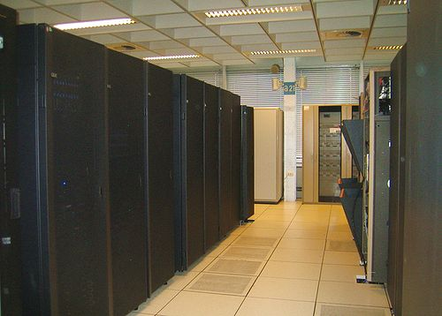
Related Examples of Green IT (1/2)
Green Data Center
Design conception
Reduce a large number of idle machines lead to land waste and power consumption
Server, generator and cooling equipment have proper design
The green data center of IBM: The ventilation equipment at the end of passageway pumped hot air out of the room.

Slide 88
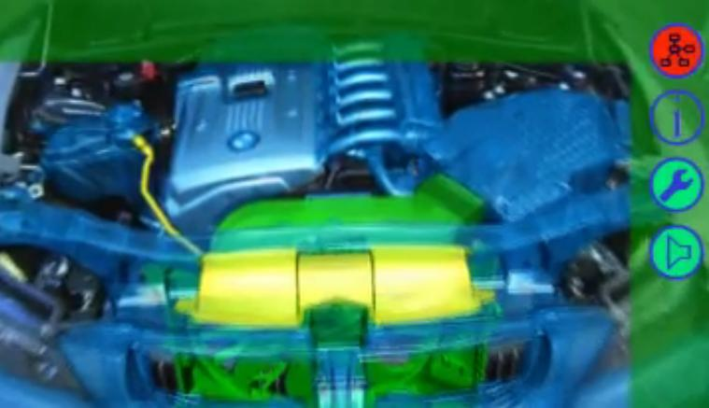

Related Examples of Green IT (2/2)
BMW augmented reality
Clothing augmented reality

Slide 89
VI. Conclusion

Slide 90



Conclusion (1/4)
Is there a “win-win game/strategy” for economic growth and sustainable development?
The answer to this question: Taiwan should go for green energy/economy
Thomas Friedman : Taiwan From IT to ET(Energy Technology)

Slide 91
Conclusion (2/4)
Sustainability means to minimize environmental/ecological impacts when pursuing economic development
The importance of Mitigation Policy vs. Adaptation Policy
Technology Breaking Through Is Needed (e.g., Biotech, Biomimics, Nanotech)
Taiwan industry upgrading for KBE (Knowledge-Based Economy)

Slide 92
Conclusion(3/4)
Life Style (eg. USA style) Adjustment Is Needed
Supply Chain of Food Consumption: Local and Vegetable
4”Rs”: Renewable, Reduce, Reuse, Recycle.
International Institution for Regulation and Implementation

Slide 93
Conclusion(4/4)
Green GDP, Green IT, Smart grid, AMI(Advanced Metering Infrastructure), RTP(Real-Time Pricing) and nuclear safety are important issues to be handled by relevant policies
Incentive mechanism and institutional innovation are the cores of government policy for handling the issues of environmental externality

Slide 94
Future Perspectives of the Energy Policy(1/2)
The Trend of Market Liberalization Policy Is the Mainstream: Every Economy Is Pursuing Economic Efficiency
From Supply-oriented to DSM in Regulated Market
From Supply-oriented to Demand Response in Deregulated Market
From State-owned to Privatization
From Economy-of-Scale to Economy-of-Scope
From Capital-intensive to Knowledge-Intensive

Slide 95
Future Perspectives of the Energy Policy(2/2)
The Rise of Soft-path Resolution(e.g. Renewable Energy) for Environmental Protection
The Circulation-type of Resource Uses Due to International Environmental Protocols/Directives(Kyoto Protocol, WEEE, RoHS, EUP, ISO 50001)
The Rise of Distributive Utilities and Multi-Utilities for More Option Demand/Value
The Need of A Better Integrated Policy Planning, Enforcement and Evaluation(e.g. SCM &CRM Implementation, ex ante and ex post BCA, and the General Public Communication) for More Satisfaction of the Consumers

Slide 96
Summary of Relevant Policies(1/3)
Policy Tools | Practices | Targeted Objects | Features | Effect
Direct Intervention | State-own enterprise Price control Quantity control | Industries with natural monopoly attribute | Avoiding private monopoly or monopoly of key resources Lack of market competition and incentives Against free-market spirit | High
 | Emission standards | Firms with substantial pollutant | Easily applicable. Lack of incentives for R & D and technology improvements Government monitor needed | High
Education and Information Disclosure | Polluter-pays principle Environmental education Pollution information disclosure | All citizen Professional personnel | Enhancing environmental awareness/knowledge Long-term effect | Low
Source :Jyh-Yih Hsu (1998)Review and Outlooks of Environmental-Economic Issues.

Slide 97
Summary of Relevant Policies(2/3)
Policy Tools | Practice | Targeted Objects | Features | Effect
Incentive system | Levying tax | Firms Emitters | May cause prevailing objection easily. No guarantee to achieve the level of pollutant reduction standards Difficulty for setting optimal tax | Medium
 | Financial incentives scheme | Specific industries Specific firms | Ex-Ante award incentives Government needs to shoulder the private investment risk in advance Crowding-out effect of governmental funds Favorable rate for investment loan | Low
 | Tax incentives scheme | Specific industries | Ex-post award incentives Tax deduction Accelerating discount rate for investment No crowding-out effects of capital funds | Low
 | Transferable emission permits | Specific industries | Reflecting emission cost on the price of pollution warrants Minimizing the emission cost through market mechanism Difficulty for setting the permission quotas to firms. | High
Source :Jyh-Yih Hsu (1998)Review and Outlooks of Environmental-Economic Issues.

Slide 98
Summary of Relevant Policies(3/3)
Policy Tools | Practice | Targeted Objects | Features | Effect
RDD&D | Existing/new control technology RDD&D Training Patent protection Commissioned research project Joint collaboration | Knowledge intensive industry/sector R & D personnel | Needing sufficient funds and manpower Difficulty for short term effect | Medium
Rulemaking | Developing regulatory measures Modifying existed regulations | Policy and law | Lengthy legislative process Lobby group | High
Source :Jyh-Yih Hsu (1998)Review and Outlooks of Environmental-Economic Issues.

Slide 99
Thank You for your attention

