Slide 1

Discussion on ”Policy Design for Renewable Energy Procurement”
George Jyh-Yih Hsu
Professor
Department of Management Information Systems
Department of Applied Economics
National Chung-Hsing University
2011/9/28

Slide 2

Outline
I. Introduction 3
II. Key Points for RE Procurement Policy 5
III. Policy Design for FIT, RPS and RAM 10
IV. Comparison: Germany vs. Taiwan 14
V. Challenges for Accommodating New RE 15
VI. Possible Solutions for Accommodating New RE 16
VII. Conclusions 19

Slide 3
I. Introduction (1/2)
The purpose of my following presentation is to reflect some of the thoughts on the speeches and PowerPoint slides of the speakers in the conference today.
It is my privilege to be able to read in advance the speakers’ excellent presentation materials, which I have learned a lot of information.
My topics will be focused on “Policy Design for Renewable Energy Procurement” in reflection to the materials of distinguished presenters in the morning sessions and the first session in the afternoon.
Since time is very limited, I will focus only on the most related points.

Slide 4
I. Introduction (2/2)
Trends of Global RE Development and FIT, RPS Policy Countries
Selected Indicators | Unit | 2008 | 2009 | 2010
Wind power capacity(existing) | GW | 121 | 159 | 198
Solar PV capacity(existing) | GW | 16 | 23 | 40
Solar PV cell capacity (capacity) | GW | 6.9 | 11 | 24
Solar hot water capacity(existing) | GW_{th} | 130 | 160 | 185
Ethanol production(annual) | billion liters | 67 | 76 | 86
Biodiesel production(annual) | billion liters | 12 | 17 | 19
Countries with policy targets | # | 79 | 89 | 96
States/provinces/countries with feed-in policies＊ | # | 71 | 82 | 87
States/provinces/countries with RPS/quota policies | # | 60 | 61 | 63
States/provinces/countries with biofuels mandates | # | 55 | 57 | 60
Source: Renewables 2011, Global Status Report, REN 21,P15

Slide 5
II. Key Points for RE Procurement Policy(1/5)
RE could be treated as two types:
(1) Customer-based RE, also referred as “behind the meter” generation, which is more like demand-side load change (such as very small rooftop PV under 10 KW), less predictable and less controllable by the utility.
(2) Wholesale RE, a new energy and capacity supply-side generating source, which is more visible, predictable and controllable by the utility.
For wholesale RE, utilities could be more proactive (contrasting to reactive nature of customer-based RE) in identifying the locations with higher value and such additional value could be reflected in the market.

Slide 6
II. Key Points for RE Procurement Policy(2/5)
The increasing RE projects will make it more and more difficult for the utility to proactive grid planning.
Interconnection costs have become a major barrier for such RE projects. In contrast, ratepayers often absorb the initial cost for transmission upgrades (as shown in Dr. des. David Jacobs’ ppt p41-p44).
With proper planning, the utility could help RE developers overcome this disadvantage.

Slide 7
II. Key Points for RE Procurement Policy(3/5)
Policymakers should provide incentives to locate RE projects where they can help avoid network modifications, improve grid resilience or provide energy close to load centers for minimizing congestion and line losses.
Policymakers may also consider the additional value capture of RE, including economic development, “green jobs” employment, full ratepayer impact (eg. integration costs), site availability and appropriateness, and environmental justice, other than conventional system value capture of avoiding network costs, congestion and line losses.

Slide 8
II. Key Points for RE Procurement Policy(4/5)
Ultimately, policymakers may want to prioritize policy objectives based on total benefit to all citizens (not just ratepayers).
To the extent that each type of benefit can be monetized, would the benefits be ranked, or could some kind of blended priority score be created?
All the above key points should be carefully addressed into RE procurement policy.

Slide 9
II. Key Points for RE Procurement Policy (5/5)
Value Capture for Various Policy Objectives
Policy Objective | Value Factors
Capturing the Best Renewable Resources | Resource quality (i.e. production potential)
Lowest Cost Energy | Full cost accounting of T&D, permitting, construction, congestion, line losses, site availability/appropriateness
Schedule/Speed of Deployment | Easiest, low-cost interconnection, Environmental impact
Grid Reliability/Balancing/Resilience | Resource Adequacy, islanding, inverter functions
Matching Demand Growth/Changes | Generation profile (e.g. “as-available” or “firm” capacity, match to anticipated electric vehicle, BESS or DR adoption)
Facilitating Development of Related Industries | Local job creation, economic development, attracting business, tax revenues
Environmental Justice/Public Health/Equal Right for Power Generation | Reduced pollution, fair access to clean energy, right to self-generation/consumers’ empowerment

Slide 10
III. Policy Design for FIT, RPS and RAM (1/4)
A. FIT Policy Design
FIT(Feed-in Tariff): Governments/utilities offer long-term contracts to renewable energy producers, typically based on the cost of generation of each different technology.
The fixed price is helpful for reducing the investors’ financing risk and uncertainty.
Relationship with market price:
Fixed price FIT: Germany
Premium FIT: Spain, Holland, Denmark(wind)
FIT tariff may be differentiated by multiple policy designs:
tariff degression over time (for technology learning, economies of scale, innovation pressure, and implemented in Germany)
location value (as discuss above, and implemented in Germany)
time of delivery (by day or by season)
capacity caps (for avoid gold rush and public financial burden)
bidding system (eg. Taiwan’s 3-phase bidding from 2010-2011, or RAM in other countries)
Source: Kreycik, C., T. D. Couture and K. S. Cory(2011), Innovative Feed-In Tariff Designs that Limit Policy Costs, P34

Slide 11
III. Policy Design for FIT, RPS and RAM (2/4)
A. FIT Policy Design
Policy caps are a direct way of limiting total expenditures in a FIT program. However, project size caps may limit the ability to harness economies of scale.
How to design FIT policy to successfully track market costs of RE technologies so that producers are not under- or overcompensated will be a challenge.
Responsive frameworks for price adjustment can provide a more “hands-off” approach, as the self-correcting nature of the mechanism adjusts the payment levels over time without direct intervention.
Source: Kreycik, C., T. D. Couture and K. S. Cory(2011), Innovative Feed-In Tariff Designs that Limit Policy Costs, P34

Slide 12
III. Policy Design for FIT, RPS and RAM (3/4)
B. RPS Policy Designs
RPS(Renewable Portfolio Standard) generally places an obligation on electricity supply companies to produce a specified fraction of their electricity from renewable energy sources. Uncertified renewable energy generators can purchase Renewable Energy Certificates(REC) to achieve goals.
RPS ensures the obligation of generating-mix is achieved.
High investment risk due to the uncertain market price.
Compared with FIT, RPS has less public financial burden.
Needs to establish the certificate schemes, market procedure and regulation.
Needs to ensure market information fully disclosure.
RPS is more relevant for competitive/liberalized market.

Slide 13
III. Policy Design for FIT, RPS and RAM (4/4)
C. RAM Policy Designs
RAM(Renewable Auction Mechanism) is a mechanism requiring utility to purchase electricity from various renewable technologies with capacity smaller than 20MW.
Less transaction/administration costs; a market-based approach
Developers would bid at a price close to or slightly higher than marginal cost.
Purchase price is determined by auction, not decided by regulators, and is non-negotiable price.
Developers who were awarded bids will sign long-term contracts with utility and electricity generated will be purchased with bid price over a fixed period.
Take market, utility, regulators and ratepayers into consideration
Help to achieve RPS target more quickly.
Encourage developers to offer more efficient generating technologies.
Avoid administration costs for regularly adjusting prices and possible disputes.
Performance deposits and development deposits are required.
Might underestimate new technology costs or speculate for underbidding; developers have higher risk (vs. FIT).
Source: Summarized from CPUC Resolution 4414(2011), PG&E advise letters, SDG&E advise letters(2011),SCE advise letters(2011)

Slide 14
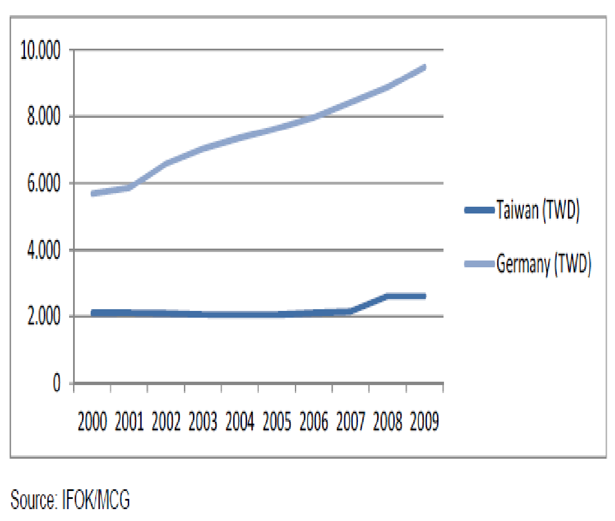
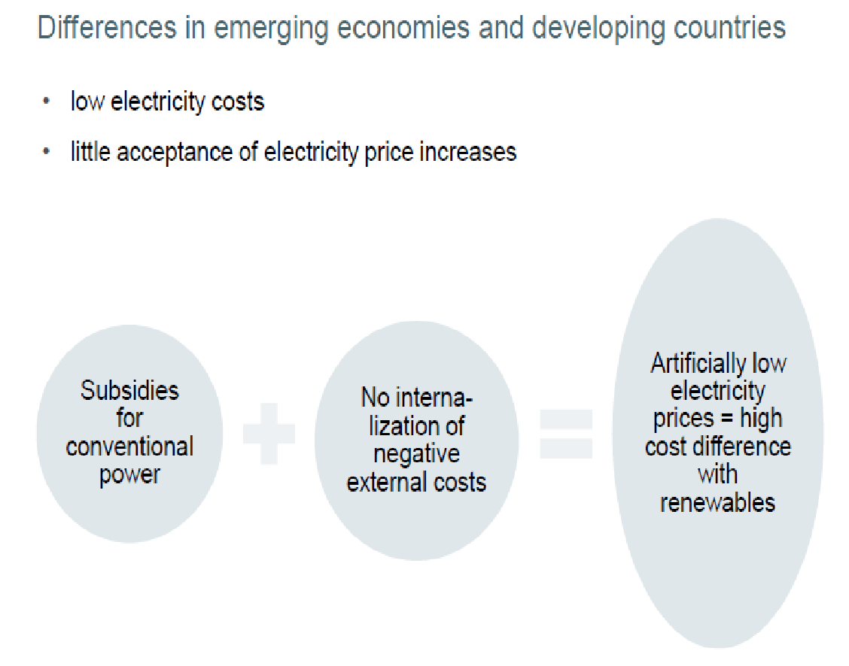
IV. Comparison: Germany vs. Taiwan
Impacts on electric rates and public financial expenditure/subsidy are much more significant in Taiwan (vs. less impact in Germany).
Source: quoted from Dr. des. David Jacobs(2011), Applicability of the German FIT to the Taiwanese policy framework Design considerations in comparison, p74&p75.

Slide 15
V. Challenges for Accommodating New RE
Plentiful volume of interconnection RE requests and limited experience in handling the young market of RE procurement in Taiwan.
Physical/jurisdictional RE projects overlap among 19 counties/cities ( including 5 special municipalities), ie., various projects that electrically affect each other may overlap different counties/cities.
Data availability, ie., insufficient data have been collected for local distribution grid.
Modeling sophistication, ie., TaiPower system may not be in place to accurately model/predict the intermittent output of local RE facilities.
Policy constraints, ie., the inertia of existing institutions may prevent beneficial paradigm shifts e.g. rate basing, resource adequacy, etc..

Slide 16
VI. Possible Solutions for Accommodating New RE (1/3)
Avoided resource adequacy cost: RE benefit calculations should include avoided resource adequacy costs, especially in transmission-constrained local capacity areas. In other words, they could provide additional value to ratepayers, eg. Germany and France (as presented by Dr. des. David Jacobs’ PPT p46).
German-style cost allocation: In Germany (as presented in this conference), RE developers are responsible for the costs to interconnect their facilities to the nearest point on the grid. Further grid modifications are evenly shared across all ratepayers. Such a policy could remove a major complicating factor in grid planning, but may also result in inappropriate cost allocation to ratepayers. Taiwan may consider this approach for both transmission-level and distribution-level grid planning, in order to simplify the complication of cost allocation.

Slide 17
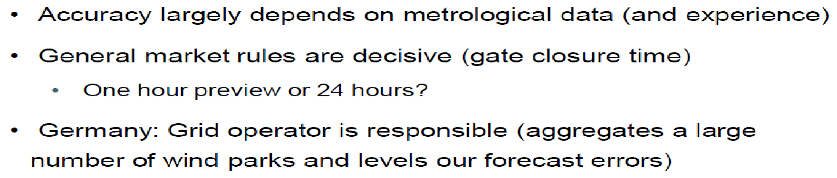
VI. Possible Solutions for Accommodating New RE (2/3)
German predictive models and grid impact simulation software: As one of the global best practices, Germany has been famous for predictive modeling and grid impact simulation software, which are significantly more accurate in real-time predictions of generation from local energy facilities.
Taiwan could adopt similar modeling and methodologies:
It should be useful to plan the grid for local renewables and determine location-based value in Taiwan.
--quoted from Dr. des. David Jacobs’s PPT p81.

Slide 18
VI. Possible Solutions for Accommodating New RE(3/3)
Multi-stakeholder collaboration: Because the distribution grid has an order of magnitude more circuits, substations, etc. than the transmission grid, multi-stakeholder collaboration and communication should be strengthened.
Cluster studies of interconnection: One of the most complex problems with a large volume of interconnection requests is the cumulative effect of projects in a concentrated location. In this case, the combined impact on the distribution and transmission grid is not attributable to a single project. Cluster approaches to assess related interconnections may be needed for some special cases.

Slide 19
VII. Conclusions (1/5)
Taiwan should learn from the German policy experience which is one of the global best practices.
TaiPower system is isolated with limited land resources, versus Germany power system, which is connected with EU neighbor countries. Reliability and stability policy issues should be treated more carefully.
In the near-term, more sophisticated FIT policy design for RE procurement is needed. Customer-based RE vs. wholesale RE might be treated with different approaches as discussed above.

Slide 20
VII. Conclusions (2/5)
Critical Policy Considerations Include:
What is the complete set of objectives that need to be considered when determining value capture of RE?
How should policymakers prioritize these objectives? Ultimately, policymakers would want to prioritize based on total benefit to all citizens, not just ratepayers.
To the extent that each type of benefit can be monetized, would the benefits be ranked, or could some kind of blended priority score be created?
What are the near term procedure and policy changes needed to encourage RE development in the highest location-based value?
How to integrate fixed FIT scheme with auction mechanism for a better RE procurement procedure?

Slide 21
VII. Conclusions (3/5)
It is important to facilitate the development of RE related industries in order to shift Taiwan from an IT (information technology) country to an ET (energy technology) country.
With improved forecasting tools (could be learned from Germany as discussed above), policymakers will have better information about resource variability and can make more informed dispatch decisions to maintain system reliability.

Slide 22
VII. Conclusions (4/5)
Storage technologies can be applied on the transmission and distribution system to stabilize intermittency from RE output and secure system reliability.
Demand response can ease the intermittency of RE by curtailing consumers’ electricity use (just like a virtual power plant) to cope with instability of RE generation.
Combining demand response with electric energy storage in a transmission/distribution system enhances the value and capabilities of both measures.

Slide 23
VII. Conclusions (5/5)
Ratepayers can better manage their energy needs by installing RE (making the grid from Web1.0 to Web2.0, ie., every consumer is potentially a producer), and education is needed to understand RE benefits and costs, and ways to capture value.
Education, demonstration, and ratepayers’ awareness and acceptance are the keys to a successful policy for RE procurement.
A collaborative effort among all the stakeholders is needed for policy design of RE procurement.
Electric price freezing policy should be lifted and electric rate should reflect its real cost plus environmental charge.

Slide 24
Thank you for your attention.

