Slide 1
Major Challenges for Economic and Sustainable Development in Taiwan
Jyh-Yih Hsu(許志義)
Professor
Department of Management Information Systems
Department of Applied Economics
National Chung Hsing University
and
Affiliate Professor
Department of Economics
National Cheng Chi University
2011/7/6

Slide 2
Outline
Introduction……………………………………………………………3
The history of economic development in Taiwan…10
Challenges for energy conservation and carbon reduction ………………………………………………………………36
Relevant policies for sustainable development………59
Conclusion……………………………………………………………83

Slide 3
1. Introduction
1.1 Concept of market failure …………………………………4
1.2 Externality of energy utilization …………………………6
1.3 Sustainable development……………………………………7
1.4 Trend of temperature anomaly……………………………8
1.5 What is the problem …………………………………………9
1.6 Social marginal cost vs. private marginal cost……10
1.7 Crises vs. opportunities……………………………………11

Slide 4
1.1 Concept of Market Failure
Public goods
Natural monopoly
Externalities
Bounded rationality
Information asymmetry
Source: Wikipedia, title：Market Failuer

Slide 5
1.1 Public Goods
Public good is a good that is non-rival and
non-excludable
Non-rivalry means that consumption of the good by one individual does not reduce availability of the good for consumption by others
Non-excludability that no one can be effectively excluded from using the good.
Examples: national defense, air, sunshine, wind (Also termed environmental goods)
Source: Wikipedia, title：Public Good

Slide 6
1.2 “Externality” of Energy Utilization
The problem of externality is rooted from ” The Law of Thermodynamics”
(1) The First Law of Thermodynamics
The Law states that energy cannot be created or destroyed; rather, the amount of energy lost in a steady state process cannot be greater than the amount of energy gained.
(2) The Second Law of Thermodynamics
Energy systems have a tendency to increase their entropy rather than decrease it.
Source: Hsu, Jyh-Yih (2009), Policy for Sustainable Energy Development.

Slide 7
1.3 Sustainable Development
Sustainable development is a pattern of resource use, that aims to meet human needs while preserving the environment so that these needs can be met not only in the present, but also for generations to come.
Key Question: Can economic development be economically sustainable?
Source: en.wikipedia.org, title: Sustainable development

Slide 8
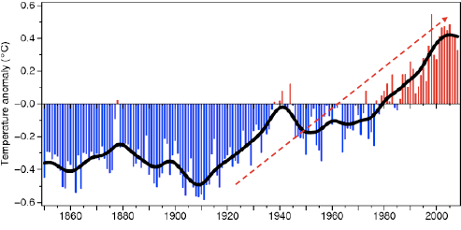
1.4 Trend of Temperature Anomaly
Source：Intergovernmental Panel on Climate Change，IPCC

Slide 9
1.5 What Is the Problem
Origins of the Problem
The First Law of Thermodynamics
The Second Law of Thermodynamics
Water Vapor, CO2, CH4, N2O, O3, CFCs Are Major GHGs.
Developing/Underdeveloped Countries’ Population Increase and Economic Growth
Fixing the Problem
Needing Technologies Conformable to Thermodynamics Laws
Needing Government Policies and International Regulations for the Alignment of SMC=PMC
Source: Hsu, Jyh-Yih (2009), Policy for Sustainable Energy Development.

Slide 10
1.6 Social Marginal Cost vs. Private Marginal Cost
P
SMC (Social Marginal Cost)= PMC+ EMC
PMC (Private Marginal Cost)
T
s
EMC
(Environmental Marginal Cost)
P_{S}
U
Pe
D(Demand )
O
Q
Q_{m}
Qs Qe
Source: Hsu, Jyh-Yih (2009), “Policy Towards a Low-carbon Sociality”

Slide 11
1.7 Crises vs. Opportunities
Global Warming Crisis
Emerging Economy of BRICs and VISTA
Excessive Consumption of Fossil Fuel
Global Financial Crisis
Low Interest of Capital Market
Unregulated “Shadow Banks”
Opportunities for Green Energy & Industry
Government Fiscal Policy for Boosting the Economy
“Green Technology”, “Green Collar” & “Green Job”
Source: Hsu, Jyh-Yih (2009), “TOWARDS A LOW-CARBON ECONOMY”
Notes:
‹#›

Slide 12
2. The History of Economic Development in Taiwan
2.1 Geographic Features and Natural Resources ……………………………13
2.2 Economic Development ……………………………………………………………14
2.3 Economic Growth Rate ………………………………………………………………19
2.4 Change in Price Index ………………………………………………………………20
2.5 Income Distribution …………………………………………………………………21
2.6 Production Structure …………………………………………………………………22
2.7 Trade …………………………………………………………………………………………23
2.8 Trade Partners in 2009 ………………………………………………………………24
2.9 Saving and Investment ………………………………………………………………25
2.10 Infrastructural Development ……………………………………………………26
2.11 i-Taiwan 12 Projects …………………………………………………………………27
2.12 Inward and Outward Foreign Direct Investment ………………………29
2.13 Monetary and Financial Development ……………………………………30
2.14 Labor Force and Employment …………………………………………………31
2.15 Education ………………………………………………………………………………32
2.16 Science and Technology …………………………………………………………33
2.17 Social Security …………………………………………………………………………34
2.18 Future Development Prospects ………………………………………………35

Slide 13
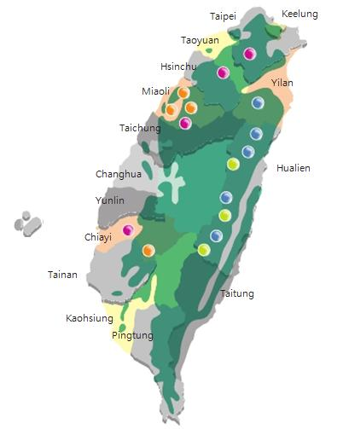
2.1 Geographic Features and Natural Resources
POPULATION & NATURAL RESOURCES
TOTAL AREA
TOTAL POPULATION
POPULATION DENSITY
36,191 Km²
23,164,628
668 /km²
RESERVES
COAL
NATURAL GAS
MARBLE
103 Million M.T.
7 Billion M3
297 Billion M.T.
DOLOMITE
110 Million M.T.
FOREST
367 Million M3
Source: CEPD(2010), Economic Development, R.O.C. (Taiwan)

Slide 14
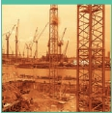
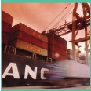
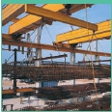
2.2 Strategies of Economic Development (1/3)
1950s
In Pursuit of Stability and Self-sufficiency
Implementing a land-reform program, stimulating agricultural production, and promoting economic stability
Developing labor-intensive import-substituting industries to reduce the trade deficit
1960s
Expanding Exports of Light Industry
Encouraging saving, investment, and exports
Introducing new agricultural products
Establishing export-oriented industries and export-processing zones
1970s
Developing Basic and Heavy Industries
Improving infrastructural facilities and eliminating transport bottlenecks
Establishing intermediate-goods industries
Developing basic and heavy industries
Source: CEPD(2010), Economic Development, R.O.C. (Taiwan)

Slide 15
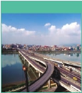
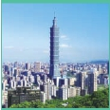
2.2 Strategies of Economic Development (2/3)
1980s
Economic Liberalization and Technology-intensive Development
Restructuring industrial production and expanding R&D spending
Pursuing economic liberalization and internationalization
Expanding domestic demand to improve the trade imbalance
1990s
Coping with Change and Setting New Priorities
Implementing the Six-Year National Development Plan to bolster infrastructure
Using the BOT approach to encourage the private sector to participate in public construction
Promoting telecommunications liberalization
Balancing economic and social development to improve living quality
Developing Taiwan into an Asia-Pacific Regional Operations Center
Source: CEPD(2010), Economic Development, R.O.C. (Taiwan)

Slide 16

2.2 Strategies of Economic Development (3/3)
2000s
Industrial Renovation and Global Linkage
Actively implementing the i-Taiwan 12 Projects to bolster the nation's capital stock by expanding public investment and boosting private investment.
Promoting industrial remodeling by developing six major emerging industries and four emerging intelligent industries, building an "intelligent Taiwan," increasing R&D inputs, and creating industrial innovation corridors and new high-tech industrial clusters, to raise the rate of technological progress.
Speeding up global connection, enhancing cross-strait and global logistics capabilities, ECFA(Economic Cooperation Framework Agreement) and bringing national economic and trade systems into line with the world, to raise Taiwan's economic efficiency.
Source: CEPD(2010), Economic Development, R.O.C. (Taiwan)

Slide 17
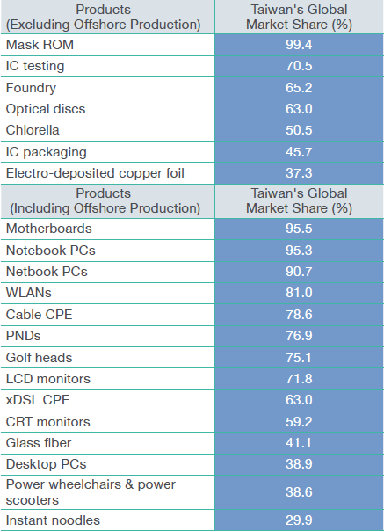
2.2 Products of which Taiwan was the World’s Largest Supplier in 2009
Source: CEPD(2010), Economic Development, R.O.C. (Taiwan)

Slide 18
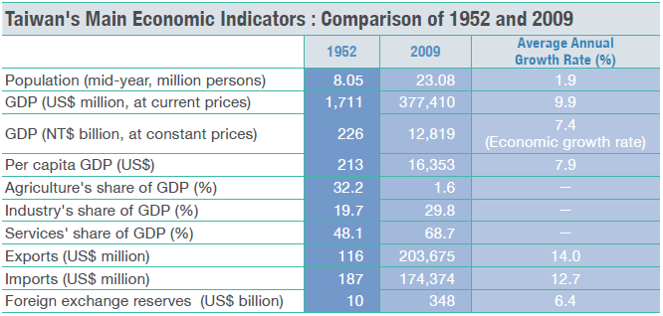
2.2 Taiwan‘s Economic Development Indicators
Source: CEPD(2010), Economic Development, R.O.C. (Taiwan)

Slide 19
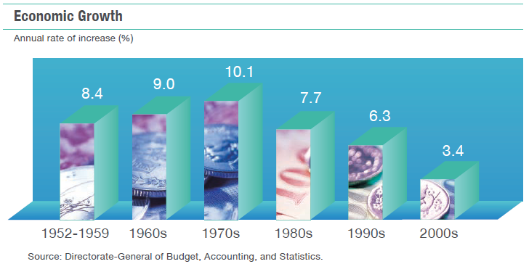
2.3 Economic Growth Rate
Source: CEPD(2010), Economic Development, R.O.C. (Taiwan)

Slide 20
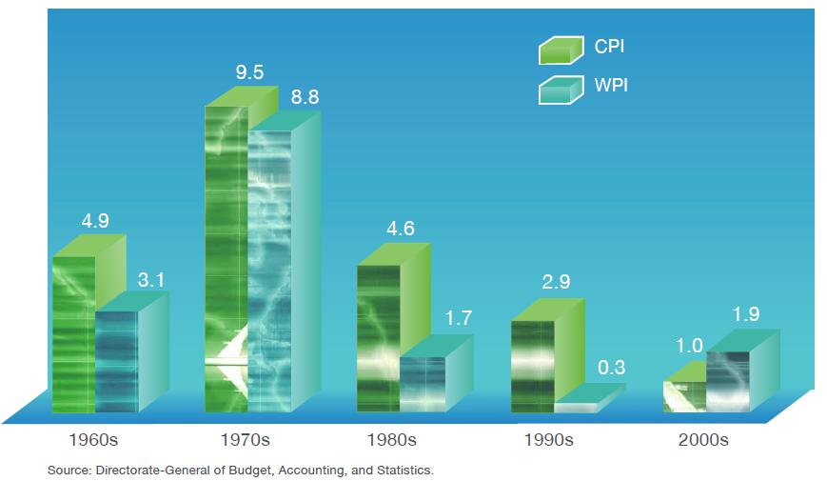
2.4 Change in Price Indexes
Annual rate of increase (%)
Source: CEPD(2010), Economic Development, R.O.C. (Taiwan)

Slide 21
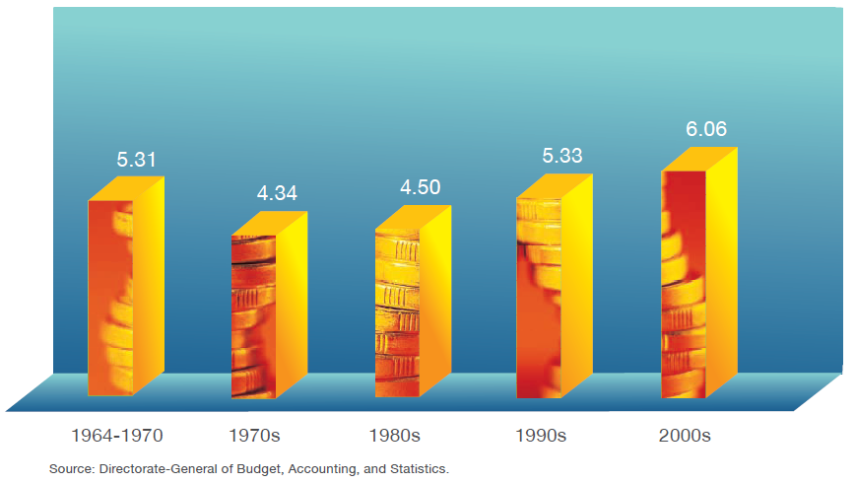
2.5 Income Distribution
(Ratio of income share of highest 20% to that of lowest 20%)
Source: CEPD(2010), Economic Development, R.O.C. (Taiwan)

Slide 22
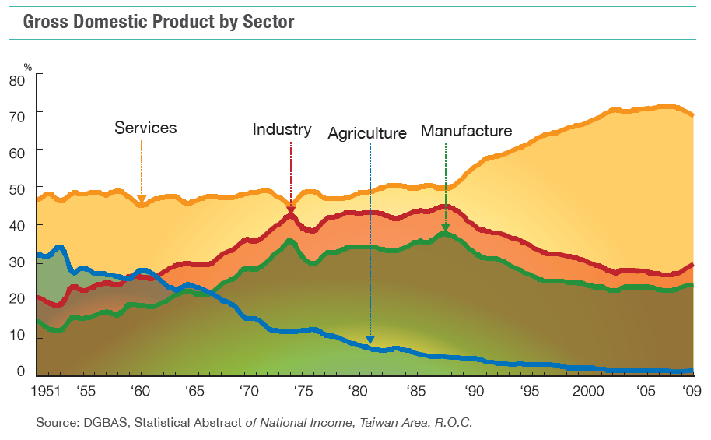
2.6 Production Structure
Source: CEPD(2010), Economic Development, R.O.C. (Taiwan)

Slide 23
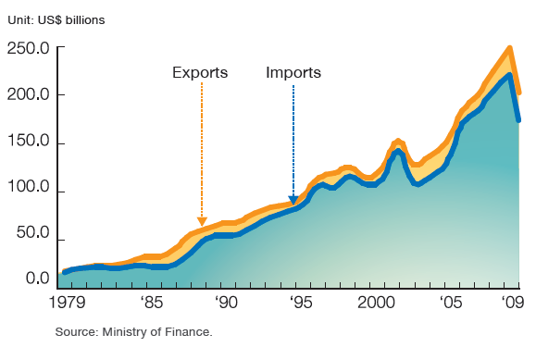
2.7 Trade
Source: CEPD(2010), Economic Development, R.O.C. (Taiwan)

Slide 24
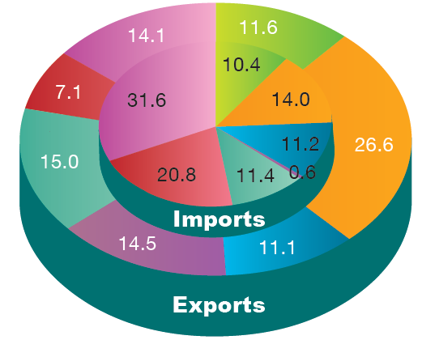
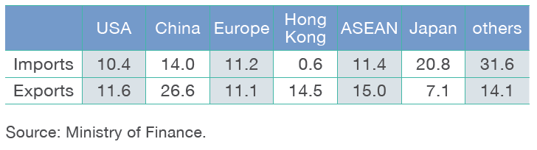
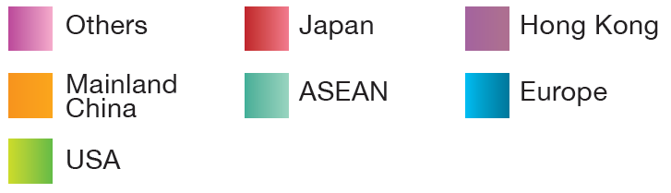
2.8 Trade Partners in 2009
Source: CEPD(2010), Economic Development, R.O.C. (Taiwan)

Slide 25
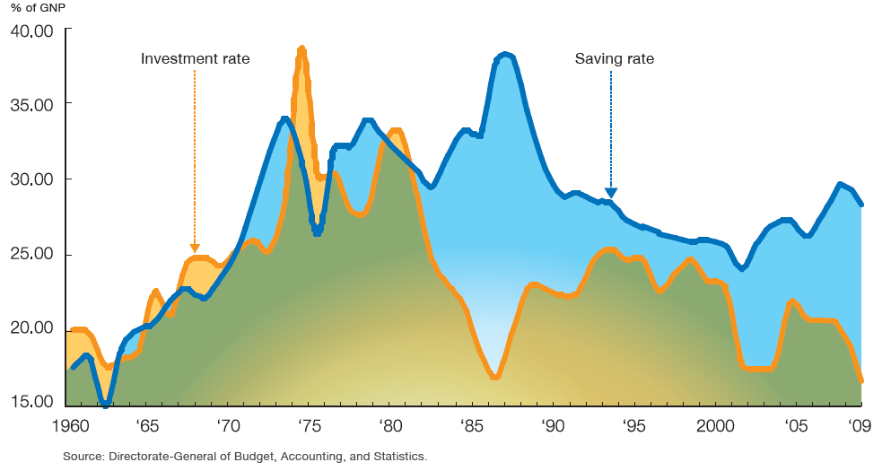
2.9 Saving and Investment
Source: CEPD(2010), Economic Development, R.O.C. (Taiwan)

Slide 26
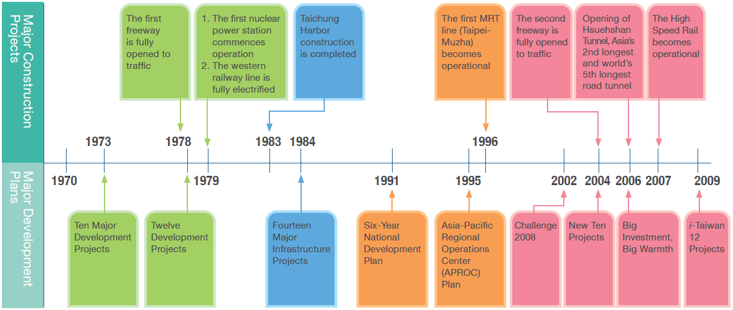
2.10 Infrastructural Development
Source: CEPD(2010), Economic Development, R.O.C. (Taiwan)

Slide 27
2.11 i-Taiwan 12 Projects (1/2)
Twelve prioritized public construction projects to regenerate Taiwan’s economic miracle.
Investment of NT$3.99 trillion within eight years since 2008.
Creating job opportunities for 120,000 people each year.
Source: www.cepd.gov.tw/encontent/dn.aspx?uid=7910

Slide 28
2.11 i-Taiwan 12 Projects (2/2)
A Fast and Convenient Islandwide Transportation Network
Kaohsiung Free Trade Zone and Eco-Port
Taichung Asia-Pacific Sea and Air Logistics Hub
Taoyuan International Air City
Intelligent Taiwan
Industrial Innovation Corridors
Urban and Industrial Zone Renewal
Farm Village Regeneration
Coastal Regeneration
Green Forestation
Flood Prevention and Water Management
Sewer Construction
Source: www.cepd.gov.tw/encontent/dn.aspx?uid=7910

Slide 29
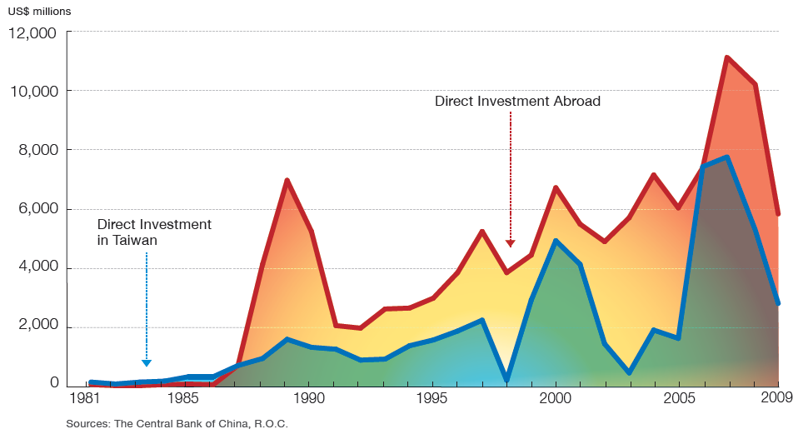
2.12 Inward and Outward Foreign Direct Investment
Source: CEPD(2010), Economic Development, R.O.C. (Taiwan)

Slide 30
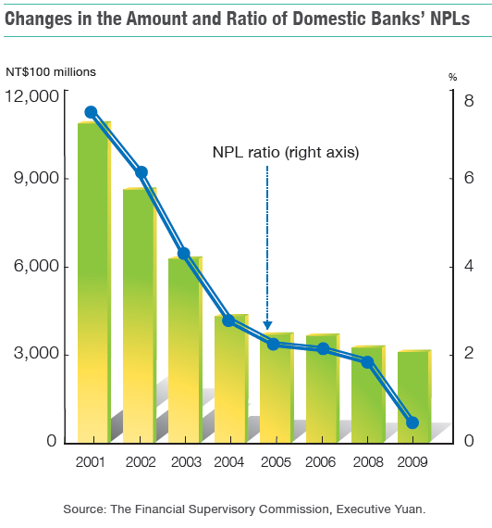
2.13 Monetary and Financial Development
Source: CEPD(2010), Economic Development, R.O.C. (Taiwan)

Slide 31
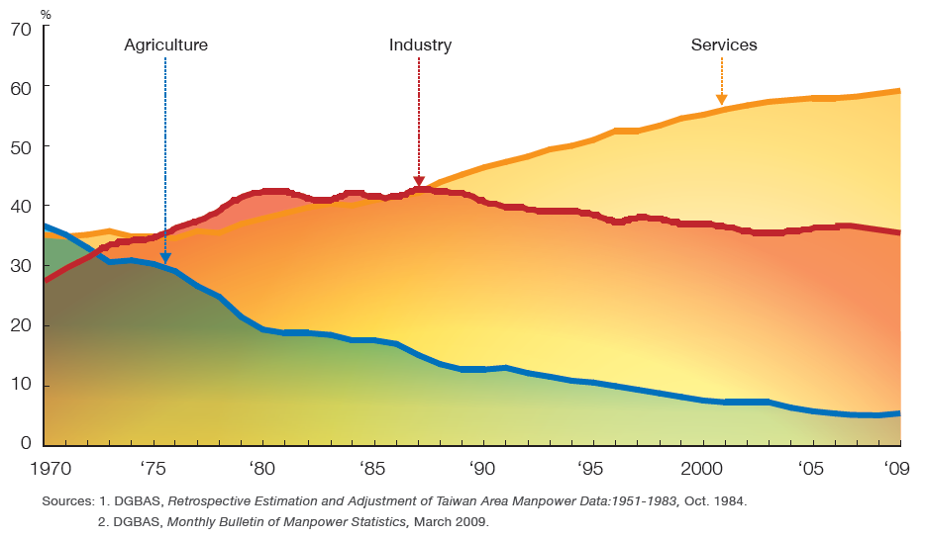
2.14 Labor Force and Employment
Employment Structure (%)
Source: CEPD(2010), Economic Development, R.O.C. (Taiwan)

Slide 32
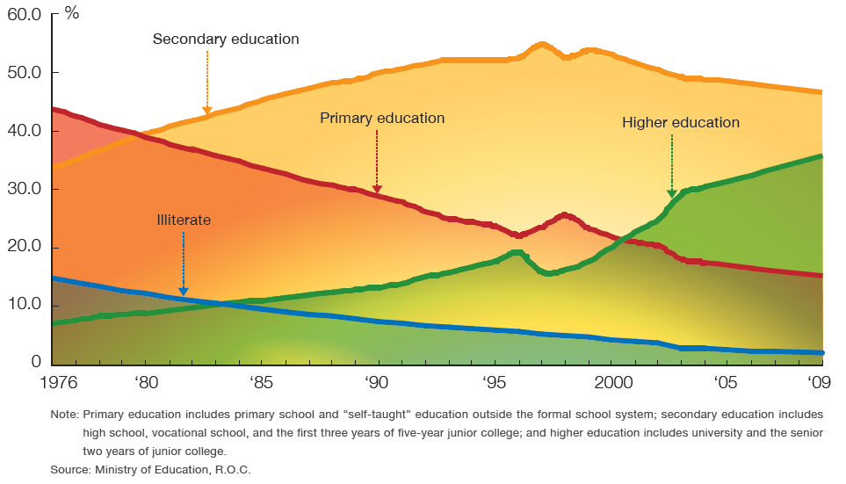
2.15 Education
Population Aged 15 and Over by Level of Education
Source: CEPD(2010), Economic Development, R.O.C. (Taiwan)

Slide 33
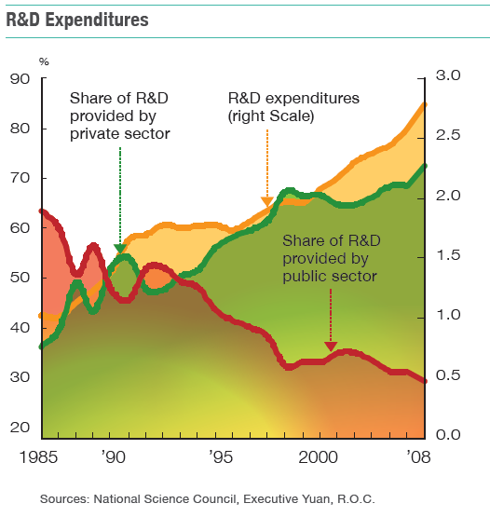
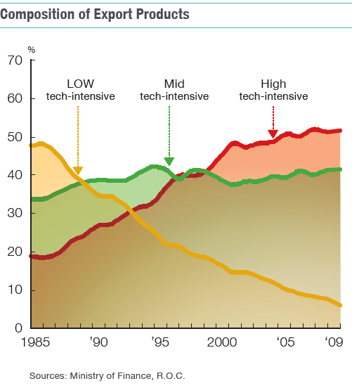
2.16 Science and Technology
Source: CEPD(2010), Economic Development, R.O.C. (Taiwan)

Slide 34
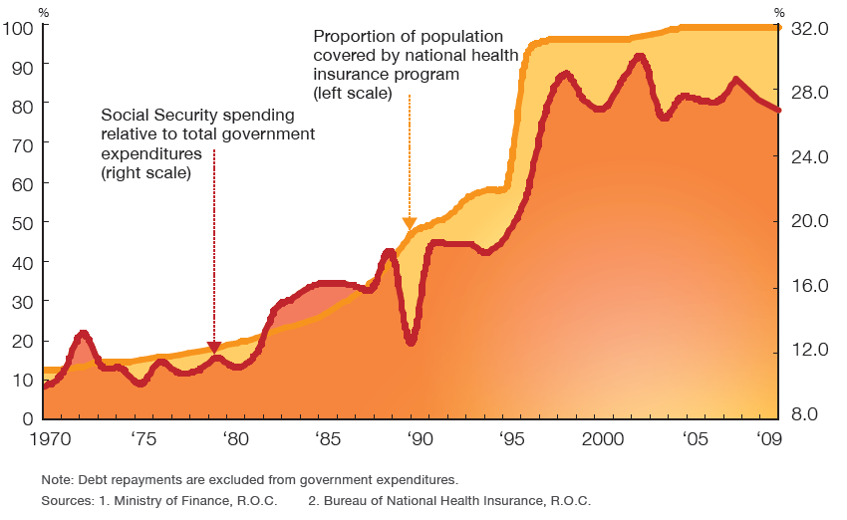
2.17 Social Security
Source: CEPD(2010), Economic Development, R.O.C. (Taiwan)

Slide 35
2.18 Future Development Prospects
Strategies
Increase public investment
Promote industrial remodeling
Enhance global linkage
Source: CEPD(2010), Economic Development, R.O.C. (Taiwan)

Slide 36
3. Challenges for Energy Conservation and Carbon Reduction
3.1 The 10 Largest CO2 Emitters …………………………………………37
3.2 Carbon Footprint …………………………………………………………38
3.3 Carbon Disclosure Project ……………………………………………40
3.4 The Role of Energy ………………………………………………………44
3.5 Energy and Global Warming…………………………………………45
3.6 Framework of Taiwan’s Sustainable Energy Policy…………46
3.7 Taiwan National Energy Conference………………………………47
3.8 Related Laws …………………………………………………………………48
3.9 Energy Saving and Carbon Reduction Committee …………49
3.10 Gas Displacement of Coal ……………………………………………50
3.11 Emission Comparison …………………………………………………51
3.12 Green IT ………………………………………………………………………52

Slide 37
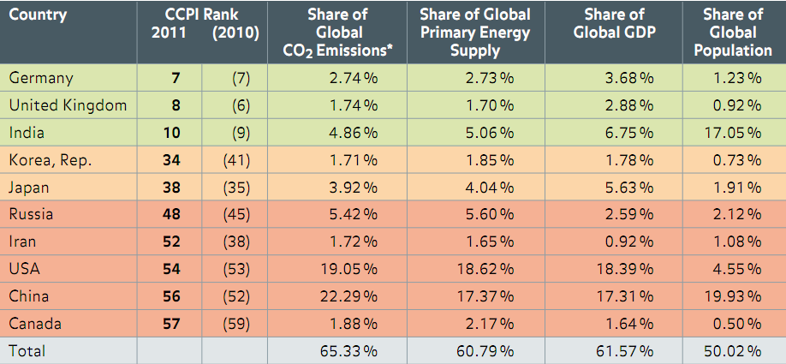
3.1 The 10 Largest CO2 Emitters
Source： Germanwatch, CCPI (Climate Change Performance Index) 2011

Slide 38
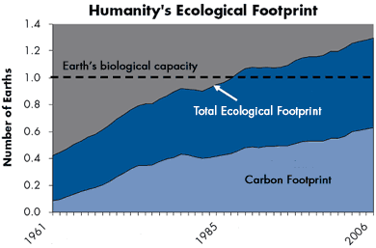
3.2 Carbon Footprint(1/2)
Source : 2003-2009 Global Footprint Network
Notes:
‹#›

Slide 39
3.2 Carbon Footprint(2/2)
The carbon Footprint is 50 % of Humanity’s Overall Ecological Footprint and Its Most Rapidly-growing Component
Reducing Humanity’s Carbon Footprint is the Most Essential Step We Can Take to End Overshoot and Live on Earth.
Source : 2003-2009 Global Footprint Network

Slide 40
3.3 Carbon Disclosure Project(1/3)
The Carbon Disclosure Project is an independent not-for-profit organization which holds the largest database of corporate climate change information in the world.
Some international corporations are sending a strong message to their suppliers of the benefits in measuring and reporting greenhouse gas emissions and have selected the Carbon Disclosure Project as the standard system for suppliers to report through.
Source: Hsu, Jyh-Yih (2009), TOWARDS A LOW-CARBON ECONOMY

Slide 41
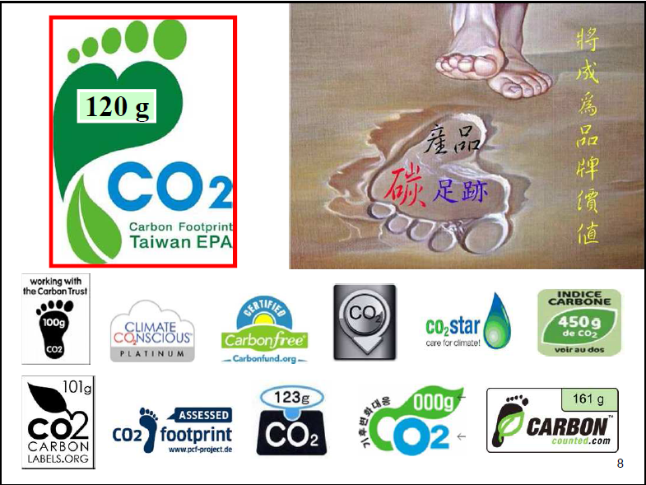
3.3 Carbon Disclosure Project(2/3)
Source: Hong Yuan Lee (2011), Adaptation Strategy of Climate Change

Slide 42
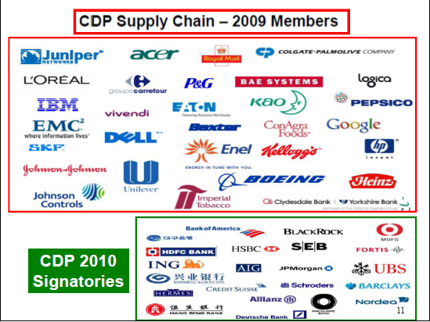
Source: Hong Yuan Lee (2011), Adaptation Strategy of Climate Change

Slide 43
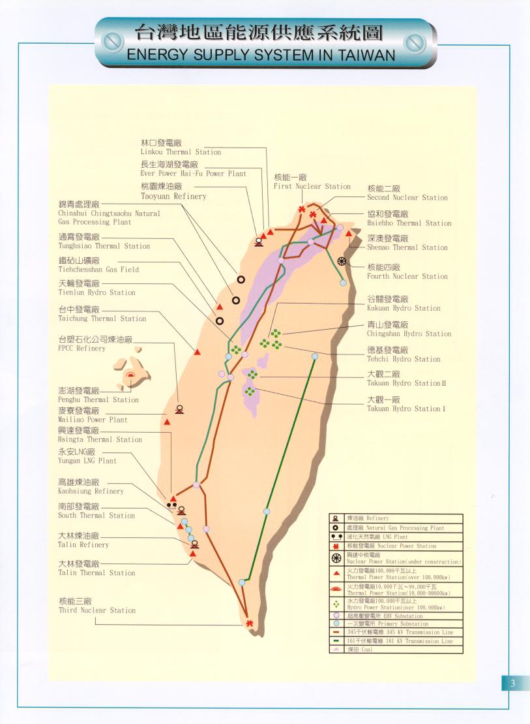
Source: MOEABOE

Slide 44
3.4 The Role of Energy
Major Resource of Industrial and Residential Activities
Largest Commodities in Trade for the Modern Economies
Main Sources of Environmental Pollution
Source: Hsu, Jyh-Yih (2009), Policy for Sustainable Energy Development.

Slide 45
3.5 Energy and Global Warming
1. Fossil Fuels
Coal, petroleum and natural gas.
2. Renewable Energy
solar, wind, ocean, hydropower, biomass, geothermal, and biofuels
3. Nuclear Energy
4. Electricity vs. Fossil Fuels
secondary energy
multi-inputs, single output
electricity is the key energy for sustainable development
Source: Hsu, Jyh-Yih (2009), Policy for Sustainable Energy Development.

Slide 46
3.6 Framework of Taiwan’s Sustainable Energy Policy
June 2008
Objective
Win-Win-Win Solution for Energy, Environment and Economy
Target
Improving energy efficiency
Developing clean energy
Securing stable energy supply
Source: MOEA website

Slide 47
3.7 Taiwan National Energy Conference
Held in April 2009
CO2 Reduction Target: 2016-2020 Emission Level Equivalent to 2008 Base.
New Government Targets (2008/5)
2025 Emission Level Equivalent to 2000 Base
2025 55% Low-Carbon Energy Supply
2050 Equivalent to 50% 2000 Base
Implementing Energy Tax, Carbon Tax, Green Tax Reform, ETS (Emission Trade System)
Source: Hsu, Jyh-Yih (2009), TOWARDS A LOW-CARBON ECONOMY

Slide 48
3.8 Related laws
2009 July
“Act For the Renewable Energy Development”
“Energy Management Law(updated)”
“Act for Mitigating Greenhouse Gas Emission” is currently under drafting.
Source: Executive Yuan website

Slide 49
3.9 Energy Saving and Carbon Reduction Committee, Executive Yuan
Established in January 2010
Responding to 《Copenhagen Accord》
December 2009
For national energy policy planning
Regular follow-up supervision and evaluation of national energy policy
Source: Executive Yuan website

Slide 50
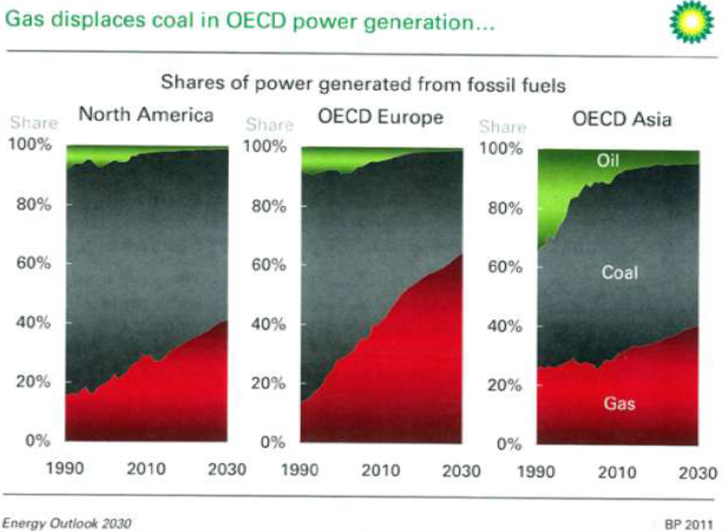
3.10 Gas Displacement of Coal
Source: http://www.energycentral.com/marketing/pdf/042111_EB_Coal_Slides.pdf

Slide 51
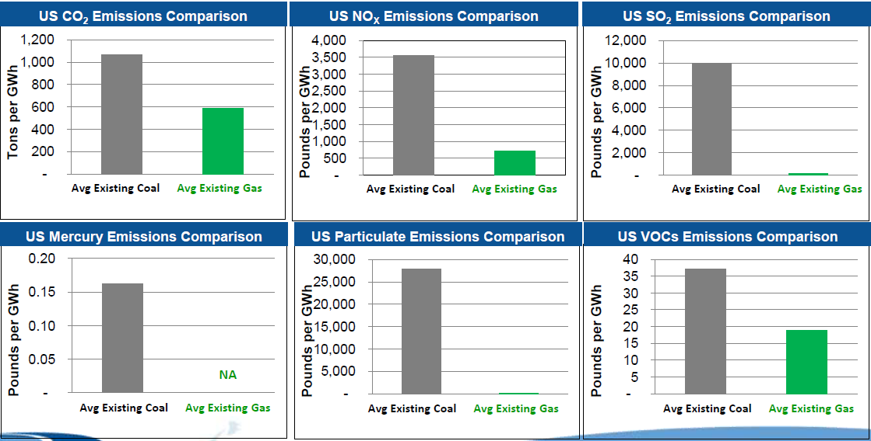
3.11 Emission Comparison
Natural gas-fired generation is far superior to any of its fossil fuel counterparts when considering environmental attributes
Natural gas burns cleaner than coal, and is also used in generating facilities that are much more efficient, requiring less fuel to be burned, therefore significantly lowering emissions
Source: http://www.energycentral.com/marketing/pdf/042111_EB_Coal_Slides.pdf

Slide 52
3.12 Definition of Green IT (Green Computing)
Refers to environmentally sustainable computing of IT.
Make the entire IT lifecycle greener along the following four complementary paths:
Green Use
Green Disposal
Green Design
Green Manufacturing
Source: Lin, M.L., C.C. Song and Y.S. Cheng(2009), Introduction to Green IT

Slide 53
3.12 Two Dimensions of Green IT
Green of IT
how can we reduce energy consumption when we use IT products or technique
Green by IT
how can we reduce energy consumption by using IT products or technique
Source: Lin, M.L., C.C. Song and Y.S. Cheng(2009), Introduction to Green IT

Slide 54
3.12 Applications of Green IT
Smart Building
Service Virtualization by IT
Smart Grid
Green IT
Smart Working
Intelligent
City
Smart Transportation
Source: Lin, M.L., C.C. Song and Y.S. Cheng(2009), Introduction to Green IT

Slide 55

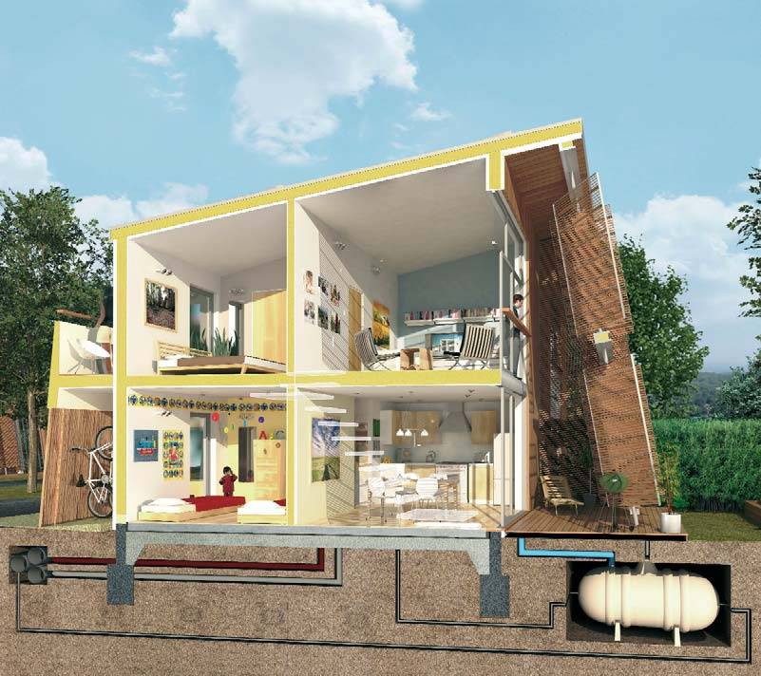
3.12 Related Examples of Green IT (1/4)
The Barratt Green House
Founded in 1958 in Newcastle upon Tyne
The target of zero carbon development by 2016
Source: Lin, M.L., C.C. Song and Y.S. Cheng(2009), Introduction to Green IT

Slide 56
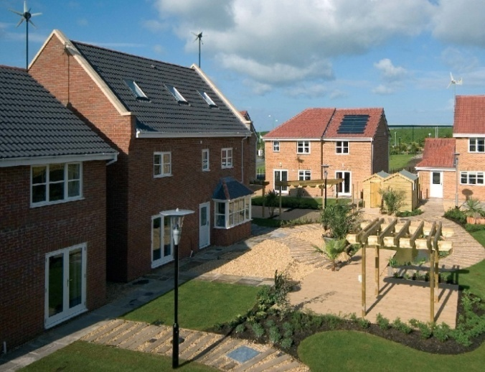
3.12 Related Examples of Green IT (2/4)
The first eco-village
Unveiled in May 2006
Combinations of wind, solar and geothermal power
Remained open for 15 months
Solar PV roof panels
generate 850kW of electricity
Ground Source Heat Pump
Reduce 62% CO2 emissions
The project won the Built Environment award in the Innovation in Engineering Awards
Source: Lin, M.L., C.C. Song and Y.S. Cheng(2009), Introduction to Green IT

Slide 57
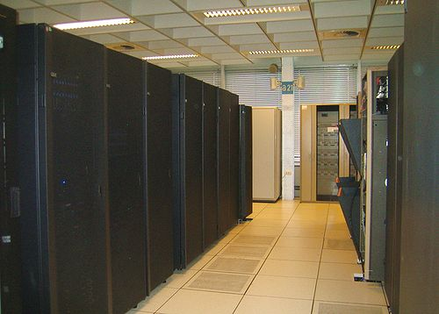
3.12 Related Examples of Green IT (3/4)
Green Data Center
Design conception
Reduce a large number of idle machines lead to land waste and power consumption
Server, generator and cooling equipment have proper design
The green data center of IBM: The ventilation equipment at the end of passageway pumped hot air out of the room.
Source: Lin, M.L., C.C. Song and Y.S. Cheng(2009), Introduction to Green IT

Slide 58
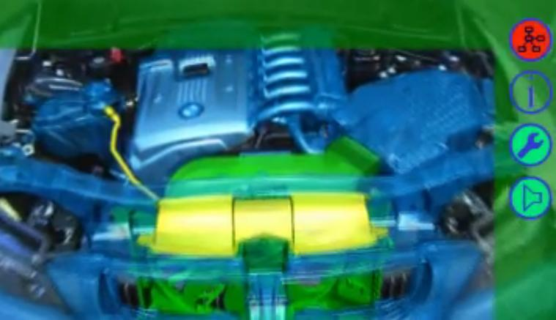

3.12 Related Examples of Green IT (4/4)
BMW augmented reality
Clothing augmented reality

Slide 59
4. Relevant Policies for Sustainable Development
4.1 The Importance of Energy Conservation…………………………60
4.2 Energy Demand Conservation vs. Supply Cost Efficiency…61
4.3 Policies Needed ………………………………………………………………63
4.4 Comparison of Policy Tools ……………………………………………64
4.5 Liability Laws …………………………………………………………………65
4.6 Coase Theorem ………………………………………………………………67
4.7 Emission Standard …………………………………………………………71
4.8 Incentives for Technology Improvement …………………………75
4.9 Pigouvian Tax …………………………………………………………………76
4.10 Other Policy Tools …………………………………………………………81

Slide 60
4.1 The Importance of Energy Conservation
Conserving
5 kwh
Conserving
1 kwh
Mining fossil fuels
Power
Generation
Transmission
and distribution systems
Power
metering
Electric
end-use
equipment
Efficiency Loss of Energy Conversion (Second Law of Thermodynamics)
Source: Hsu, Jyh-Yih (2010), “The promotion and impact of Energy/Carbon tax ”.

Slide 61
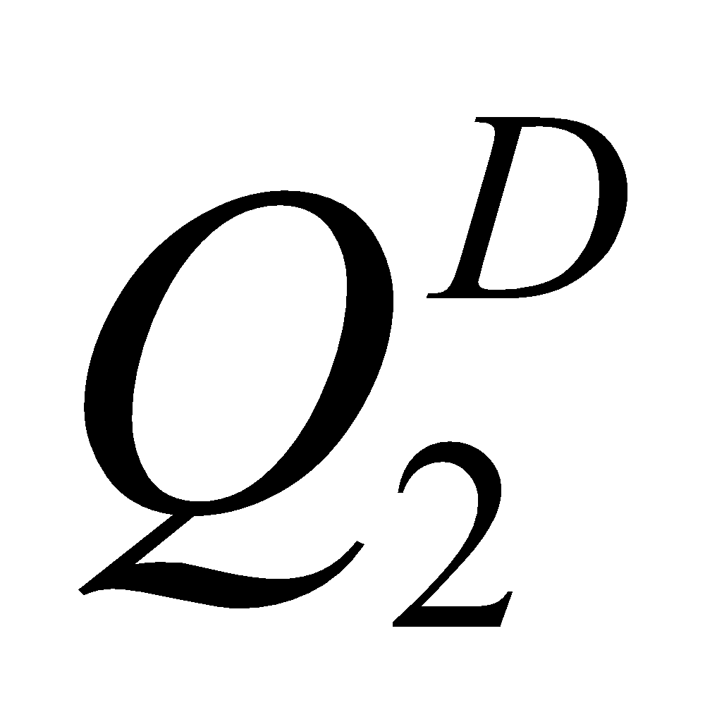

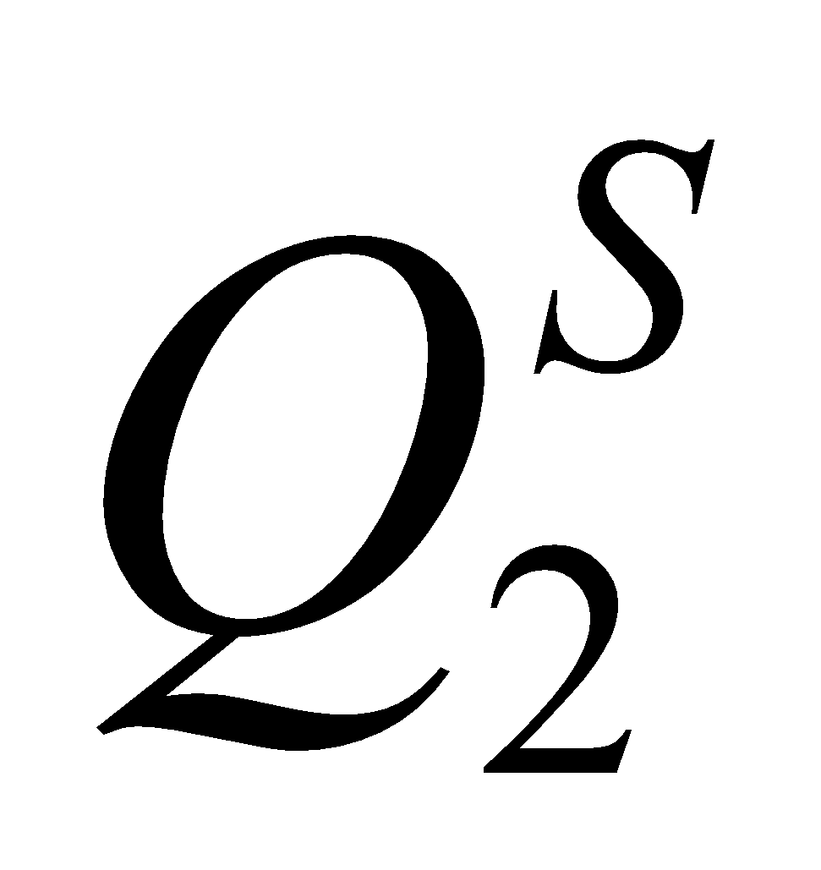
4.2 Energy Demand Conservation vs. Supply Cost Efficiency
P
S₁
S₂
P₁
P₂
D₁
D₂
0
Q
Source: Hsu, Jyh-Yih (2009), “Policy Towards a Low-carbon Sociality”

Slide 62
4.3 Policies Needed
1. Command and Control Policies
2. Financial/Monetary/Pricing Policies
Carbon Tax, Energy Tax
Guaranteed Pricing Scheme (e.g. for renewable energy)
Financial Loan, Accelerating Depreciation, Investment/Tariff Deduction
3. Cap and Trade Policy
European Climate Exchange, ECX
4. Comparison (pro and con) of Various Policies
Source: Hsu, Jyh-Yih (2009), Policy for Sustainable Energy Development.

Slide 63
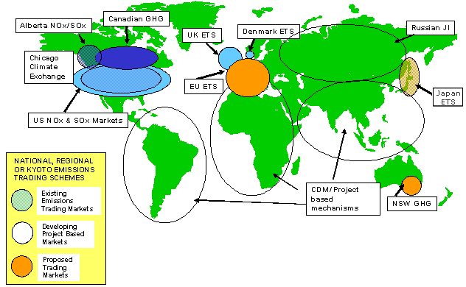
NZETS
“Carbon would become the world’s
biggest market.”

Slide 64
4.4 Comparison of Policy Tools
Methods for Internalizing environmental externalities:
Liability laws in general
Emission trade based on Coase theorem
Emission Standard
Taxation based on Pigouvian tax
Source: Ahmed M. Hussen(2009), Principles of Environmental Economics

Slide 65
4.5 Balancing Marginal Control Cost(MCC) and Marginal Damage Cost(MDC) by Liability Laws
Assuming “Polluter-pays principle”.
Assuming full and accurate information on MDS and MCC.
P
MCC (Marginal control cost)
MDC
$
T
Dead-Weight-Loss from over control
U
R
S
DWL from Over pollution
V
Z
0
W_{f}
W_{e}
W_{j}
W*
Pollutant
Source: Ahmed M. Hussen(2009), Principles of Environmental Economics

Slide 66
4.5 Disadvantages of Liability Laws
Legal process in general is expensive and prolong.
It is unfair to those victims who pursue liability laws without legal resources.
Transaction cost could be very high, including identify the cause and effect. Particularly, when there are multiple pollution sources and/or polluters. －transaction cost is one of the social costs.
What about garbage throwing, illegal spitting or smoking??And why these cases can work??
Source: Ahmed M. Hussen(2009), Principles of Environmental Economics

Slide 67
4.6 Coase Theorem
Ronald Harry Coase (1910) describes the economic efficiency of an economic allocation or outcome in the presence of externalities.
The theorem states that if trade in an externality is possible and there are no transaction costs, bargaining will lead to an efficient outcome regardless of the initial allocation of property rights.
Source: Wikipedia, title：Coase Theorem

Slide 68
4.6 Coase Theorem
Property rights assigned for A(factory) or B(resident).
Transparent and full information of polluter (factory) and victim(resident).
P
Marginal Benefit to A
P
Marginal Damage to B
Social Optimal
B
A
Q
E*
B’s action
A’s action
Source: Ahmed M. Hussen(2009), Principles of Environmental Economics

Slide 69
4.6 Disadvantages of Coase Theorem
Asymmetric information on polluters and victims.
Property rights assignment could be a problem.
Property rights and income distribution issue.
The “only” optimal equilibrium may not be optimal (eg. The optimal pollution level may cause actual disaster of one party/side.)
International pollutions such as acid rain, global warming and ozone depletion could be more complicated.
Source: Ahmed M. Hussen(2009), Principles of Environmental Economics

Slide 70
4.6 Emission Trade System
Relatively Less Participants
Universal Price (Buy & Sale) Across Nations
Carbon Price May Vary and Uncertain
Conformable with the principle of cap set by Kyoto Protocol.
Base on the Caose theorem
Source: Hsu, Jyh-Yih (2009), “Policy Towards a Low-carbon Sociality”

Slide 71
4.7 Emission Standard as a Policy Tool
Emission standard has various types:
Within per unit of time
Air and/or water quality level control
(eg. CO2 concentration: 450ppm)
Technical standards for emission discharge
This is also termed as “command and control“ regulation.
Source: Ahmed M. Hussen(2009), Principles of Environmental Economics

Slide 72
4.7 Emission Standard as a Policy Tool
Adjusting process for seeking optimal emission standard level:
from 75 25 50
A relationship between mitigation and adaptation.
P
MCC
MDC
F
W*
0
25
W_{e}
75
100
Pollutant
50
Source: Ahmed M. Hussen(2009), Principles of Environmental Economics

Slide 73
4.7 Cost-effectiveness of Emission Standards
A case of multiple polluters(MCC1 and MCC2).
Cost-effectiveness of emission standards are polluter 1 at 75,
polluter 2 at 125.
P
MCC₁
MCC₂
Dead-Weight-Loss of emission standard 100
N
K
L
M
0
75
100
200
Polluter1
Polluter2
200
125
100
0
Source: Ahmed M. Hussen(2009), Principles of Environmental Economics

Slide 74
4.7 Disadvantages of Emission Standards
It violates the spirit of ”free market”.
Administrative cost could be very high, which is social opportunity cost. It represents some kind of “government failure”.
Collusion might exist(bias for setting market entry barrier).
Setting emission standard optimal level is difficult.
It neglects “economic efficiency”.
Source: Ahmed M. Hussen(2009), Principles of Environmental Economics

Slide 75
4.8 Incentives for Technology Improvement
Polluter in general will seek for technology improvement(from MCC0
to MCC1).
Original total MCC0 is A+B; now total MCC₀’ is D+B.
P
MDC₀
MCC₀
Comparison between A and D determines whether the total MCC increases or decreases.
MCC₀’
A
D
B
0
Pollutant
W_{n}
W_{e}
W*
Source: Ahmed M. Hussen(2009), Principles of Environmental Economics

Slide 76
4.9 Pigouvian Tax
From Arthur Cecil Pigou (1877 – 1959)
Pigovian tax is a tax levied on a market activity that generates negative externalities.
P
MCC
S
T
0
W_{e}
W
Pollutant
Source: Ahmed M. Hussen(2009), Principles of Environmental Economics

Slide 77
4.9 Optimal Level of Pigouvian Tax
P
MCC
MDC
S
t_{e}
0
W_{e}
Pollutant
Source: Ahmed M. Hussen(2009), Principles of Environmental Economics

Slide 78
4.9 Energy/Carbon Tax (1/2)
Covers Most Walks of Society
Different Tax Level for Different Countries (e.g. Exchange Rate, Tax Level, Money Purchasing Power)
Maybe Against Distributed Equity
Carbon Pricing Is Certain in Short-Run
Base on Pigouvian tax
Source: Hsu, Jyh-Yih (2009), “Policy Towards a Low-carbon Sociality”

Slide 79
4.9 Energy/Carbon Tax(2/2)
Advantage
Double dividends.
Encouraging energy saving industry.
Adjusting Long-term industrial structure.
Disadvantage
Difficult to adjust for short-term industrial structure.
May influence the affordability of low-income households.
Difficult to set the optimal tax rate and to meet the cap by Kyoto Protocol.
Source: Hsu, Jyh-Yih (2010), “The promotion and impact of Energy/Carbon tax ”.

Slide 80
4.9 Green Tax Reform
Implementing Energy/Carbon tax.
Replacing fuel tax and vehicle license tax.
Reducing Income tax rate.
Utilizing energy/carbon tax to encourage R & D, project investment of reducing carbon emissions and carbon reduction.
Subsiding public transportation and low-income households with energy saving projects.
Double-dividends effects.
Source: Hsu, Jyh-Yih (2009), “Policy Towards a Low-carbon Sociality”

Slide 81
4.10 Other Policy Tools(1/2)
Target for Quantity (command and control policies)
CO2 emission cap (bubble, grandfather’s rule)
Electricity generation capacity target for renewable energy
Standards for EER（energy efficiency ratio）, green buildings, strategic fuel reserve, etc
Source: Hsu, Jyh-Yih (2009), Policy for Sustainable Energy Development.

Slide 82
4.10 Other Policy Tools(2/2)
RDD&D(Research, Development, Demonstration and Deployment)
Education & Dissemination
Information Disclosure
Direct Investment and Management by Government
Source: Hsu, Jyh-Yih (2009), Policy for Sustainable Energy Development.

Slide 83
5. Conclusion and Summary
5.1 Conclusion ………………………………………………84
5.2 Summary of Relevant Policies ……………………88

Slide 84



5.1 Conclusion (1/4)
Is there a “win-win game/strategy” for economic growth and sustainable development?
The answer to this question: Taiwan should go for green energy/economy
Thomas Friedman : Taiwan From IT to ET(Energy Technology)

Slide 85
5.1 Conclusion (2/4)
Sustainability means to minimize environmental/ecological impacts when pursuing economic development
The importance of Mitigation Policy vs. Adaptation Policy
Technology Breaking Through Is Needed (e.g., Biotech, Biomimics, Nanotech)
Taiwan industry upgrading for KBE (Knowledge-Based Economy)

Slide 86
5.1 Conclusion(3/4)
Life Style (eg. USA style) Adjustment Is Needed
Supply Chain of Food Consumption: Local and Vegetable
4”Rs”: Renewable, Reduce, Reuse, Recycle.
International Institution for Regulation and Implementation

Slide 87
5.1 Conclusion(4/4)
Green GDP, Green IT, Smart grid, AMI(Advanced Metering Infrastructure), RTP(Real-Time Pricing) and nuclear safety are important issues to be handled by relevant policies
Incentive mechanism and institutional innovation are the cores of government policy for handling the issues of environmental externality

Slide 88
5.2 Summary of Relevant Policies(1/3)
Policy Tools | Practices | Targeted Objects | Features | Effect
Direct Intervention | State-own enterprise Price control Quantity control | Industries with natural monopoly attribute | Avoiding private monopoly or monopoly of key resources Lack of market competition and incentives Against free-market spirit | High
 | Emission standards | Firms with substantial pollutant | Easily applicable. Lack of incentives for R & D and technology improvements Government monitor needed | High
Education and Information Disclosure | Polluter-pays principle Environmental education Pollution information disclosure | All citizen Professional personnel | Enhancing environmental awareness/knowledge Long-term effect | Low
Source :Jyh-Yih Hsu (1998)Review and Outlooks of Environmental-Economic Issues.

Slide 89
5.2 Summary of Relevant Policies(2/3)
Policy Tools | Practice | Targeted Objects | Features | Effect
Incentive system | Levying tax | Firms Emitters | May cause prevailing objection easily. No guarantee to achieve the level of pollutant reduction standards Difficulty for setting optimal tax | Medium
 | Financial incentives scheme | Specific industries Specific firms | Ex-Ante award incentives Government needs to shoulder the private investment risk in advance Crowding-out effect of governmental funds Favorable rate for investment loan | Low
 | Tax incentives scheme | Specific industries | Ex-post award incentives Tax deduction Accelerating discount rate for investment No crowding-out effects of capital funds | Low
 | Transferable emission permits | Specific industries | Reflecting emission cost on the price of pollution warrants Minimizing the emission cost through market mechanism Difficulty for setting the permission quotas to firms. | High
Source :Jyh-Yih Hsu (1998)Review and Outlooks of Environmental-Economic Issues.

Slide 90
5.2 Summary of Relevant Policies(3/3)
Policy Tools | Practice | Targeted Objects | Features | Effect
RDD&D | Existing/new control technology RDD&D Training Patent protection Commissioned research project Joint collaboration | Knowledge intensive industry/sector R & D personnel | Needing sufficient funds and manpower Difficulty for short term effect | Medium
Rulemaking | Developing regulatory measures Modifying existed regulations | Policy and law | Lengthy legislative process Lobby group | High
Source :Jyh-Yih Hsu (1998)Review and Outlooks of Environmental-Economic Issues.

Slide 91
Thank You for your attention

